Slide 1
THE DIGESTIVE SYSTEM

Slide 2
Let’s say you are having pizza for lunch today….
Your digestive system starts working even before your first bite…
It works for the next few hours or sometimes days (depending on what you ate)

Slide 3
Digestion
This process allows your body to get nutrients and energy from what you eat.

Slide 4
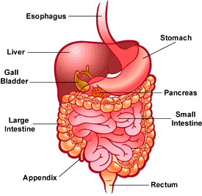

Slide 5
#1 Digestion begins in the mouth
Saliva breaks down food in your mouth

Slide 6
#2 Food travels to your Esophagus
This is the second stop in digestion
A pipe around 10 inches long

Slide 7
#3 Stomach
The stomach has 3 jobs
  To store food
  Break down food into liquid
  Empty the liquid mixture into the small intestine

Slide 8
The stomach is like a mixer with gastric juices

Slide 9
#4 Small Intestine
A long tube 22 ft long (when stretched out)
Breaks down food more so you can absorb all the food’s nutrients

Slide 10
3 Organs help the small intestine
Pancreas – digests fats
Liver – Uses bile to absorb fats into the bloodstream
Gallbladder – stores the bile

Slide 11
Food stays in the small intestine foe about 4 hours

Slide 12
#5 Liver
Filter waste

Slide 13
#6 Large Intestine
This is the end of the road for digestion
It removes water from any left over undigested food
When the water is removed it turns into solid waste

Slide 14
#7 Colon

Slide 15
#8 Rectum
Stores the feces

Slide 16
#9 Anus
The ring of muscle that pushes out the feces

Slide 17
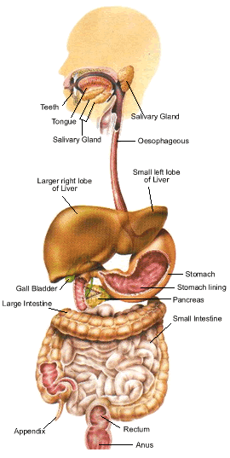

Slide 18
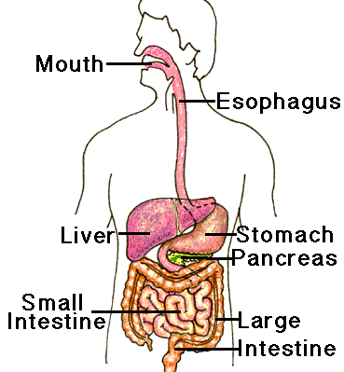
Path of digestion
Mouth> esophagus> stomach> small intestine> Large intestine> Colon> Rectum> Anus

