Slide 1
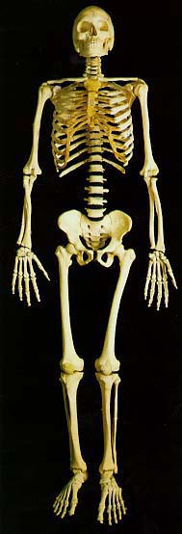
Skeletal System
By
Jacquelyn
Maninder
Alice

Slide 2
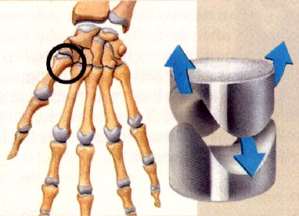
Functions
The first function is that it provides shape & support
The next function is it allows movement
The third function is that it protects tissues and organs
It also stores certain materials
It also produces blood cells

Slide 3
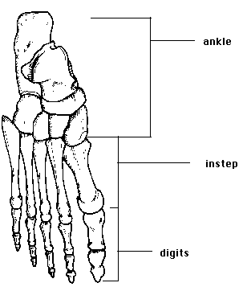
The largest bone in your body is the femur, or your thigh bone
The smallest bone in your body is in your ear,it’s call the stirrup
In the normal adult there are 206 bones all together
Your bone accounts for 20% of your weight
The skull protects the brain and it’s the control center of the body
The cartilage areas at the ends of long bones are growth centers
The long bones in your body such as your arms and legs, produce many blood cells
Bones

Slide 4
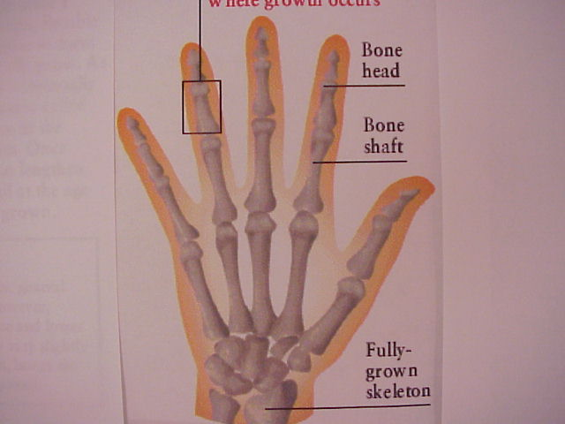
How bones grow
The bone grows by replacing the cartilage in your baby skeleton. Not all of the tissues disappears. There is some left in the ends of the joints to help smooth the joints. To move better.

Slide 5
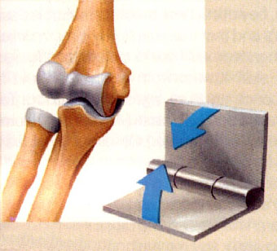
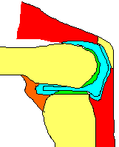
joints
How do you think you move? You move by the joints in your body. They are found in the meeting point of joints. There are three types of joints. Most of the joints in your body move like a door hinge. It enables your bones to open and close. Other types of joints allow you to move slightly.

Slide 6
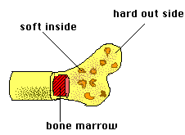
The fully grown bone has lots of salt, water and tissues. There are two types of bones. One of them is called compact. The compact bone is very smooth and solid. The second type is cancellate. The cancellate’s structure is very similar to a honeycomb. It’s light in structure and Inside of the bone there is a jelly like substances it’s call bone marrow. It helps makes blood cells for the body.
Inside the Bone

Slide 7

Your body

Slide 8
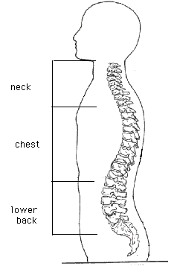

Spine
* The spine is the central support of your body.
* The spine is made up of irregular bones call vertebrae
* It’s the message cable to the brain.
* If it breaks you are paralyzed.
* It’s made up of spongy bones call cancellate
* There are 26 vertebrae in the spine
* Each vertebrae can move a little bit, but the whole spine is very flexible.

Slide 9
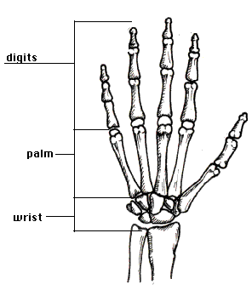
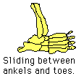

Feet & Hand
The hand has 27 bones and the feet has 26 bones. Inside are, phalanges. The bones in the foot are shorter and fatter. This helps balance out the feet. The hand is connected with mucles and tentdons.

Slide 10
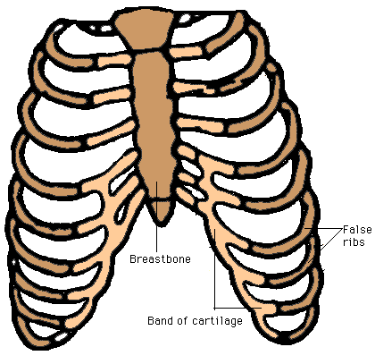
Ribs
* Your rib cage is made up of 12 vertebrae.
* with 24 ribs
* and a breastbone with 3 parts.
* Protects heart and lungs.

Slide 11
Sources
The Musculoskeletal system Chelsea House 1993
Human biology and health Prentice Hall 1993
Web sites:
http://tqjr.advanced.org/5777/ske1.htm

