Slide 1

Temperature of the Earth
The temperature of the Earth is determined by three factors:
The amount of sunlight the earth receives
The amount of sunlight the Earth reflects
Atmospheric retention of heat
What are some of the ‘greenhouse gases’ that retain heat in the atmosphere?
Water vapor
Carbon dioxide
Methane
chlorofluorocarbons CFC’s
Nitrous oxides

Slide 2
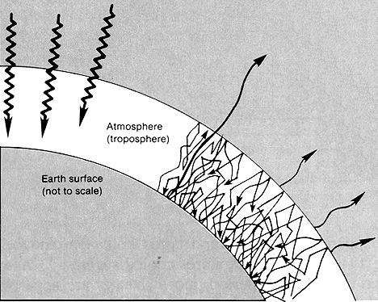
The Greenhouse Effect is a natural process and has been happening for millions of years.
Without this effect the worlds oceans would be frozen and it would be approximately 33°C cooler than it is now.
Global warming that is occurring at present has been linked to the increase in CO₂, CH₄, (NO₂ and N₂O₂), and CFC’s.
The atmospheric concentrations of these gases have increased due to human activities.

Slide 3
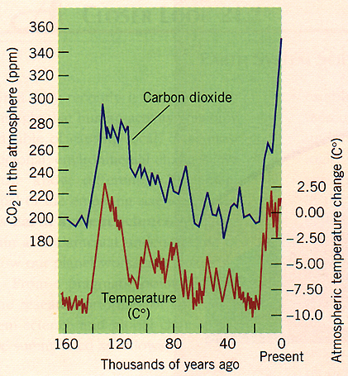

Carbon Dioxide
Carbon dioxide is one of the major greenhouse gases.
There is a direct relationship between temperature and the level of CO₂ in the atmosphere.
To understand its role in climate you have to understand the carbon cycle

Slide 4
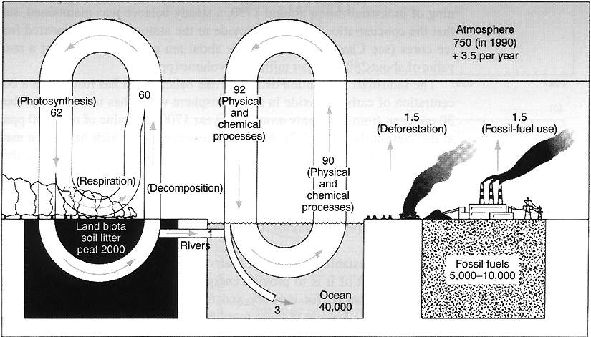
The Carbon Cycle
The reservoirs of carbon in the earth, biosphere, oceans, and atmosphere in giga-tonnes (Gt) or thousand millions of a ton

Slide 5
Carbon dioxide is the main way in which carbon is transferred in nature between a number of natural carbon reservoirs.
The Atmosphere The Oceans and ocean biota Terrestrial Biota and soil Fossil fuels

Slide 6
The carbon cyclelinks both the atmosphere, hydrosphere, biosphere and geosphere.
Oceans
(hydrosphere)
(atmosphere)
Interior of Earth
Air
CO₂
(geosphere)
Life
(biosphere)

Slide 7
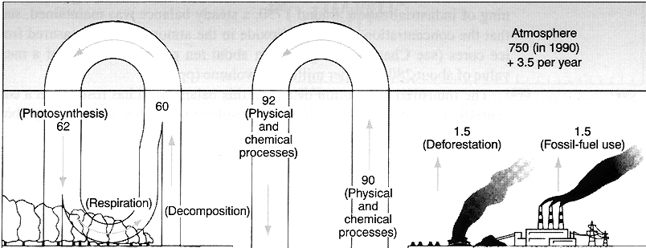
The Atmosphere
The movement of carbon in and out of the atmosphere is large. 1/4 of all carbon dioxide is cycled during a year.
Humans add 7.5 Gt of CO₂ into the atmosphere. 55% of this is taken up by the oceans and land biota. The rest, 3.5 Gt builds up in the atmosphere.
95% of fossil fuel burning occurs in the northern hemisphere.

Slide 8
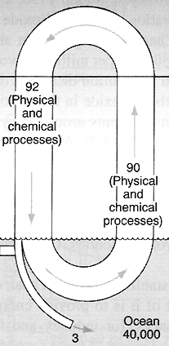
The Oceans
CO₂ dissolves in water. It is being continually exchanged between air and the upper waters of the ocean.
There is an equilibrium established
CO_{2 (g)} + H₂O _{(l)} ⇔ H₂CO_{3 (aq)}
Anthropogenic CO₂ can be rapidly taken up by surface water. But absorption in the lower levels of the ocean takes longer.
It takes 100’s to 1000’s of years for CO₂ to mix with lower ocean waters.
So oceans don’t provide an immediate sink for increases in CO₂ levels.
In the short term only surface waters play a large part in the carbon cycle.

Slide 9
Biological activity in the Oceans
Ocean life take in carbon, they die and decay. Some of this carbon is carried to deep waters where it is removed from the carbon cycle for 100’s -1000’s of years. This removal of carbon from surface waters to deep waters draws more CO₂ out of the atmosphere to restore the equilibrium. This is called the ‘biological pump’.
Plant and animal plankton are the main source of biological activity. Most of this production occurs in the upper levels of the oceans.

Slide 10
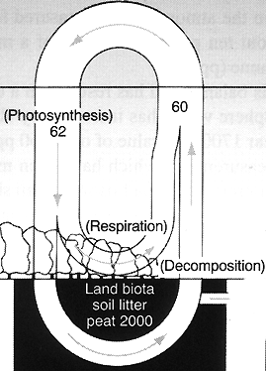
Land biosphere
Respiration adds CO₂ while photosynthesis removes it
Photosynthesis by green plants in the summer (Northern hemisphere) exceeds respiration. CO₂ is removed from atmosphere during summer.
In winter photosynthesis decreases greatly and becomes less than total respiration. CO₂ is added to atmosphere.
Northern hemisphere forests

Slide 11
Biosphere: Plants consume CO₂ and lock it into their tissue, but only temporary.
Animals and burning return it with water vapor to the air.
But plants can be buried before they are eaten or burned. As it gets deeper and hotter it forms coal beds, oil and gas fields and carbon rich rock. Here carbon is deposited in a long term bank.
Only tectonic processes could release this stored carbon before industrial revolution. Until present withdrawals have been less than deposits.
This has had two effects:
1. Climate has been cooler than it might have been.
2. Oxygen has gradually built up in the atmosphere
HCHO + O₂ ⇔ H₂O + CO₂ + Heat

Slide 12
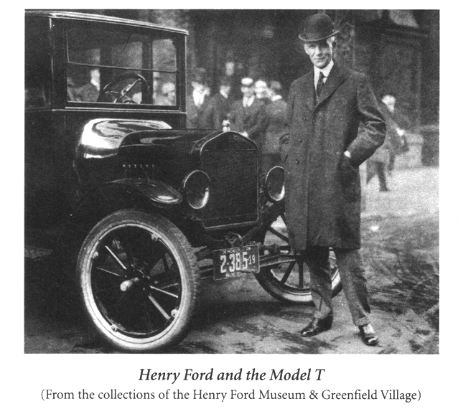
At the start of the industrial revolution, humanity started on a carbon spending spree, with increasing burning of fossil fuels.
It is this sudden release of stored carbon that is upsetting the carbon cycle.

Slide 13
Positive and Negative feedback loops in the Carbon Cycle
Both negative and positive feedback processes occur in the atmosphere. If the negative feedback loop is strong then global warming will not occur. But there is a great deal of debate over which is the most important or even if human activities are causing global warming.

Slide 14
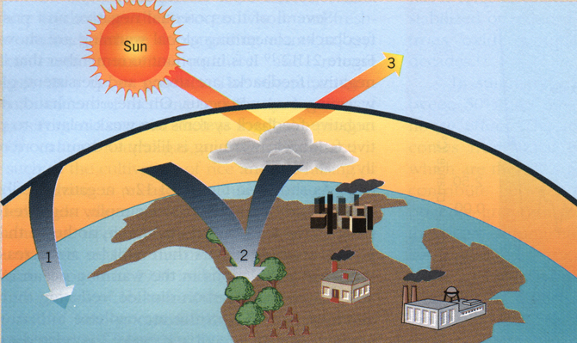
1. Increased algae populations reduce [CO₂] in atmosphere and causes cooling.
3. Increased water evaporation will increase cloud cover and cause cooling.
The Negative Feedback loop
2. Increased plant growth will reduce [CO₂] in atmosphere and causes cooling.

Slide 15
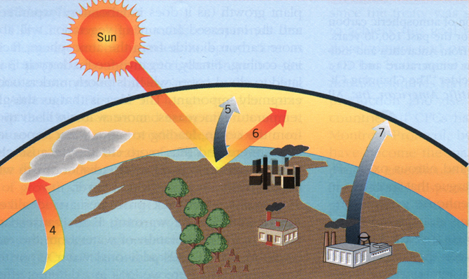
4. Increased evaporation adds more water vapor to atmosphere causing warming
5. Melting of permafrost releases more methane gas causing warming
6. Reduced summer snow-pack decreases Earth’s albedo causing warming
7. Increased use of air conditioning using more fossil fuels causes warming
The Positive Feedback Loop

Slide 16

Global Warming
Global warming is the natural or human-induced increase in the average temperature of the atmosphere near Earth’s surface.
Four main factors determine near surface temperature.
1. The amount of sunlight Earth receives
2. The amount of sunlight Earth reflects
3. Retention of heat by the atmosphere, and
4. Evaporation and condensation of water vapor.
Most natural greenhouse warming is due to water vapor. But water is not greatly increasing so it is not a major concern.
But we are worried about gases produced by anthropogenic processes. (human activities)

Slide 17
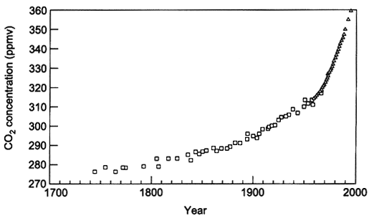
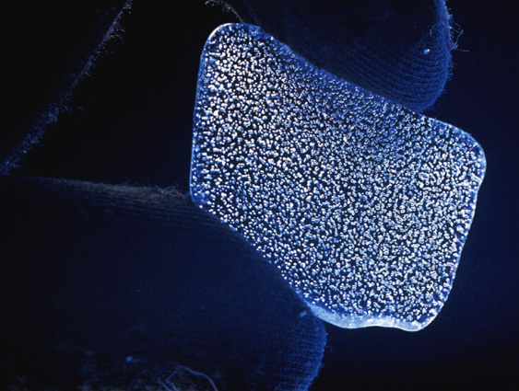
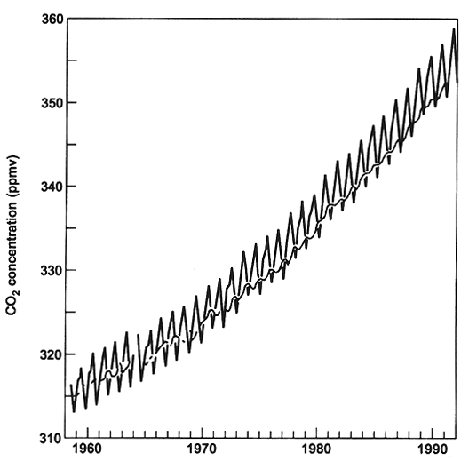
Only since 1959 have CO₂ levels be recorded in detail.
So how do we know levels as higher today than 300 years ago?
Ice cores from Antarctica have given us readings back to 1700.
Why do the levels of CO₂ appear to go up and down each year?

Slide 18
There are two trends in this graph of CO₂ levels in the atmosphere
1. A strong upward trend over the years.
2. An annual cycle, it peaks in winter and drops in summer. Why?
Photosynthesis by green plants in summer exceeds respiration. CO2 is removed from atmosphere during summer.
In winter photosynthesis decreases greatly and becomes less than total respiration.

Slide 19
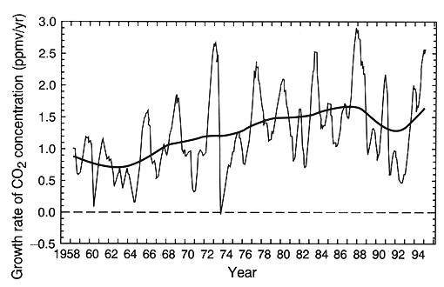
This graph shows growth rate of CO₂ since 1958 at Mauna Loa.
The smooth curve is the same data filtered suppress variations on time scales less than 10 years
Note small growth rate from 1991-1994. May be due to Pinatubo eruption in 1991 or El Nino in 1990

Slide 20
Rate of increase of Greenhouse gases

Slide 21
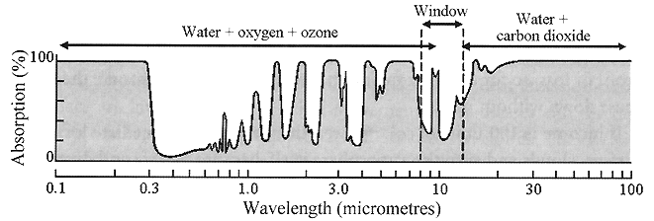
Other Greenhouse gases:
Chlorofluorocarbons, CFC’s: used as aerosol propellants and in refrigeration units. Important because they absorb in the atmospheric window.
They also destroy ozone molecules and are thought to be the major cause of the ozone hole
CFC’s significantly contribute to the greenhouse effect

Slide 22
Methane (CH₄): Major sources include termites, freshwater wetlands, burning of wood, coal and agriculture (rice & cattle), leakage from gas pipelines and oil wells, methyl hydrate formations.
Decomposition of organic matter releases methane. Old landfills are examples of this.
For the last 2000 years the levels of CH₄ have been constant.
But since 1800 its concentration has doubled and are increasing at about 0.6 per year.
Methane has an average lifetime of about 12 years

Slide 23
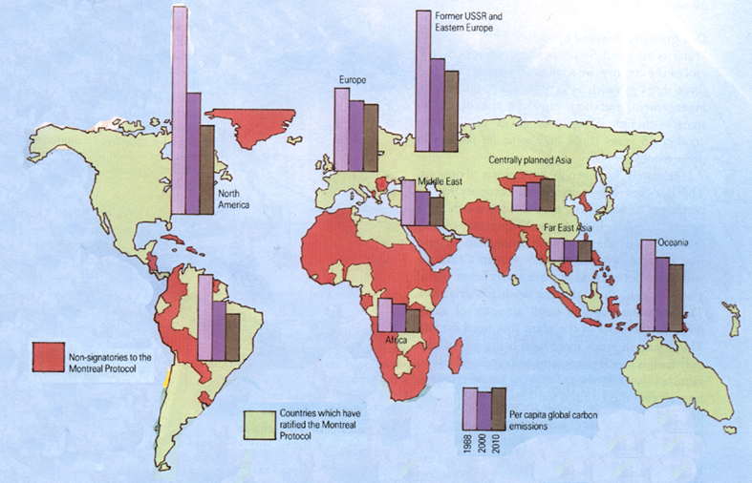
Nitrous Oxide, (N₂O): Anthropogenic sources include fertilizers and burning of fossil fuels. This gas has a long residence time, up to several decades.
The Montreal Protocol is an international treaty signed by 24 countries to reduce and eventually eliminate the production of CFC’s. The treaty calls for the production of CFC’s to be phased out by 2000.

Slide 24
What would be the impact of global warming?
It is estimated that global warming of 1.0 to 3.5 °C could happen by the year 2100.
This will have many adverse and some beneficial effects.
North American climate zones could move northward by 340 miles
Increase in tropical malaria
Higher latitudes would have longer growing seasons
Will require changes in agricultural practices. (more irrigation)
Rises in sealevel by 10 to 30 inches by 2100
Melting of ice caps, affecting ocean currents

Slide 25

Global Warming Controversy
Many scientists question the integrity of the global mean temperature record.
Many criticize the climate models used to predict changes.
Many factors that control climate are not well understood.
Other scientists say that so much is at stake that international action needs to be taken to curb carbon dioxide emissions.
The United Nations’ Earth Summit in Rio de Janeiro in 1992 saw the first global climate treaty. 116 industrial nations ratified this treaty to reduce CO₂ emissions to 1990 levels by 2000. But many are worried that this will not be enough.
H/W: Read article latest News paper article

Slide 27
Carbon Dioxide and the Carbon Cycle
The worlds oceans are a storage site for carbon dioxide.
Carbon dioxide dissolves in water, but not completely.
CO_{2 (g)} + H₂O _{(l)} ⇔ H₂CO_{3 (aq)}
How much dissolves depends on air pressure. As more dissolves the air pressure drops and so does the amount that dissolves drops. It is at equilibrium, unless the temperature changes.
Levels of CO₂ in air go up in summer and drop in winter.This is because the colder it is the more CO₂ dissolves into ocean water.
The warmer it is the less CO₂ dissolves in water.

Slide 28
At the start of the industrial revolution, humanity started on a carbon spending spree, with increasing burning of fossil fuels.
Carbonic acid in water is formed by dissolved carbon dioxide
CO₂ + H₂O ⇔ H⁺ + HCO₃ ⁻ ⇔ H⁺ + CO₃ ²⁻
Only tectonic processes could release this before man.
Ca²⁺ + 2HCO₃ ⁻ ⇔ CaCO₃ + H₂O + CO₂

Slide 29
CaSiO₃ + 3H₂O + 2CO₂ ⇔ Ca²⁺ + 2HCO₃⁻ + H₄SiO₄

