Slide 1
Forces in Two Dimensions
Equilibrium and Statics

Slide 2
Equilibrium
An object in equilibrium is either…
At rest and staying at rest, or
In motion and continuing in motion with the same speed and direction.
Forces are balanced.
F_{NET} = 0 N and a = 0 m/s/s.

Slide 3
Static Equilibrium
If an object is at rest and is in a state of equilibrium
Static means stationary or at rest

Slide 4
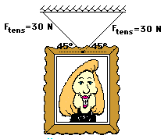
Hanging Picture Problem
1. The following picture is hanging in the white house. For each picture, use trigonometric functions to determine the weight of the picture.

Slide 5
Solution #1
F_{vert} = ??
F_{tens} = 30 N = F_{tens}
F_{vert} = ??
45°
45°
sin 45° = F_{vert} / 30 N
F_{vert} = 30 N (sin 45°)
= 21.2 N
F_{wt} = F_{vert} + F_{vert} = 21.2 N + 21.2 N = 42.4 N

Slide 6
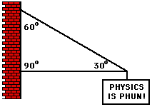
Single Cable Sign Problem
2. The sign below hangs outside the physics classroom, advertising the most important truth to be found inside. If the sign has a mass of 50 kg, then determine the tension in the single cable which supports its weight.

Slide 7
Solution #2
Since there is only one “upward-pulling” cable,
it must supply all the upward force .
F_{tens} = ??
F_{vert} = 500 N
30°
F_{wt} = mg = (50 kg)(-10 m/s/s)
= -500 N or 500 N, down
sin 30 ° = 500 N / F_{tens}
F_{tens} = 500 N / 0.5 = 1000 N
F_{wt} = 500 N

Slide 8
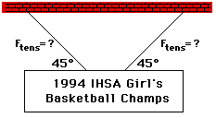
Two Cable Sign Problem
3. The following sign can be found in Glenview. The sign has a mass of 50 kg. Determine the tension in the cables.

Slide 9
Solution #3
F_{vert} = ??
?? = F_{tens} = ??
F_{vert} = ??
45°
45°
F_{wt} = mg = (50 kg)(-10 m/s/s)
= -500 N or 500 N, down
Sin 45° = 250 N / F_{tens}
Each cable must pull upwards with
250 N of force.
F_{tens} = 250 N / sin 45°
= 354 N

Slide 10
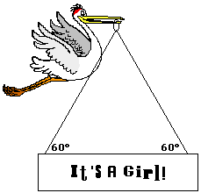
It’s a Girl Sign Problem
4. After its most recent delivery, the infamous stork announces the good news. If the sign has a mass of 10 kg, then what is the tensional force in each cable? Use trigonometric functions and a sketch to assist in the solution.

Slide 11
Vector Diagram #4
F_{up} = ??
60°
60°
F_{vert} = ??
F_{vert} = ??
?? = F_{tens} = ??
60°
60°
F_{down} = ??
F_{down} = ??

Slide 12
Solution #4
m = 10 kg
W = mg = (10 kg)*(-10 m/s/s) = -100 N = 100 N, down
Each cable must pull upwards with 50 N of force
sin 60° = 50 N / F_{tens}
F_{tens} = 50 N / sin 60° = 57.8 N

Slide 13
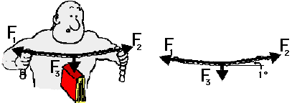
Strongman Problem
5. The Strongman below pulls with two large forces (F₁ and F₂) in order to lift the 1-kg book by two cables. If the cables make a 1-degree angle with the horizontal, then what is the tension in the cable?

Slide 14
Solution #5
F_{vert} = 5 N
F_{vert} = 5 N
F_{tens} = ??
F_{tens} = ??
1°
1°
F₃ = 10 N
m = 1 kg
F_{wt} = mg = (1 kg)*(-10 m/s/s) = -10 N = 10 N, down
Each cable must pull upwards with 5 N of force
sin 1° = 5 N / F_{tens}
F_{tens} = 5 N / sin 1° = 286 N

