Slide 1
What makes a Plant a Plant?
Plant Characteristics
How are Plants Classified

Slide 2
Plant Characteristics
They make their own food
  Chloroplasts contain chlorophyll
  Chlorophyll absorbs energy from the sun
  Plants use the energy to make food - glucose (sugar)
  Process is called Photosynthesis

Slide 3
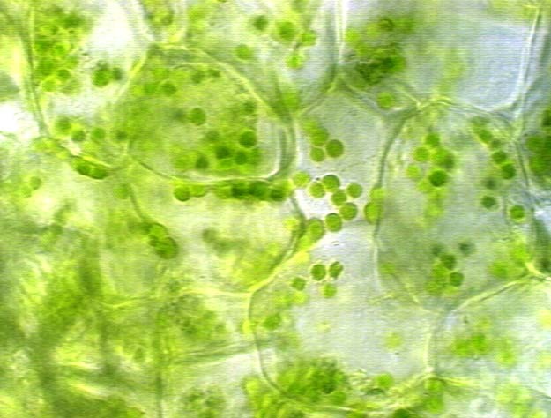
Chloroplasts:

Slide 4
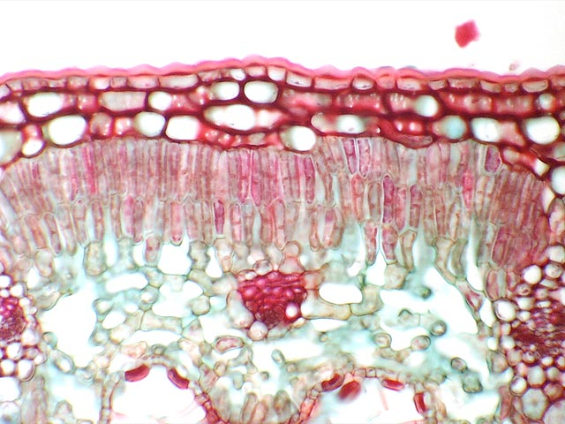
Plant Characteristics
Plants Have a Cuticle

Slide 5
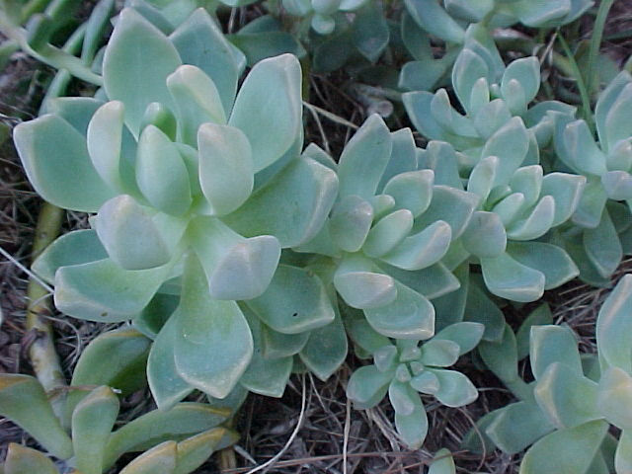
What is a Cuticle?
  A waxy layer that coats the surface of stems, leaves, and other plant parts exposed to the air.
  Keeps plants from drying out.

Slide 6
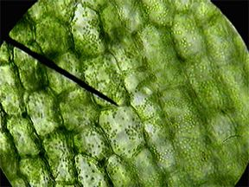
Plant Characteristics
Plant Cells have Cell Walls

Slide 7
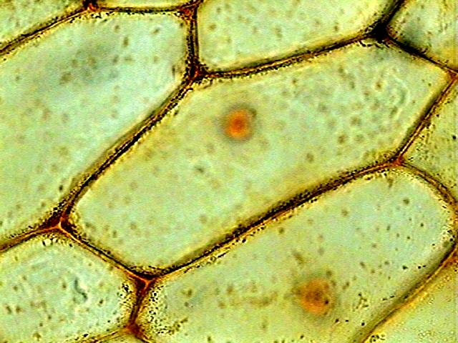
What is a Cell Wall
  a plant cell is surrounded by a rigid cell wall
  outside of the cell membrane
  helps support and protect the plant

Slide 8
Plant Characteristics
Plants reproduce with spores and sex cells
  there are two stages in a plants life:
    sporophyte
    gametophyte

Slide 9
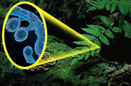
What is a Sporophyte?
A plant in the spore producing stage of life.
Spores can grow directly into an adult plant

Slide 10
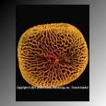
What is a Gametophyte?
The stage in a plant’s life where it produces male and female sex cells.

Slide 11
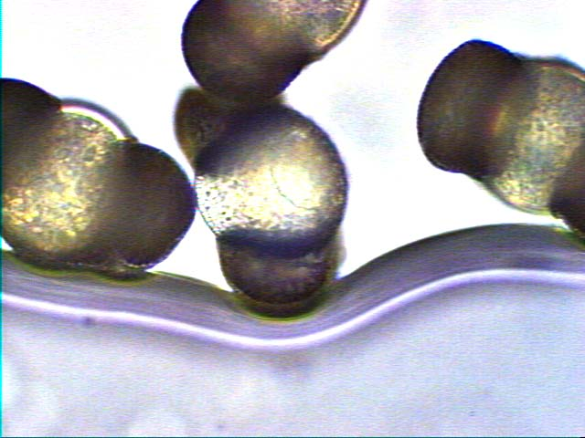
More on Gametophytes
Male and female sex cells must join in order to grow into a new plant. This is called Fertilization.

Slide 12
How are Plants Classified?
There are more than 260,000 species of plants.
They can be divided into two groups:
  Nonvascular
  Vascular

Slide 13
How are Plants Classified?
Nonvascular Plants:
  have no pipes to transport water and nutrients
  depend on diffusion and osmosis to move material from one part of the plant to another
  They have to be small: mosses, liverworts

Slide 14
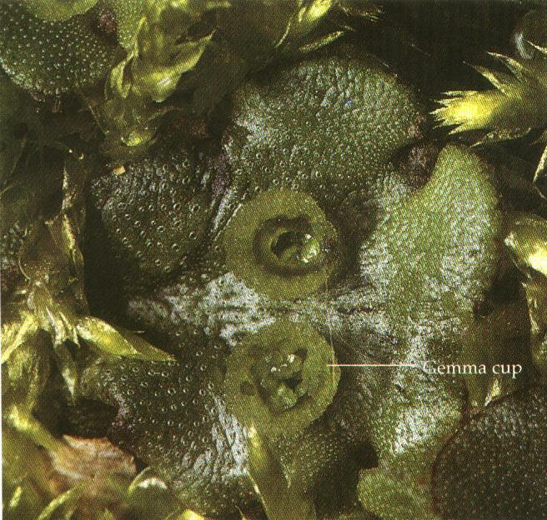
Liverwort:

Slide 15
How are Plants Classified?
Vascular Plants
  Have tissues that deliver needed materials throughout a plant - called vascular tissues.
  Can be almost any size.
  Are divided into gymnosperms and angiosperms

Slide 16
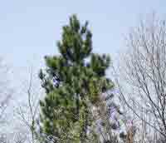
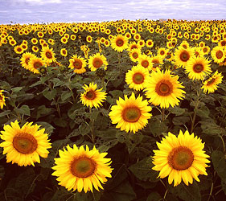
How are Plants Classified?
Gymnosperms -- non-flowering plants
Angiosperms -- flowering plants

