Slide 1


Slide 2
www.makemegenius.com
Check MMG School Science
for free Science Videos
for Kids

Slide 3
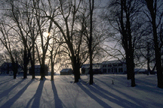

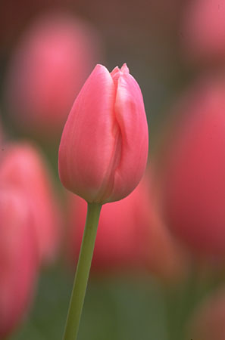
ECOSYSTEM
The self-sustaining structural and functional interaction between living and non-living components.

Slide 4
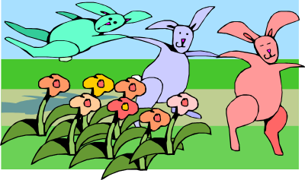
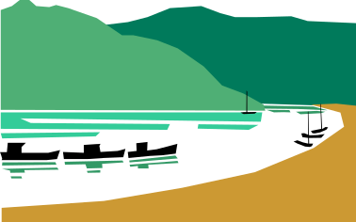
TYPES OF ECOSYSTEMS
Natural
1.Terrestrial ecosystems (grasslands, forests, desert ecosystems)
2.Aquatic ecosystem
a.Lentic (Stagnant water) like lake, ponds etc.
b.Lotic (Flowing water) like river, ocean, sea, etc.
Artificial
1.A crop land, garden, aquarium, park, kitchen garden.

Slide 5


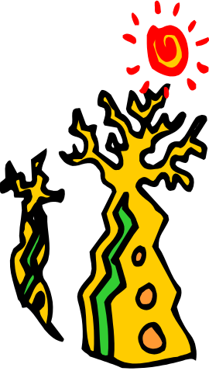

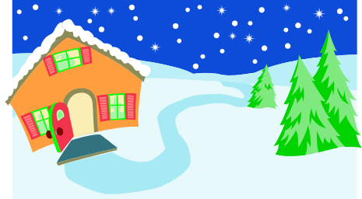
COMPONENTS OF AN ECOSYSTEM
An ecosystem consists of two main components
Abiotic or Non-living components.
  1. Inorganic substances
  2. Organic compounds
  3. Climatic factors
Biotic or Living components.
1. Autotrophs or Producers
2. Heterotrophs or Consumers
3. Decomposers or Saprotrophs

Slide 6

FUNCTIONS OF AN ECOSYSTEM
The Producers, the green plants, fix radiant energy(solar energy) and with the help of minerals take from their edaphic(soil where they grow) or aerial environment and build up complex organic matter. These are their food. So, with the help of solar energy they convert the chemical energy of the food to kinetic energy and finally heat energy.
The animals eat up plants and other animals as food. So, the energy is transferred through food to animals.
When plants and animals die, then decomposers(like certain bacteria and fungi) act on their dead bodies and decompose them into simple materials like carbon dioxide, water and minerals which go back to air, water bodies and soil from where they were taken.

Slide 7

PROCESS OF FUNCTIONING OF THE ECOSYSTEM
The carbon dioxide from air, water and minerals from water bodies and soil are again taken up by green plants along with solar energy to make their food. This process is repeated again and again. This leads to continuous functioning of the ecosystem.

Slide 8

ENERGY FLOW THROUGH THE ECOSYSTEM
The transfer of energy and matter takes place in the process of predator and prey relationship in a food chain. The original source of energy is the energy from the sun.
Out of the enormous amount of energy continuously radiated by the sun, most of it is reflected or refracted back (by atmosphere, earth surface and object like plants). Only a very small fraction, about one per cent, of the solar energy received by the plant is used through the process of photosynthesis.

Slide 9

IMPORTANCE OF ECOSYSTEM
We know that no living organism can live in isolation. We cannot survive without producers in nature. All living beings depend on other living beings in the biological community. Not only they are dependent on one another, but also each of them exist in a certain proportion. This creates a complete balance in nature amongst living organisms. This is evident from the study of food chains which operate between living organisms.

Slide 10


ECOLOGICAL BALANCE IN NATURE
The balance between the living beings and also with the non- living environment is called the Ecological Balance or simply a Balance in Nature. Unfortunately, however human activities have upset the ecological balance in nature, so it is more essential that balance in nature should be established soon because it is essential for our own existence.

Slide 11


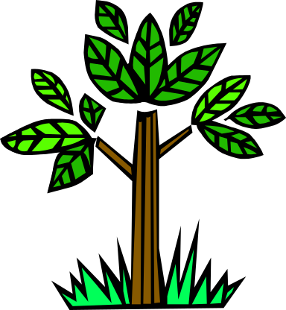
CONSERVATION OF FORESTS
Diversion of forest lands for other purposes have to be prevented. Reckless cutting of forests need to be checked. Steps have to be taken to stop shifting practice of cultivation. Forest fire is another cause of forest depletion which needs to be controlled effectively. Afforestation has to be taken up effectively.

Slide 12

CONSERVATION OF WILDLIFE
It is believed that if forest destruction is not checked then there is a fear that many birds and animals may become extinct. There must be a control over ruthless hunting. Suitable laws are to be made against it. National parks, biosphere reserves and zoological parks are to be set up to safe guard the lives of wild animals and birds.

Slide 13

CONSERVATION OF ECOSYSTEM
Forests are important components of our environment. Rapid destruction of this important resource is a cause of concern.
Afforestation, preventing reckless cutting of trees and making everyone aware of the need to conserve it will help forest conservation.
Nature enjoys ecological balance only if the relative number of species is not disturbed. So, conservation of wildlife is important for the future.
National parks, wildlife sanctuaries and biosphere reserves are established to protect and conserve wildlife.
Such measures would ensure that the wildlife does not become extinct.
Conservation of aquatic life would be ensured by removal of industries near water bodies.

Slide 14


CREATING AWARENESS
Awareness about ecosystem conservation can be done by posters, competitions about ecosystem conservation, arranging T.V. programmes and websites related to ecosystems.

Slide 15

If all mankind were to disappear,
The world would regenerate back to the rich state of equilibrium
That existed ten thousand years ago.
If insects were to vanish,
The environment would collapse into chaos.
Edward O Wilson

