Slide 1

www.makemegenius.com– Full of ingredients to make your child a genius.
“Don’t make me read, make me understand “

Slide 2



WATER

Slide 3
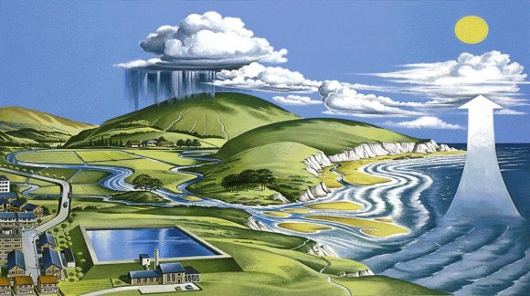
3. Water vapour condenses to form clouds
4. Rain water falls to form rivers.
2
3
4
2. Water vapour is carried up into the air.
5
5. Rivers flow into the sea
1
1. Water evaporates
THE WATER CYCLE

Slide 4
THE WATER CYCLE
A. SNOW AND ICE ON MOUNTAIN TOPS MELT AND FLOW INTO RIVERS
B. RESERVOIRS ARE MADE TO STORE WATER FOR OUR USE
A
B
C. WATER FROM RESERVOIRS IS CLEANED AT WATER WORKS AND PUMPED TO OUR HOUSES
D
D. WASTE WATER FROM OUR HOUSES IS CLEANED AT THE SEWAGE WORKS AND PUMPED BACK INTO THE SEA
C

Slide 5
TASK
Write down in the correct order the 5 events in the water cycle
Label the events 1 – 5
Write down the other 4 events with their correct label A, B, C or D
Colour and stick the water cycle diagram into your books
Heading – THE WATER CYCLE

Slide 6

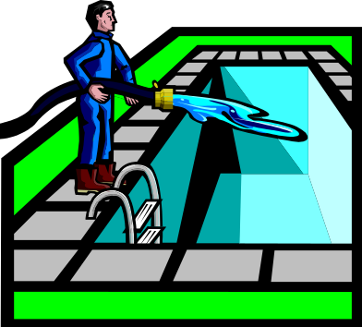



AT PLAY

Slide 7


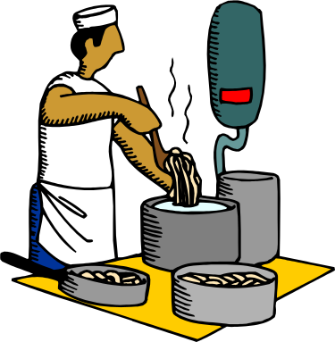

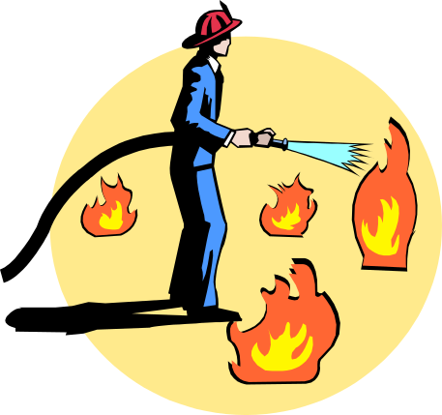

AT WORK

Slide 8
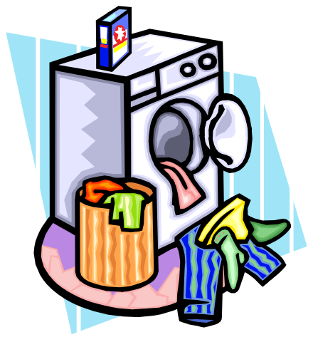


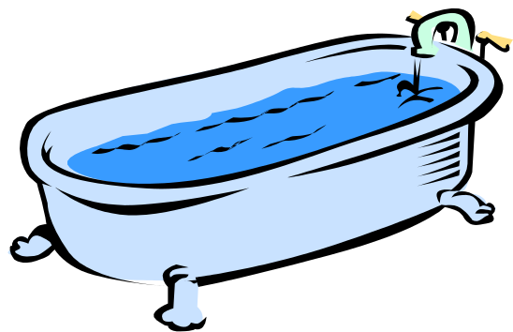
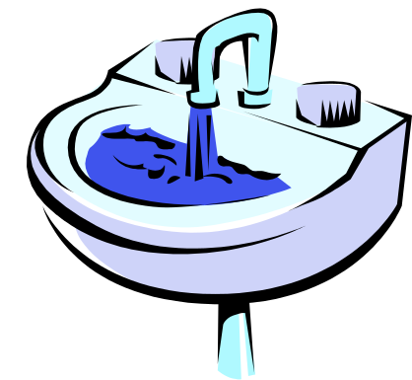


AT HOME

Slide 9




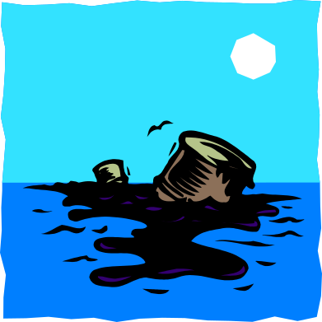


ENVIRONMENT
DANGERS!
NATURE

Slide 10
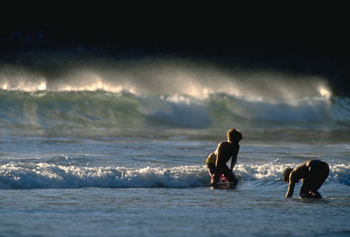
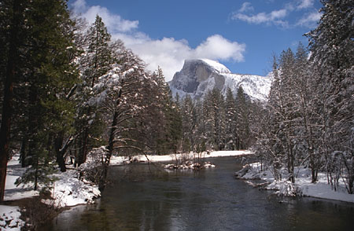
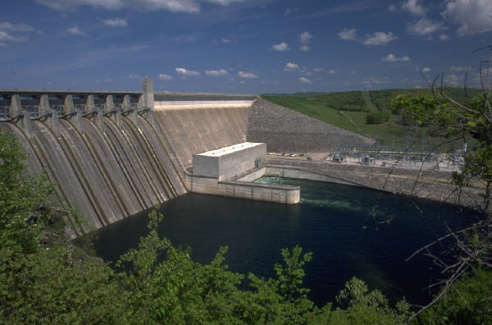
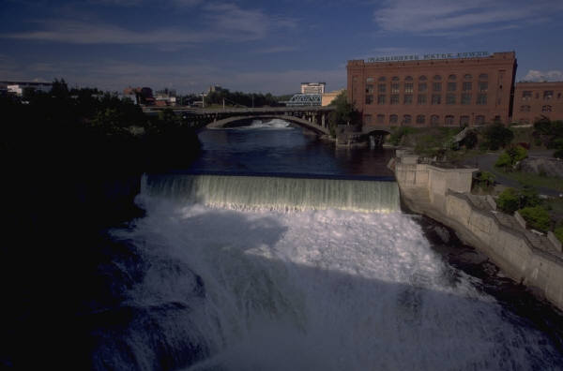
THE BEAUTY OF WATER

Slide 11

TASK
MY
WATER
DIARY
NAME:

Slide 12
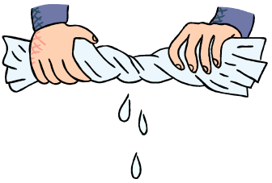
DIARY
 | Fri | Sat | Sun | Mon | Tue | Wed | Thu
Drink
Toilet
Shower
Bath
Teeth
Face Hands
Other drinks
dishes
Waste

Slide 13
TASKS
At Home
At School
Water used
Tally
At home
Waste
4 uses of water
4 labels
4 pictures
Heading –
USES OF WATER

Slide 14

Thanks
Submitted by
Adit
Gurgaon

Slide 15
If you also want to share your own or your kid’s presentation(ppt) please send it on info@makemegenius.com

Slide 16
www.makemegenius.com– Full of ingredients to make your child a genius.
“Don’t make me read, make me understand “

