Slide 1

CELLS
The Basic Unit of Life

Slide 2







Cells
Cells are living things.
Notes:
Lamprey

Slide 3


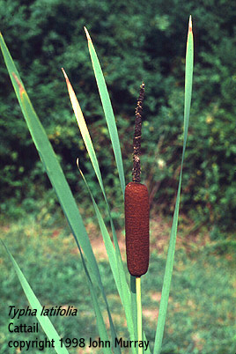
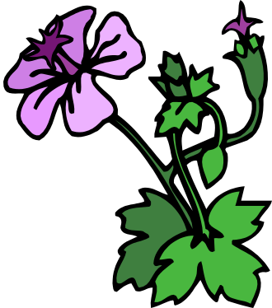
Cells Make up Plants

Slide 4
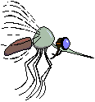

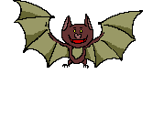


Cells make up all living things.

Slide 5


What is the definition of a cell?
The basic unit of life.
Can you think of reasons why cells need nutrition and a good environment?

Slide 6
Cells produce tissues
Tissues produce organs
Organs produce organ systems
Organs systems produce organisms

Slide 7
Parts of a plant cell
Cell Wall
Chloroplast
Cytoplasm
Mitochondrion
Endoplasmic Reticuleum
Nucleus
Vacuole

Slide 8
Robert Hooke discovered the first cells. Cork Cells were thought to have been these cells. Anton von Leeuwenhoek was first to observe one celled living things. Examples of these were bacteria and parameciums.

Slide 9
Definitions and plant cell parts.
Cytoplasm-gel like substance found in a cell
Chloroplasts-a green structure in a plant
Cell Wall-a stiff covering that protects plant cells
Nucleus-control center of the cell
Chromosomes-provides direction for cell to follow
Endoplasmic Reticulum-transportation network
Mitchondrion-produces energy in the cell
Vacuole-cell storage sac for food, waste and water

Slide 10
Parts of the animal cell and definition.
Vacuole-cell storage sac for food,waste, and water
Mitochondrion –produces energy in a cell
Chromosomes-provides direction for cells to follow
Nucleus-control center of a cell
Endoplasmic Reticulum--transporation system
Cytoplasm-gel like substance found in a cell
Cell Membrane-surrounds cell material

Slide 11
Plants and animals cells have many of the same type of structures. These structures perform the same type of activities.
Plants and animals cells have some structures that are not the same. These structures perform different activities, but necessary to it’s particular cell.

Slide 12
Cells also carry out diffusion,passive transport active transport and osmosis.
Diffusion-movement of gases from higher concentrations to lower concentrations
Passive Transport-materials do not need energy to move from higher concentration to lower to a lower concentration
Active Transport-materials need energy to move from a higher concentration to lower concentration
Osmosis-water moving from higher concentration to a lower concentration

Slide 13
Why do you think that all students need to have an understanding of the parts of a cell and the differences between the parts found in plant and animal cells?

Slide 17
How can one cell develop into a plant or animal?
Mitosis- forms identical cells
Meiosis-one half the number of forms cells with chromosomes

