Slide 1
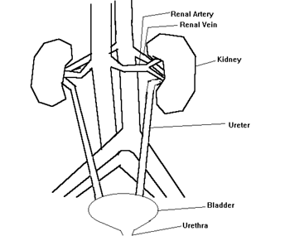
Circulatory
System

Slide 2
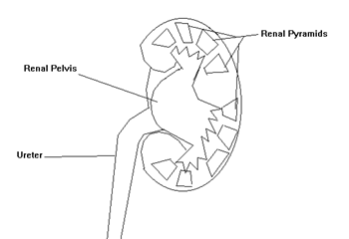
Circulatory System

Slide 3
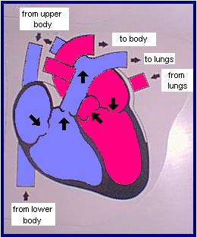
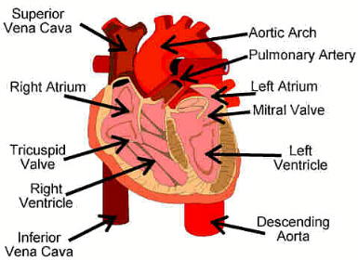
Circulatory System

Slide 4



circulatory system

Slide 5
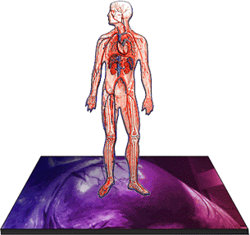

Slide 6
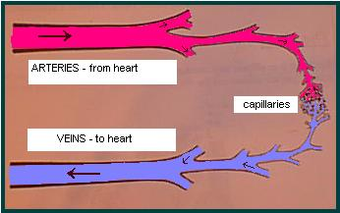

Slide 7
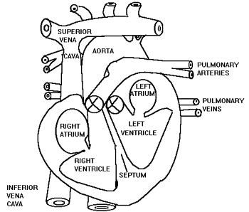
The Heart

Slide 8
Iformation
Book:
Human Biology and Health,Prentice Hall,1993
Web sites:
http://askjeeves.com/\
http://www.tmx.com/fun/road map/

