Slide 1
The Circulatory
System
By: My N., Andrew W., Jerimiah B. Henry N.

Slide 2
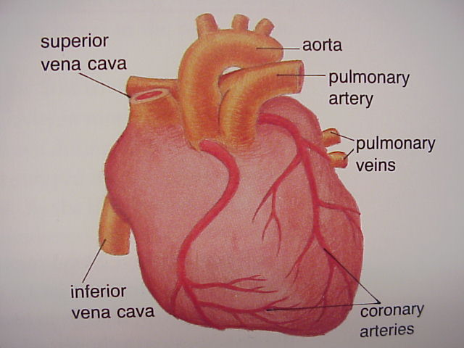
The Heart
The Heart is the main organ in the circulatory system.
It pumps blood all through the body so that nutrients
get to the body cells.

Slide 3
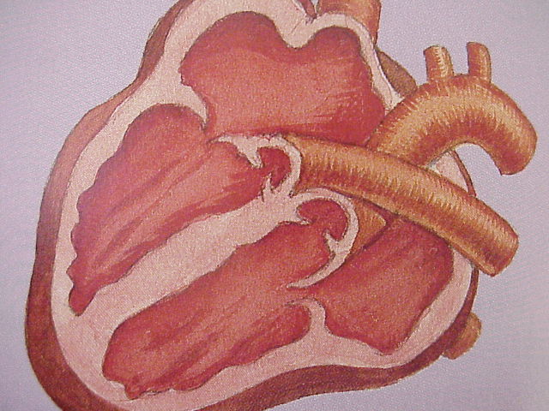
It Pumps
Blood, carrying oxygen and nutrients is
pumped into the body through things called arteries.
Arteries carry blood all throughout the body and the
veins bring new blood back to the heart.

Slide 4
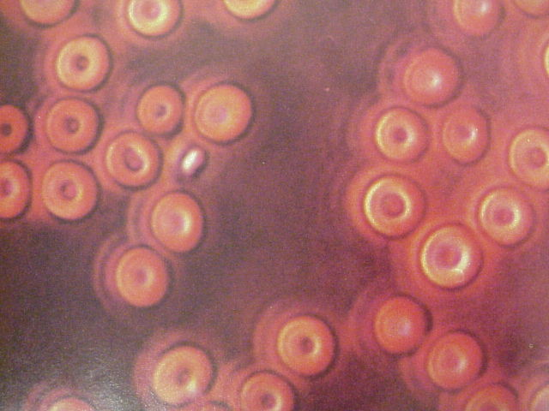
Red Blood Cells
Red Blood cells are the most numerous cells in blood.
The thinnest of red blood cells enables it to squeeze
through narrow capillaries. Red blood cells reproduce
in bone marrow.

Slide 5
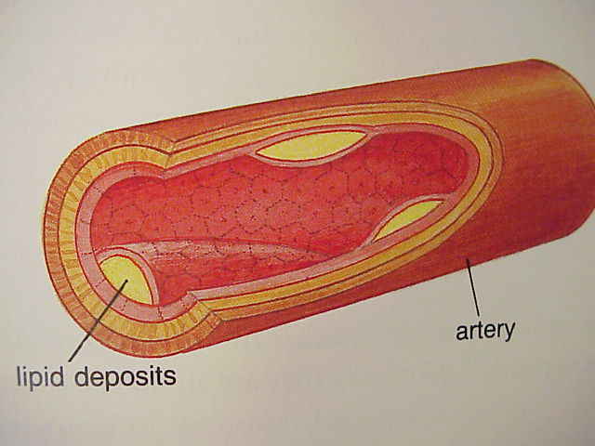
Veins
Veins are arteries that bring blood back to the heart so that the blood can be refilled with nutrients and oxygen.

Slide 6
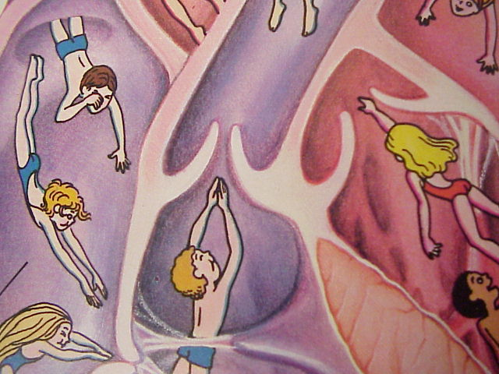
Valves
One-way valves and veins keep
blood from flowing backward.
The journey of blood from the
heart to the big toe and back to
the heart takes less than a minute.

Slide 7
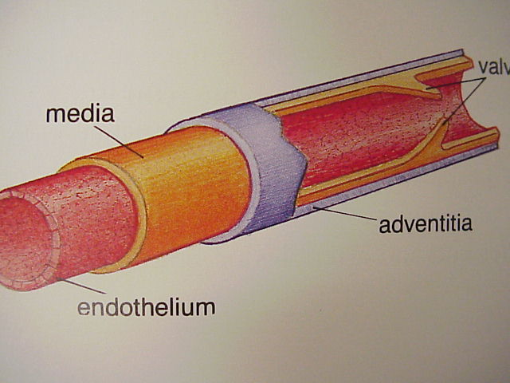

Arteries
Arteries channel blood back to
the heart.
They carry waste the cells
have release
The kidneys and lungs pick
up the waste for disposal.

Slide 8
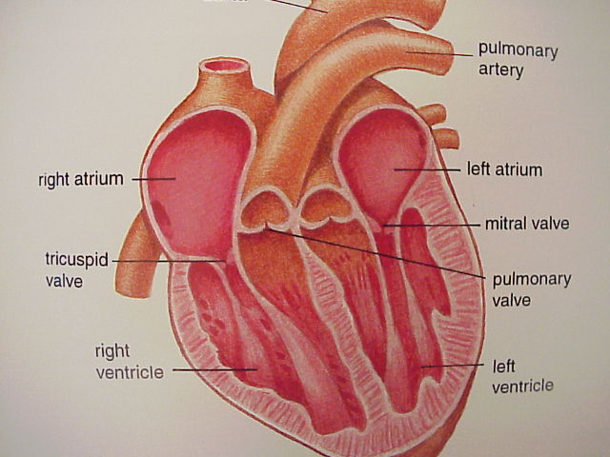
Atrium
Inside the right atrium, you’ll find yourself swirling in a sea of
blood. Oxygen-poor blood are held in the right atrium after its
trip throughout the body.

Slide 9
Bibliography
Books
Your Wonderful Body, National Geographic Society, 1982
Thanks to
Human Biology and Health, Prentice
Hall, 1993
The Circulatory System,
Lloyd Birmingham, 1994

