Slide 1

Digestive
System
By: Javier, Harjeet, Steven, and
Craig

Slide 2
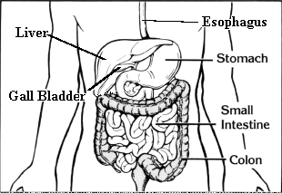

Slide 3
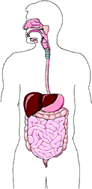
Mouth and Esophagus
The first part of digestion starts
from the mouth as you take your
first bite. It then travels to your
esophagus.
Mouth
Esophagus

Slide 4
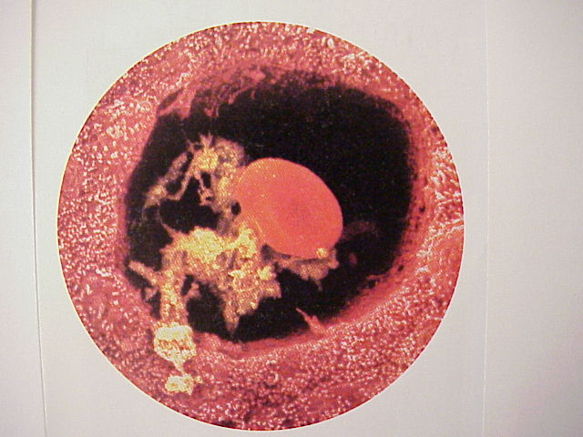
STOMACH
After leaving the esophagus
the food enters a J-
shaped organ called
the stomach.

Slide 5
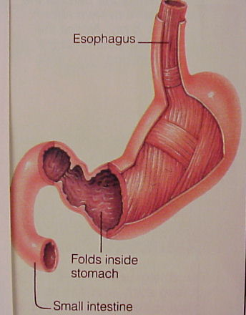
ESOPHAGUS,
STOMACH,
and SMALL INTESTINES

Slide 6
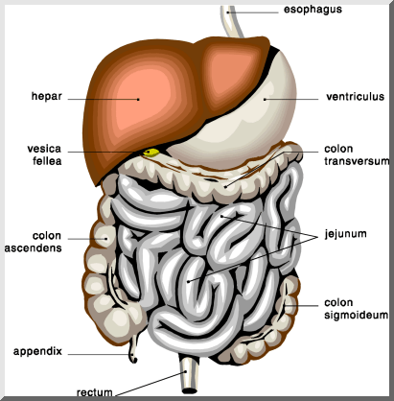
ORGANS OF THE DIGESTIVE SYSTEM

Slide 7
THE END

Slide 8
SOURCES
Books- Human Biology and Health
PUBLISHER- Prentice Hall, 1993
Websites-
http://www.innerbody.com/html/body.html
http://tqjunior.thinkquest.org/5250/
Yahoo Search “Science Human Digestive System”
Http://www.pa.k12.ri.us/Curric/Science/Human1.
htm

