Slide 1
Chapter 2
Atoms and Elements
The Atom
Atomic Number and Mass Number
Isotopes

Slide 2
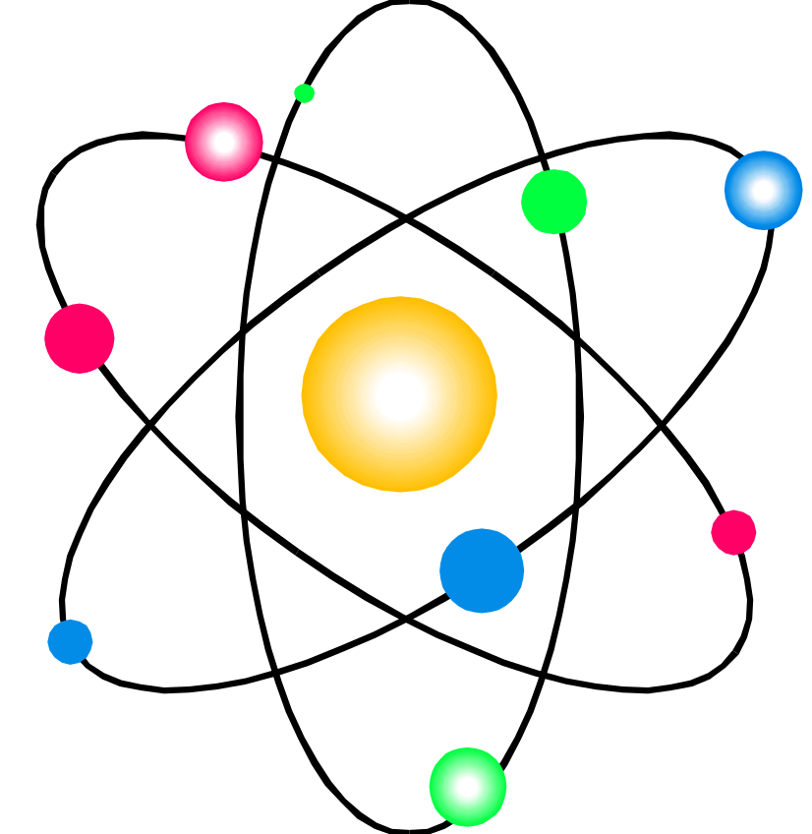
Atomic Theory
Atoms are building blocks of elements
Similar atoms in each element
Different from atoms of other elements
Two or more different atoms bond in simple ratios to form compounds

Slide 3
Subatomic Particles
Particle Symbol Charge Relative
Mass
Electron e⁻ 1- 0
Proton p⁺ + 1
Neutron n 0 1

Slide 4
Location of Subatomic Particles
10⁻¹³ cm
electrons
protons
neutrons
10⁻⁸ cm
nucleus

Slide 5
Atomic Number
Counts the number
of
protons
in an atom

Slide 6
Atomic Number on the Periodic Table
11
Na
Atomic Number
Symbol

Slide 7
All atoms of an element have the same number of protons
11
Na
11 protons
Sodium

Slide 8
Learning Check
State the number of protons for atoms of each of the following:
A. Nitrogen
1) 5 protons 2) 7 protons 3) 14 protons
B. Sulfur
1) 32 protons 2) 16 protons 3) 6 protons
C. Barium
1) 137 protons 2) 81 protons 3) 56 protons

Slide 9
Solution
State the number of protons for atoms of each of the following:
A. Nitrogen
2) 7 protons
B. Sulfur
2) 16 protons
C. Barium
3) 56 protons

Slide 10
Mass Number
Counts the number
of
protons and neutrons
in an atom

Slide 11
Atomic Symbols
Show the mass number and atomic number
Give the symbol of the element
mass number
²³ Na sodium-23
atomic number ¹¹

Slide 12

Number of Electrons
An atom is neutral
The net charge is zero
Number of protons = Number of electrons
Atomic number = Number of electrons

Slide 13
Subatomic Particles in Some Atoms
₁₆ ₃₁ ₆₅
O P Zn
⁸ ¹⁵ ³⁰
8 p⁺ 15 p⁺ 30 p⁺
8 n 16 n 35 n
8 e⁻ 15 e⁻ 30 e⁻

Slide 14
Isotopes
Atoms with the same number of protons, but different numbers of neutrons.
Atoms of the same element (same atomic number) with different mass numbers
Isotopes of chlorine
³⁵Cl ³⁷Cl
¹⁷ ¹⁷
chlorine - 35 chlorine - 37

Slide 15

Learning Check
Naturally occurring carbon consists of three isotopes, ¹²C, ¹³C, and ¹⁴C. State the number of protons, neutrons, and electrons in each of these carbon atoms.
¹²C ¹³C ¹⁴C
6 6 6
#p _______ _______ _______
#n _______ _______ _______
#e _______ _______ _______

Slide 16
Solution
¹²C ¹³C ¹⁴C
6 6 6
#p 6 6 6
#n 6 7 8
#e 6 6 6

Slide 17
Learning Check
An atom of zinc has a mass number of 65.
A. Number of protons in the zinc atom
1) 30 2) 35 3) 65
B. Number of neutrons in the zinc atom
1) 30 2) 35 3) 65
C. What is the mass number of a zinc isotope
with 37 neutrons?
1) 37 2) 65 3) 67

Slide 18
Solution
An atom of zinc has a mass number of 65.
A. Number of protons in the zinc atom
1) 30
B. Number of neutrons in the zinc atom
2) 35
C. What is the mass number of a zinc isotope
with 37 neutrons?
3) 67

Slide 19
Learning Check
Write the atomic symbols for atoms with the following:
A. 8 p⁺, 8 n, 8 e⁻ ___________
B. 17p⁺, 20n, 17e⁻ ___________
C. 47p⁺, 60 n, 47 e⁻ ___________

Slide 20
Solution
¹⁶O
A. 8 p⁺, 8 n, 8 e⁻ ⁸
B. 17p⁺, 20n, 17e⁻ ³⁷Cl
¹⁷
C. 47p⁺, 60 n, 47 e⁻ ¹⁰⁷Ag
⁴⁷

Slide 21
Atomic Mass on the Periodic Table
11
Na
22.99
Atomic Number
Symbol
Atomic Mass

Slide 22
Atomic Mass
Atomic mass is the weighted average mass of all the atomic masses of the isotopes of that atom.

Slide 23
Example of an Average Atomic Mass
Cl-35 is about 75.5 % and Cl-37 about 24.5% of natural chlorine.
35 x 75.5 = 26.4
100
35.5
37 x 24.5 = 9.07
100

