Slide 1

DO NOW
EXPLAIN THE FOLLOWING SCENARIO:
YOU GET UP FROM THE COUCH TO OPEN THE DOOR.
WHEN YOU TOUCH THE DOORKNOB YOU GET A SHOCK. EXPLAIN WHY.
Notes:
_________________________________________
_________________________________________
_________________________________________
_________________________________________
_________________________________________
_________________________________________
_________________________________________
_________________________________________
_________________________________________

Slide 2


Everything is made of Atoms
Take anything and divide it in half…..keep dividing………keep going…….!
You finally end up with the smallest piece possible
This is an atom!!!

Slide 3
Parts of the Atom
Everything around us is made of atoms
In the middle of the atom is the nucleus
orbiting around the nucleus are small particles called electrons

Slide 4
There are two types of electrical charges
Protons carry positive charges (+)
Electrons carry negative charges (-)

Slide 5
Electrons can move!
The protons and neutrons in the nucleus are held tightly together.
But….electrons are free to move from one atom to another.

Slide 6

When electrons move...
They cause STATIC ELECTRICITY!
Static electricity is the buildup of electrons.

Slide 7
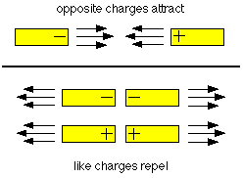
Opposites Attract!
OPPOSITE charges attract
ALIKE charges repel (push away) from each other.

Slide 8

Repulsion VS. Attraction

Slide 9
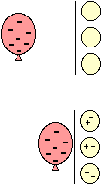
How can you get a balloon to stick to the wall?
Rub a balloon on your hair
Electrons from your hair are transferred to the surface of the balloon
Now stick the balloon on the wall!

Slide 10
As you walk across the floor you rub electrons on the bottom of your shoes…………..THEN when you touch the door knob!

