Slide 1

DO NOW
EXPLAIN THE FOLLOWING SCENARIO:
YOU GET UP FROM THE COUCH TO ANSWER THE DOOR.
WHEN YOU TOUCH THE DOORKNOB YOU GET A SHOCK!!
EXPLAIN WHY….
Notes:
____________________________________________________________________
____________________________________________________________________
____________________________________________________________________
____________________________________________________________________
____________________________________________________________________
____________________________________________________________________
____________________________________________________________________
____________________________________________________________________
____________________________________________________________________
____________________________________________________________________
____________________________________________________________________
____________________________________________________________________
____________________________________________________________________
____________________________________________________________________
____________________________________________________________________
____________________________________________________________________
____________________________________________________________________

Slide 4
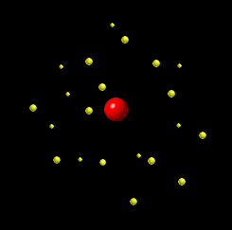
Parts of the Atom
Everything around us is made of atoms
In the middle of the atom is the nucleus
orbiting around the nucleus are small particles called electrons

Slide 5
Subatomic Particles
Protons have a positive charge(+)
Neutrons have no charge
Electrons have a negative charge (-)

Slide 6


Everything is made of Atoms
Take anything and divide it in half…..keep dividing………keep going…….!
You finally end up with the smallest piece possible
This is an atom!!!

Slide 7
Sizes of the subatomic particles
Protons and Neutrons are about the same size
The mass of electrons is much smaller than protons and neutrons

Slide 8
Electrons can move!
The protons and neutrons in the nucleus are held tightly together.
The nucleus does not change
But….electrons can move from one atom to another.
An atom that looses electrons has a more positive charge (protons) than negative charges (electrons)

Slide 9


Slide 10
Opposites Attract!
Two things with opposite, or different charges (a positive and a negative) will attract or pull towards each other.
Things with the same charge will repel each other.

