Slide 1
Minerals
Planet Earth is a rocky Planet, it’s building blocks are elements and minerals
There are 92 natural occurring elements, but only 8 of them make up 98% of the weight of the Earth’s Crust
(See overhead)

Slide 2
Most elements exist as minerals in the Earth’s Crust.
Most of these minerals are compounds
Which ones do you find as pure elements?
Gold, Silver, Copper, Carbon, Sulfur,
Most minerals are formed from liquids that solidified.

Slide 3
Crystal Systems
There are six main crystal system
1 Cubic or isometric (3 axes of equal length intersect at 90˚)
2 Tetragonal (2 axes of same length, all at 90 ˚)
3 Orthorhombic (3 axes of different length at 90 ˚)
4 Hexagonal (3 horizontal axis at 60˚. Vertical axis at 90˚)
5 Monoclinic (3 axes of different length, 2 intersect at 90 ˚, the other is oblique to the others)
6 Triclinic (3 axes of different length are all oblique to one another)

Slide 4
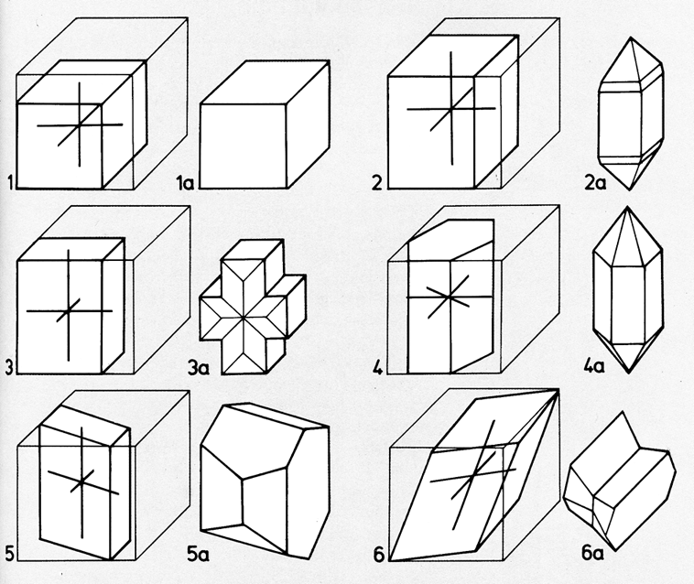

Slide 5
Crystal Habits
This is a term that refers to the form that a crystal takes as it grows.
Prismatic
Pyramidal
Tabular
Rhombohedra
Dodecahedral

Slide 6
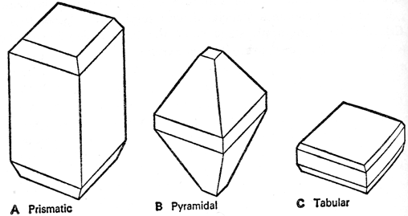

Slide 7
Mineral Cleavage (see overhead)
This is the tendency of minerals to break along smooth planes.
Cleavage in one direction
Cleavage in two directions at right angles
Cleavage in three directions at right angles
Cleavage in three directions not at right angles
Cleavage in four directions
Some minerals lack cleavage ( like quartz)
Cleavage is related to the atomic structure of the mineral

Slide 8
Mineral Fracture
This is how a mineral breaks on an uneven surface.
Some break in a conchoidal fracture like glass & quartz
Some break in a fibrous fracture
Others in a splintery fracture
Fracture is a breakage unrelated to the atomic structure of the mineral

Slide 9
Luster
This refers to the way it reflects light.
There are two main types of luster:
Metallic ( mineral is always opaque)
Non-Metallic (maybe opaque, transparent, or translucent)
Non-metallic Luster includes, glassy or vitreous , waxy, silky, resinous, dull

Slide 10
Density and Specific Gravity
This is related to the weight of a mineral is is how closely packed the atoms are in a mineral. It is usually measured in specific gravity which is a comparison of its density to the same volume of water
Metallic minerals usually have a much higher specific gravity than non-metallic minerals

Slide 11
Hardness
This is resistance to scratching
This is related to how tightly bonded the atoms in the mineral are bonded together.
(see overhead)
The German mineralogist Friedrich Mohs has devised the scale we use today

Slide 12
Moh’s Scale of Hardness
10 Diamond
9 Corundum
8 Topaz
7 Quartz
6 Orthoclase steel file (6.5)
5 Apatite Glass (5.5 - 6)
4 Fluorite
3 Calcite Copper penny (3)
2 Gypsum Finger nail (2.5)
1 Talc

Slide 13
Mineral Groups
Minerals can be grouped in terms of the compounds they are made out of. There are only a few main groups
Silicates are the most common (silicon & oxygen)
Carbonates are second most common (carbon & oxygen + a metal)
Sulfides are compounds of sulfur & a metal
Oxides are compounds of oxygen and a metal
Halides are compounds of a halogen and a metal
Hydroxides are compounds of hydrogen, oxygen and a metal
Sulfates are compounds of sulfur, oxygen and a metal

