Slide 1

www.makemegenius.com– Full of ingredients to make your child a genius.
“Don’t make me read, make me understand “

Slide 2
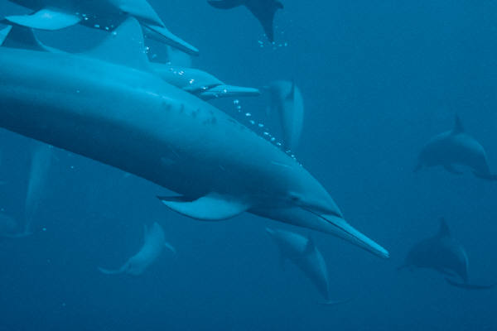
Dolphins

Slide 3

Where do Dolphins Live?
Dolphins live in saltwater oceans and seas all over the world.
It lives in oceans
They live in big groups
Group of Dolphin is called School
Most intelligent animals

Slide 4

What Do Dolphins Eat?
Dolphins eat all kinds of sea creatures
Fish
Crabs
Sea lions
Seals

Slide 5



Is a Dolphin a Fish?
Click on your answer
YES
NO

Slide 6


Oops…try again.
Go back and try second answer
Back

Slide 7


Yes, you are CORRECT!!!!!
Dolphins are not Fish , they are..
Mammals
HOW?

Slide 8

Dolphins are mammals
Because…………………..
Dolphins have live young
Dolphins feed their young milk
Dolphins are warm-blooded

Slide 9
Why Dolphins come up?
It’s related to their breathing?
It’s related to their feeding?
Click on your answer
It’s related to their Game?

Slide 10

Ooops!!! Wrong answer, try again…
Go back

Slide 11
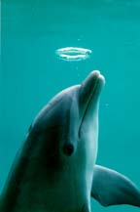
Yes !! You are correct..
They come out for BREATHING
Dolphins breathe through lungs
For that , they must come up to sea -surface for air
Dolphins breathe through the holes on top of their heads called blowholes

Slide 12
Hey Dolphins talk also!
Dolphins find their way with sounds
Dolphins keep in touch by clicks, barks and screams
Dolphins breathe through the holes on top of their heads called blowholes

Slide 13
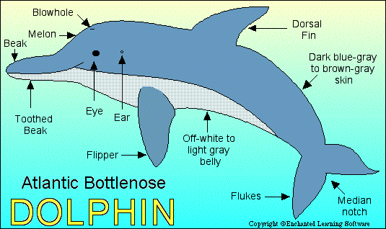

Slide 14

Thanks
Submitted by
Amar Kabel
DPS, Indore

Slide 15
If you also want to share your own or your kid’s presentation(ppt) please send it on info@makemegenius.com

Slide 16
www.makemegenius.com– Full of ingredients to make your child a genius.
“Don’t make me read, make me understand “

