Slide 1
Mosquitoes
Types & few other things
www.makemegenius.com Free Science Videos for Kids

Slide 2
For Free
Science Videos for Kids
www.makemegenius.com Free Science Videos for Kids
www.makemegenius.com
Free Science Videos for Kids

Slide 3
Species
More than 3000 species of mosquitoes have been described on a world-wide basis.
Scientists group species by genus on the basis of the physical characteristics they share.
The 3000 mosquito species found in the world are divided among 28 different genera.
The genus Aedes contains some of the worst pests. Many members of the genus Anopheles have the ability to transmit human malaria.
www.makemegenius.com Free Science Videos for Kids

Slide 4
There are three genera of medical importance:
Culex
Aedes
Anopheles
www.makemegenius.com Free Science Videos for Kids

Slide 5
Morphological difference of three genera
www.makemegenius.com Free Science Videos for Kids

Slide 6
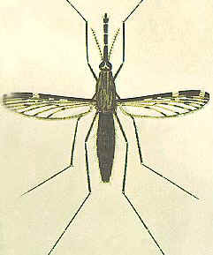
Anopheles
www.makemegenius.com Free Science Videos for Kids

Slide 7
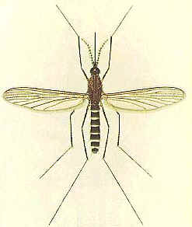
Culex
www.makemegenius.com Free Science Videos for Kids

Slide 8
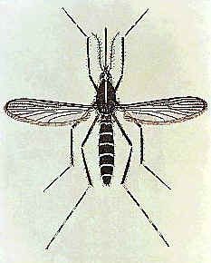
Aedes
www.makemegenius.com Free Science Videos for Kids

Slide 9
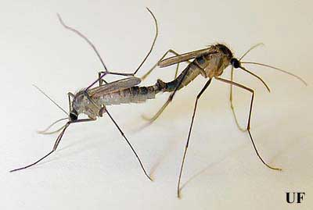
How to differentiate between male/female
Male mosquitoes tend to hatch before the females.
The male also has a feathery, plumose antenna in comparison to the female’s less bushy one.
The male’s antenna is used for sensing the high-pitched presence of female mosquitoes enabling mating.
Males generally have a shorter lifespan than females.
Males live only a few weeks as opposed to a female who can live for two months.
Male Right, Female Left
www.makemegenius.com Free Science Videos for Kids

Slide 10
Why are some people more attractive to mosquitoes than others?
Scientists are still investigating the complexities involved with mosquito host acceptance and rejection. Some people are highly attractive to mosquitoes and others are rarely bothered. Mosquitoes have specific requirements to satisfy and process many different factors before they feed. Many of the mosquito's physiological demands are poorly understood and many of the processes they use to evaluate potential blood meal hosts remain a mystery. Female mosquitoes use the CO₂ we exhale as their primary cue to our location.
www.makemegenius.com Free Science Videos for Kids

Slide 11
Why are some people more attractive to mosquitoes than others?
Dark colors capture heat and make most people more attractive to mosquitoes. Light colors refract heat and are generally less attractive. Detergents, fabric softeners, perfumes and body odor can counteract the effects of color. In most cases, only the mosquito knows why one person is more attractive than another.
www.makemegenius.com Free Science Videos for Kids

Slide 12
Diseases spread by Mosquitoes
Child with hypersensitivity to mosquito bites. Mosquito bites can produce a severe allergic reaction. In this case the child displayed both the immediate and the delayed type reactions. The scars on the forearms are due to necrotic changes which occurred during the delayed type reaction.
www.makemegenius.com Free Science Videos for Kids

Slide 13
Diseases spread by Mosquitoes
2. Parasitic diseases: Malaria and filariasis.
3. Virus diseases: Japanese encephalitis B, mainly by Aedes and Culex tritaeniorrhyncus. Dengue fever and yellow fever.
4. Mechanical transmitter: Some mosquitoes may carry fly eggs to humans, inducing myiasis.
www.makemegenius.com Free Science Videos for Kids

Slide 14
Video
Go to www.makemegenius.com to see a video on Mosquito Life cycle
www.makemegenius.com Free Science Videos for Kids

Slide 15
For Free
Science Videos for Kids
www.makemegenius.com Free Science Videos for Kids
www.makemegenius.com
Free Science Videos for Kids

