Slide 1
VERTEBRATES
WWW.MAKEMEGENIUS.COM FREE SCEINCE VIDEOS FOR KIDS

Slide 2
FREE SCIENCE VIDEOS
for Kids
www.makemegenius.com
WWW.MAKEMEGENIUS.COM FREE SCEINCE VIDEOS FOR KIDS

Slide 3
DEFINITION OF VERTEBRATES
organisms with many cells
heterotrophic
endothermic or ectothermic
WWW.MAKEMEGENIUS.COM FREE SCEINCE VIDEOS FOR KIDS

Slide 4
CHARACTERISTICS OF VERTEBRATES
Backbones
Protective skin covering
Inside or outside skeleton
Muscles
Blood that circulates through blood vessels or lungs for breathing
WWW.MAKEMEGENIUS.COM FREE SCEINCE VIDEOS FOR KIDS

Slide 5
Characteristics (continued)
Most have legs or fins for movement
Have a nervous system
A brain that processes information
Have sense organs ( ears or tongues
Have specialized organ systems
WWW.MAKEMEGENIUS.COM FREE SCEINCE VIDEOS FOR KIDS

Slide 6
VERTEBRATES ARE CLASSIFIED INTO
FIVE GROUPS
Fish
Amphibians
Reptiles
Mammals
Birds
WWW.MAKEMEGENIUS.COM FREE SCEINCE VIDEOS FOR KIDS

Slide 7
FISH
Have a backbone
Cold Blooded (ectothermic)
Obtain water through gills
Most lay eggs
Have fins
Live in water
WWW.MAKEMEGENIUS.COM FREE SCEINCE VIDEOS FOR KIDS

Slide 8
FISH CLASSIFICATION
Bony fish =are fish with bones
Jawless Fish=are fish without jaws
Cartilaginous Fish=are fish without bones, but have cartilage
WWW.MAKEMEGENIUS.COM FREE SCEINCE VIDEOS FOR KIDS

Slide 9
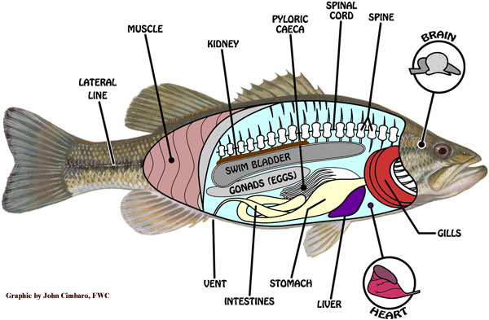
FISH ANATOMY
WWW.MAKEMEGENIUS.COM FREE SCEINCE VIDEOS FOR KIDS

Slide 10
AMPHIBIANS
Have a backbone
Are cold blooded
Can breathe with gills in early life:breathe with lungs as adults
Go thru Metamorphosis
Lay jelly like eggs
WWW.MAKEMEGENIUS.COM FREE SCEINCE VIDEOS FOR KIDS

Slide 11
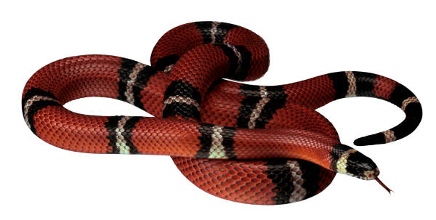
REPTILES
Have a backbone
Are cold blooded (ectothermic)
Breathe with lungs
Lay eggs
Some have fangs that inject venom into prey
Have one lung
No feet
Have no ears
WWW.MAKEMEGENIUS.COM FREE SCEINCE VIDEOS FOR KIDS

Slide 12
MAMMALS
Have backbones
Warm blooded (endothermic)
Breathe with lungs
Have babies that are born alive
Have fur or hair
Produce milk to feed their young
WWW.MAKEMEGENIUS.COM FREE SCEINCE VIDEOS FOR KIDS

Slide 13
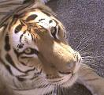


MAMMALS (CONTINUED)
WWW.MAKEMEGENIUS.COM FREE SCEINCE VIDEOS FOR KIDS

Slide 14
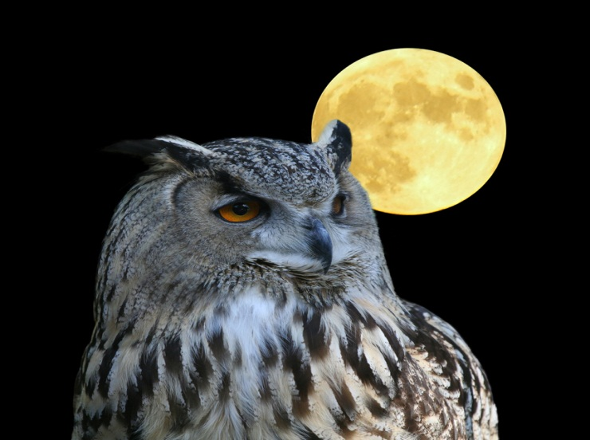
BIRDS
Are warm blooded (ectothermic)
Breathe with lungs
Lay eggs
Have feathers
Have a beak, two wings and two feet
WWW.MAKEMEGENIUS.COM FREE SCEINCE VIDEOS FOR KIDS

Slide 15

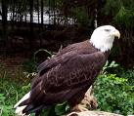

BIRD CLASSIFICATION
Birds are classified into three groups
Song birds Flightless Bird of Prey
WWW.MAKEMEGENIUS.COM FREE SCEINCE VIDEOS FOR KIDS

Slide 16
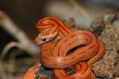


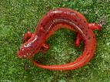
CLASSIFICATION
Which is Which? Classify the Vertebrates.
WWW.MAKEMEGENIUS.COM FREE SCEINCE VIDEOS FOR KIDS

Slide 17
FREE SCIENCE VIDEOS
for Kids
www.makemegenius.com
WWW.MAKEMEGENIUS.COM FREE SCEINCE VIDEOS FOR KIDS

