Slide 1
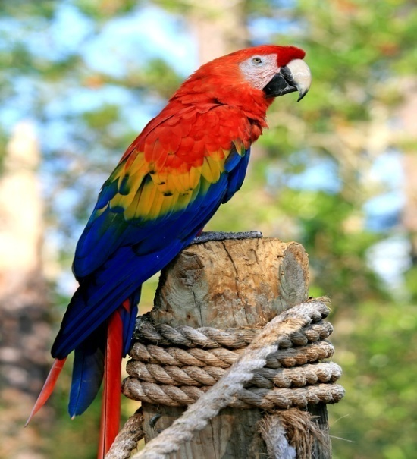
Beaks ,feet &claws of Birds
Parrot’s beak:- A Parrot have
a curved beak to
Crack fruits and
nuts and other
Foods . such beak is
Called curved beak.
Parrot’s toes :-
Parrot have two toes
forward and two
Backwards for climbing.

Slide 2
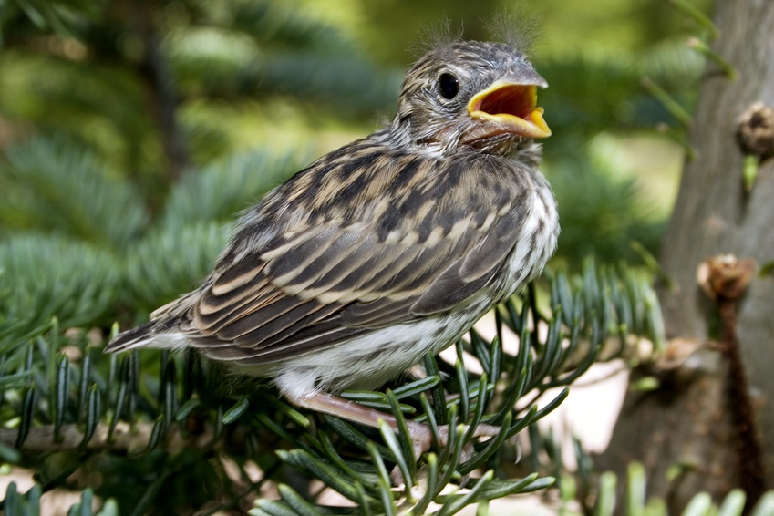
Sparrow’s beak:- A Sparrow have a short and hard beak for
Crushing seeds and grains before swallowing it.
Such beak is called crushing beak.
Sparrow’s toes & claws:- A Sparrow have long and slender claws with three toes in the front and one at the back to firmly hold a branch or a wire.

Slide 3
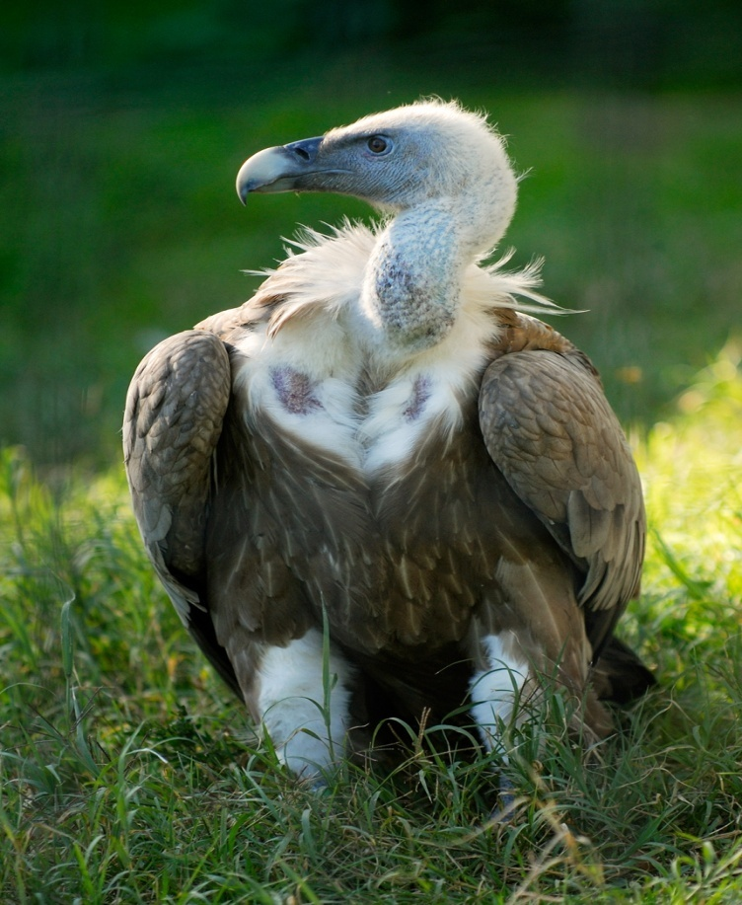
Vulture’s beak:- A vulture have a strong , hard and curved beak for tearing the flesh . Such beak is called tearing and piercing beak.
Vulture’s claws:- A Vulture have harp claws to firmly hold the prey
while flying.

Slide 4
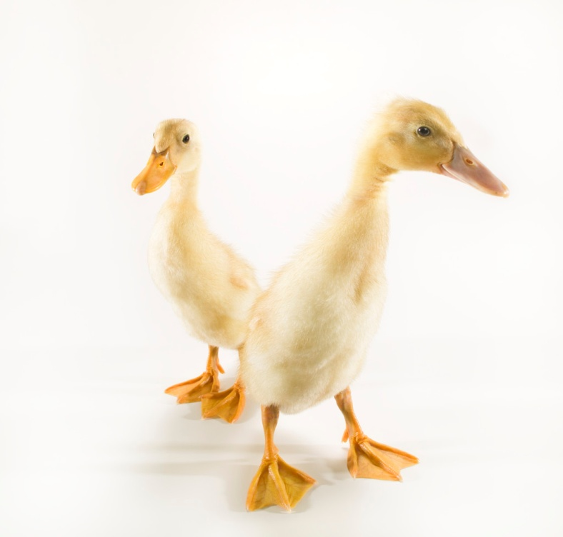
Duck’s beak:- A Duck has a flat and broad beak which has small holes on both sides . It digs up the food along with mud from the base of the pond or lake . Its beak pushes out mud and water from the holes leaving the food behind. This process is called sifting. Such beak is called sifting beak.
Duck’s feet :- A Duck have webbed feet for swimming in water.

Slide 5

THE
END
Submitted by:- shruti sail

