Slide 1
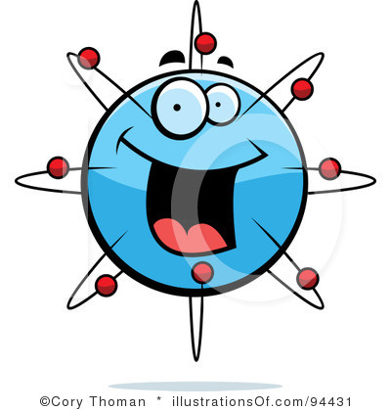
Atoms
www.makemegenius.com Free Science Videos for Kids

Slide 2
For Free
Science Video on
Atoms & other subjects for Kids
www.makemegenius.com Free Science Videos for Kids

Slide 3

Visit
www.makemegenius.com
www.makemegenius.com Free Science Videos for Kids

Slide 4
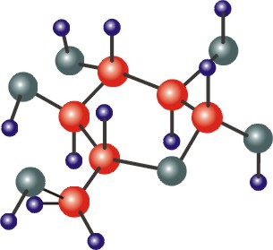

Remember that
everything is made
of atoms?
A stone, a pen,
a video game, a TV,
a dog and you too
are formed by atoms.
*
*
www.makemegenius.com Free Science Videos for Kids

Slide 5
ATOMS
Atoms are the smallest particle into which an element can be divided.
The basic building blocks of the "normal" matter that we see in the Universe are atoms, and combinations of atoms that we call molecules
Most of the mass of atoms resides in the neutrons and protons which occupy the dense central region called the nucleus
www.makemegenius.com Free Science Videos for Kids

Slide 6
What are the 3 major parts of an atom?
Proton
Neutron
Electron
www.makemegenius.com Free Science Videos for Kids

Slide 7
Nucleus
The nucleus is the central part of an atom. It is composed of protons and neutrons.
The nucleus contains most of an atom's mass.
It was discovered by Ernest Rutherford in 1911.
www.makemegenius.com Free Science Videos for Kids

Slide 8
Electron
Electrons are negatively charged particles that surround the atom's nucleus. Electrons were discovered by J. J. Thomson in 1897.
Electrons determine properties of the atom. Chemical reactions involve sharing or exchanging electrons.
www.makemegenius.com Free Science Videos for Kids

Slide 9
Neutron
Neutrons are uncharged particles found in the atomic nucleus. Neutrons were discovered by James Chadwick in 1932.
Experiments done in the late 1960's and early 1970's showed that neutrons are made from other particles called quarks. Neutrons are made from one 'up' quark and two 'down' quarks.
www.makemegenius.com Free Science Videos for Kids

Slide 10
Proton
Protons are positively charged particles found in the atomic nucleus. Protons were discovered by Ernest Rutherford..
Experiments done in the late 1960's and early 1970's showed that protons are made from other particles called quarks. Protons are made from two 'up' quarks and one 'down' quark.
www.makemegenius.com Free Science Videos for Kids

Slide 11
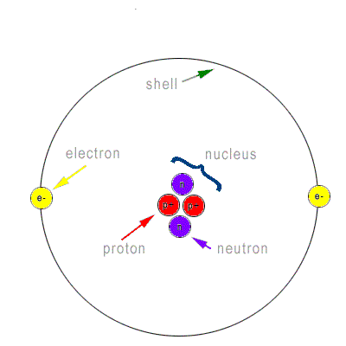
Draw a Diagram of an Atom
www.makemegenius.com Free Science Videos for Kids

Slide 12
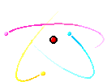
Atomic Structure
www.makemegenius.com Free Science Videos for Kids

Slide 13

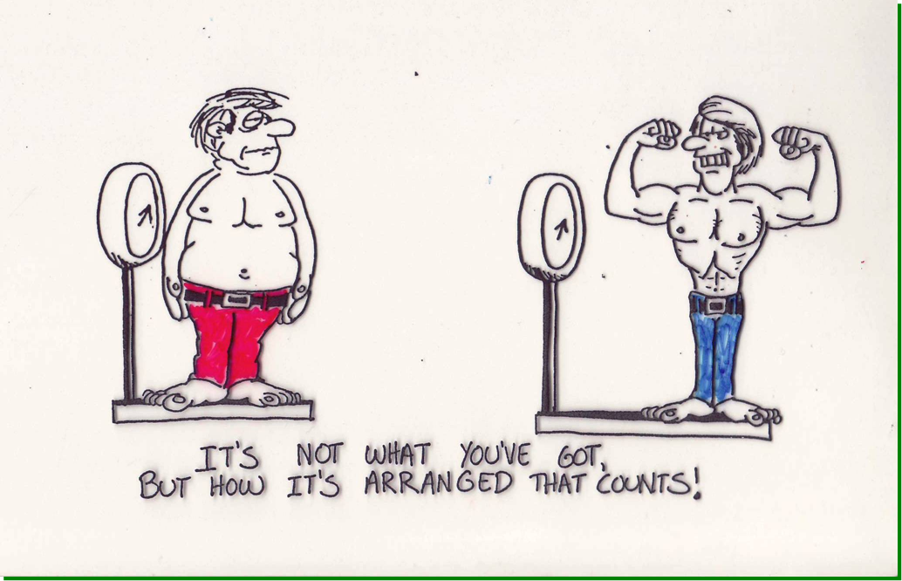
www.makemegenius.com Free Science Videos for Kids

Slide 14
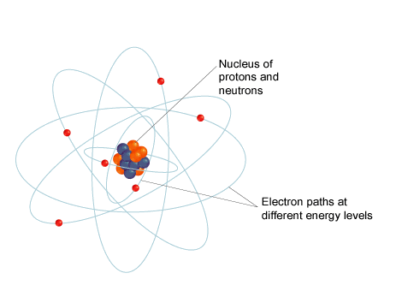
Draw a diagram showing the location of each part of the atom.
www.makemegenius.com Free Science Videos for Kids

Slide 15
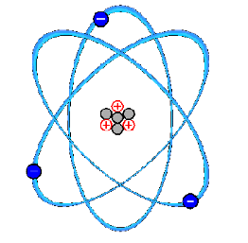
Draw a diagram showing the charges of each part of the atom.
www.makemegenius.com Free Science Videos for Kids

Slide 16
For Free
Science Video on
Atoms & other subjects for Kids
www.makemegenius.com Free Science Videos for Kids

