Slide 1

www.makemegenius.com– Full of ingredients to make your child a genius.
“Don’t make me read, make me understand “

Slide 2
FORCES
Is gravity real -
or does the Earth
just suck?

Slide 3
What do forces do?
Make things ----
move
move faster
move slower
change direction
also
change shape

Slide 4
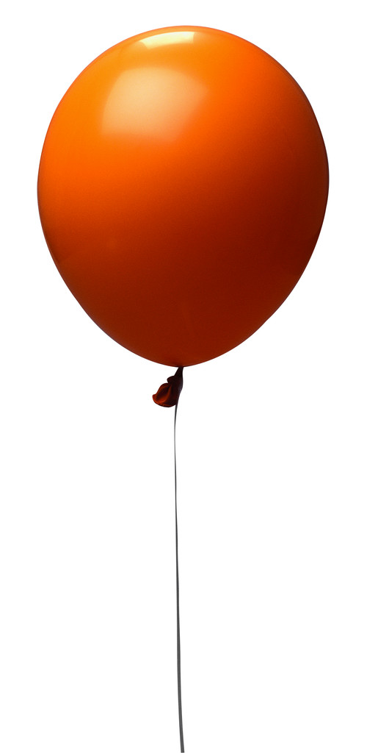
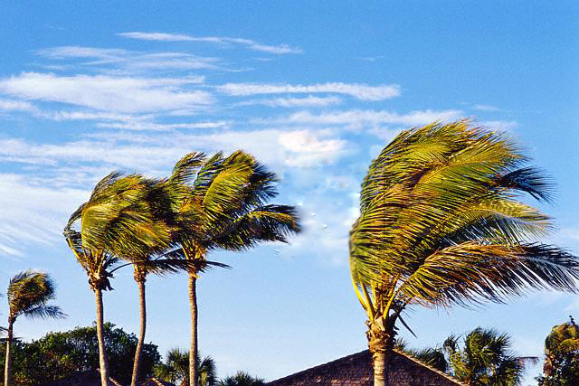
Big and little forces
We can measure forces
using a forcemeter

Slide 5
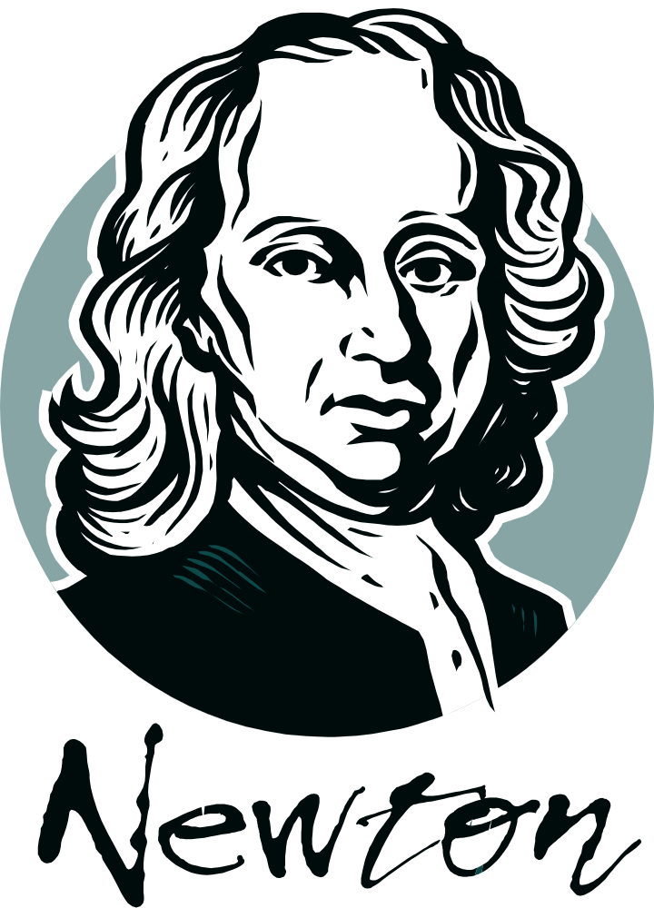
Sir Isaac Newton

Slide 6
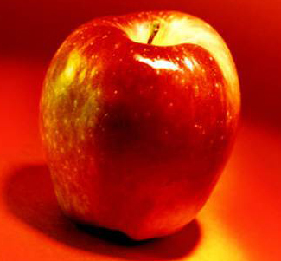
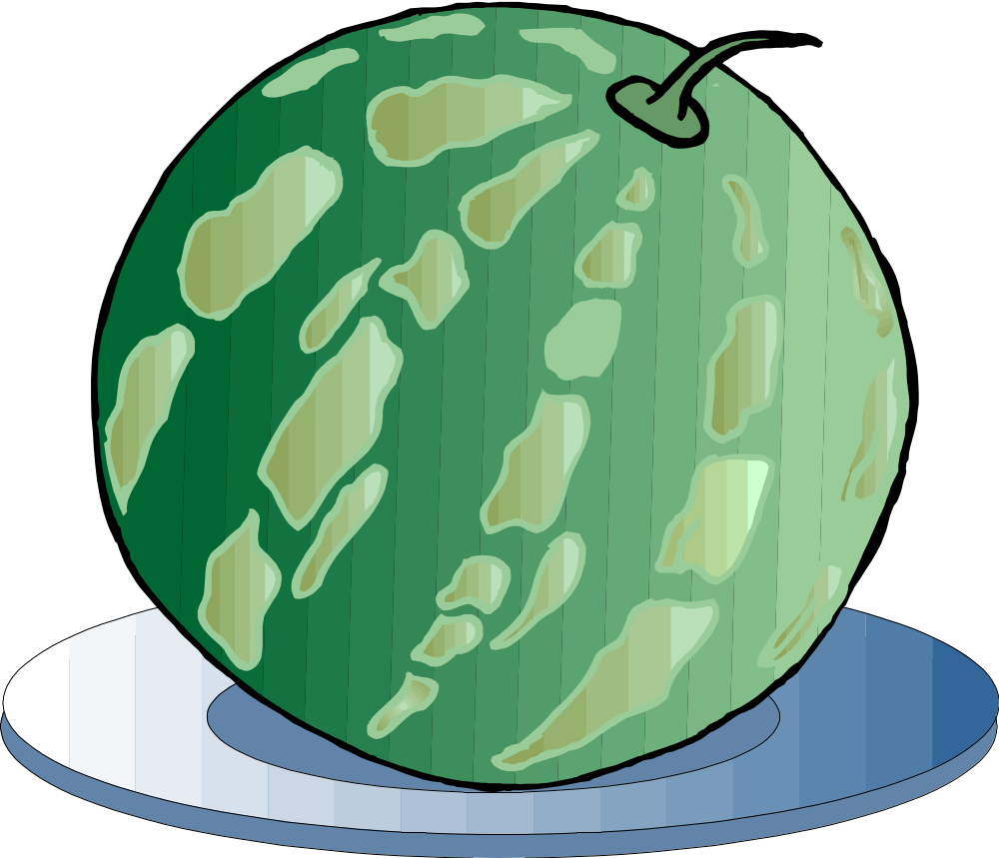
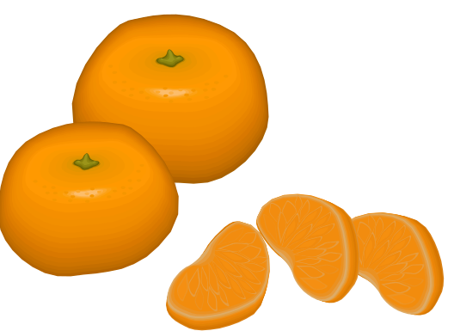
Which fruit ?

Slide 7
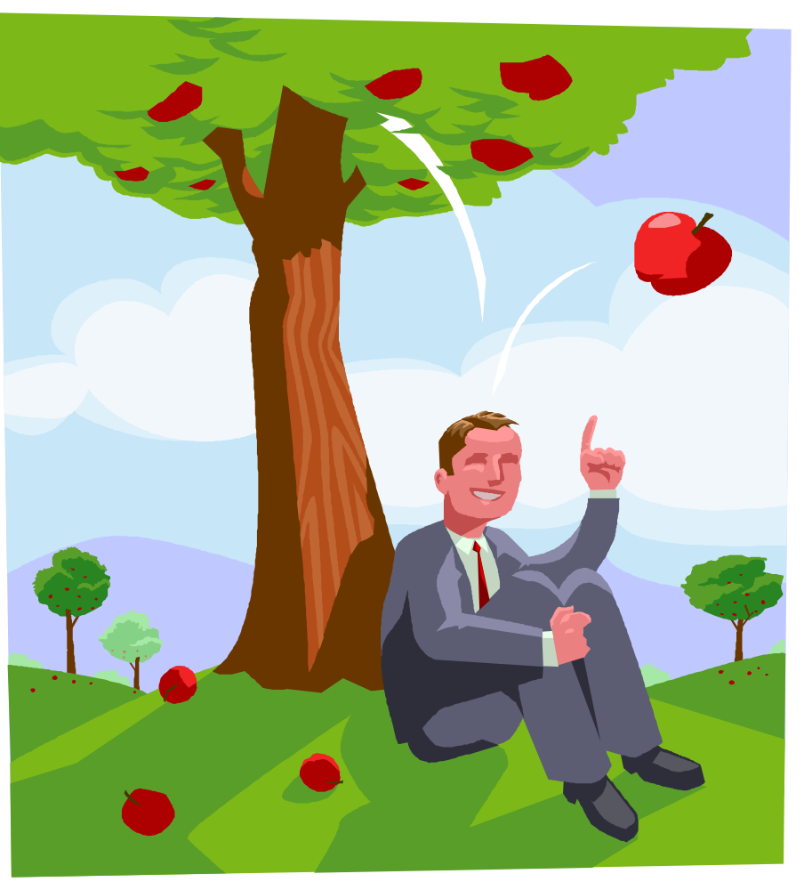
Newton?

Slide 8
Gravity is a force
When gravity pulls something towards the Earth -
- we call this force the weight.

Slide 9
Forces are measured in newtons
Weight of an apple = about 1 newton

Slide 10
Let’s play
a game !

Slide 11
Results
Measurement in newtons | A | B | C
Predicted
Real

Slide 12
Now another game!

Slide 13
Lifting a ping pong ball
.
Suck !
straw

Slide 14
ping pong ball falling
The arrow represents the force of gravity

Slide 15
The ball does not fall when your upward force = force of gravity
suck
straw
How have I shown this ?
gravity

Slide 16
Which diagram shows the upward force equal to the force of gravity?
suck
suck
suck
straw
straw
straw
gravity
gravity
gravity

Slide 17
The ball does not fall when your upward force = force of gravity
suck
straw
gravity

Slide 18
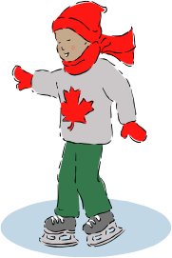
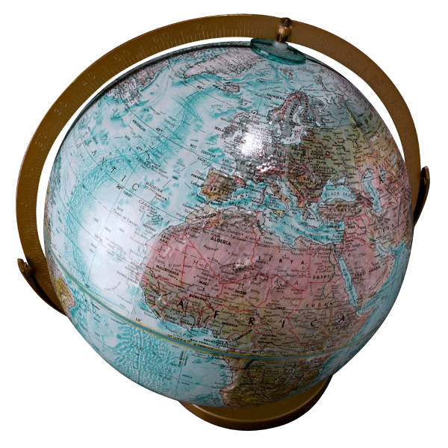
Gravity down under
People do not fall off the Earth

Slide 19
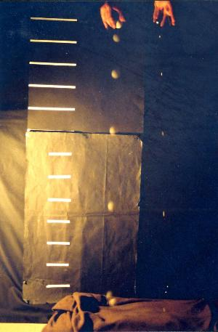
two objects dropped at the same time

Slide 20
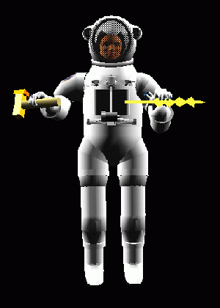
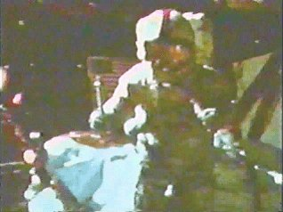
On the Moon – Apollo 15
A heavy geological hammer and a falcon feather were dropped from the same height.
They hit the lunar surface at the same time.
astronaut David Scott

Slide 21
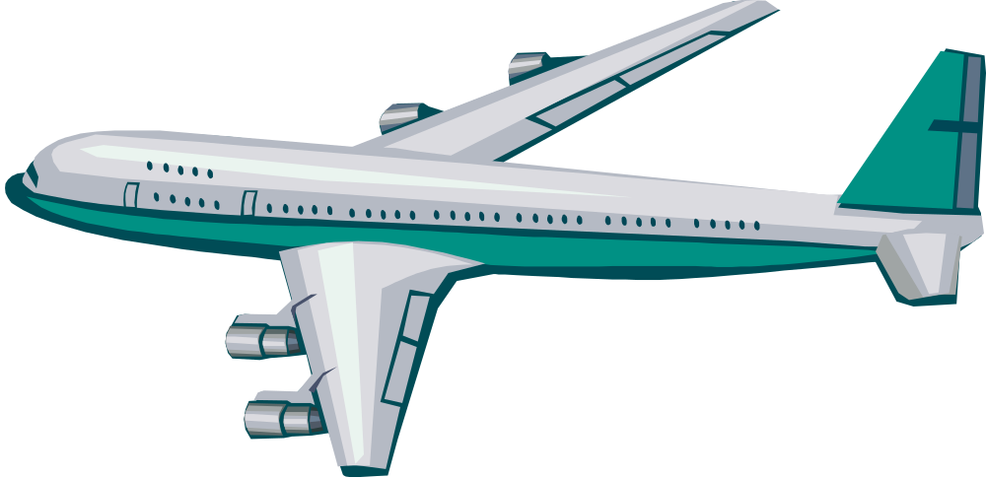
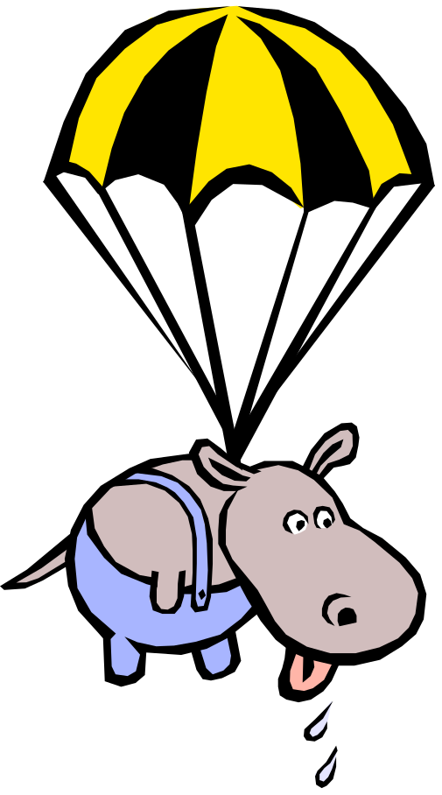
Hippo jump

Slide 22
Hippo jump
force of gravity

Slide 23
Saved?

Slide 24
Hippo is still falling quickly

Slide 25
Hippo is still falling quickly but not getting faster
air resistance
How do we know?
force of gravity

Slide 26
How can we slow Hippo down?
What can you change?

Slide 27
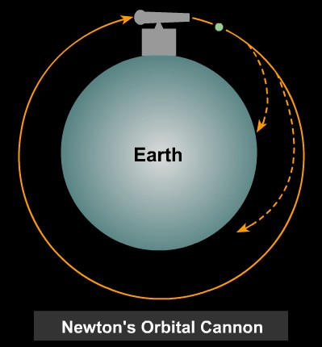
Launching a satellite
The cannon ball must move very quickly to orbit the earth.
The Moon orbits the Earth.

Slide 28
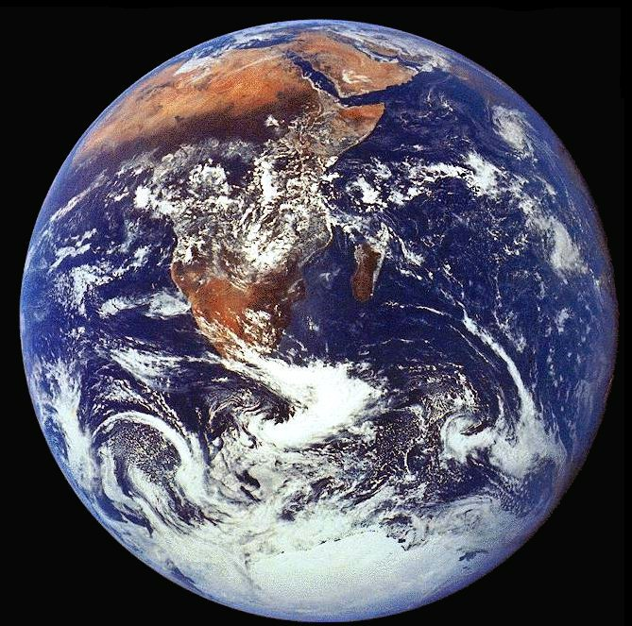
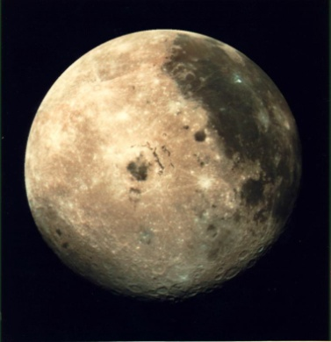
The Moon
The Earth

Slide 29
The Moon
The Earth

Slide 30
Very heavy boots- why?
Answers?
No gravity on the Moon
Weightless on the Moon
To stop them floating away
They weigh very much less than on Earth
To stop huge bounces
The Moon’s gravity is very much less than the Earth’s gravity

Slide 31
GRAVITY
Things fall
Things have weight
Things stay in place

Slide 32
No Gravity
Would an apple fall?
Would things stay on earth?
What would happen?
What?
Why?
How?
Keep asking questions
-like Newton!

Slide 33
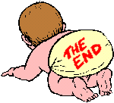
Thanks
Submitted by
Piyush
St.Paul Public School
Noida

Slide 34
If you also want to share your own or your kid’s presentation(ppt) please send it on info@makemegenius.com

Slide 35
www.makemegenius.com– Full of ingredients to make your child a genius.
“Don’t make me read, make me understand “

