Slide 1

Gravity
What is gravity?
www.makemegenius.com Free Science Videos for Kids

Slide 2
For Free
Science Videos for Kids
www.makemegenius.com Free Science Videos for Kids
www.makemegenius.com Free Science Videos for Kids

Slide 3


Gravity
Gravity is a force between ALL objects!
Gravity
www.makemegenius.com Free Science Videos for Kids

Slide 4
GRAVITY DEFINED
Gravity is the tendency of objects with mass to accelerate towards each other
Gravity is one of the four fundamental forces in nature.
www.makemegenius.com Free Science Videos for Kids

Slide 5
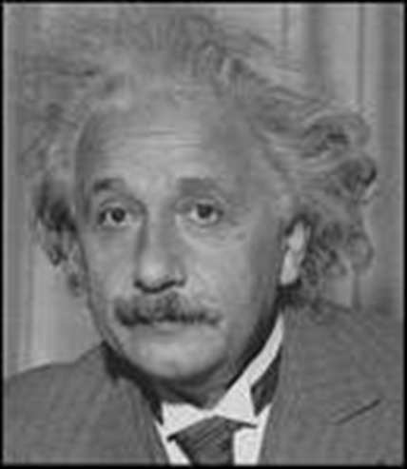
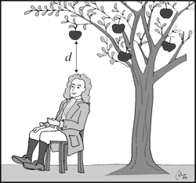
THE HISTORY OF GRAVITY
Sir Isaac Newton
wrote the
Law of Gravitation in 1687
www.makemegenius.com Free Science Videos for Kids

Slide 6
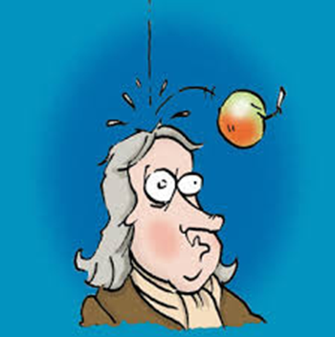
UNIVERSAL LAW OF GRAVITATION
There is an
apple
on my head
Gravity is greater when mass is larger
and distance is shorter.
www.makemegenius.com Free Science Videos for Kids

Slide 7


Law of Gravity
The size of the force depends on the mass of the objects. The bigger they are, the bigger the force!
Small attractive force
Bigger attractive force
www.makemegenius.com Free Science Videos for Kids

Slide 8



Law of Gravity
The size of the force also depends on the distance between the objects.
www.makemegenius.com Free Science Videos for Kids

Slide 9
Gravity and our Solar System
The Sun’s gravity is what holds our solar system together.
Since Jupiter is the largest planet, it has the most gravity.
Pluto has the least amount of gravity of all the planets
www.makemegenius.com Free Science Videos for Kids

Slide 10
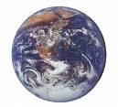
Gravity
The force of gravity on something is called its weight. Because it is a force it is measured in Newtons.
Weight
www.makemegenius.com Free Science Videos for Kids

Slide 11

Mass
Mass is a measure of the amount of material an object is made of. It is measured in kilograms.
www.makemegenius.com Free Science Videos for Kids

Slide 12
Mass and weight
Mass is a measure of the amount of material an object is made of. It is measured in kilograms.
Weight is the force of gravity on an object. It is measured in Newtons.
www.makemegenius.com Free Science Videos for Kids

Slide 13
Mass and Weight are two different Properties of Matter
MASS
Mass is a physical property of matter that explains how much matter is in an object
Mass does not change when gravity changes
WEIGHT
Weight is a force which is calculated by multiplying the acceleration of gravity times mass.
Weight can change when gravity changes
www.makemegenius.com Free Science Videos for Kids

Slide 14

Easy isn’t it?
www.makemegenius.com Free Science Videos for Kids

Slide 15
For Free
Science Videos for Kids
www.makemegenius.com Free Science Videos for Kids
www.makemegenius.com Free Science Videos for Kids

