Slide 1

www.makemegenius.com– Full of ingredients to make your child a genius.
“Don’t make me read, make me understand “

Slide 2

Photosynthesis

Slide 3
How do plants make their own food ?

Slide 4
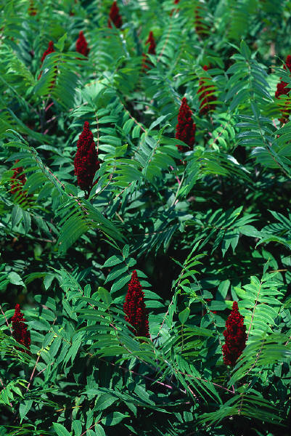
Making food
Green plants are the only living things which can make their own food.
This process is called photosynthesis.

Slide 5
Making food
Leaves are green in colour because they contain chlorophyll.
Chlorophyll is needed in photosynthesis.

Slide 6


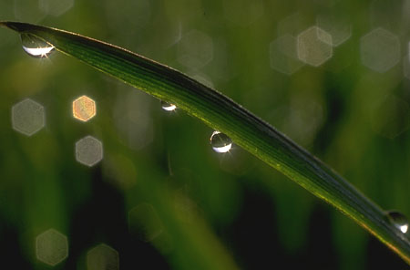
What does the plant need ?
For photosynthesis to take place a plant needs :
Carbon dioxide from the air
Light from the sun
Water from the rain
Chlorophyll from the leaves

Slide 7
What then … ?
When the plant has all of these things …
… photosynthesis can take place.
The plant produces sugar and oxygen.

Slide 8
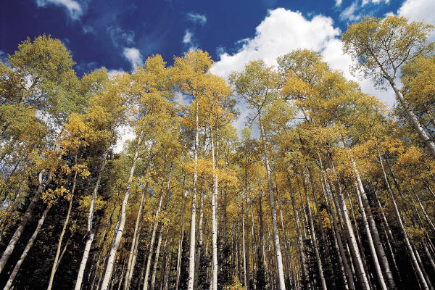
A closer look at photosynthesis
Food out
Oxygen out
1. Carbon dioxide in
2. Light in
3. Water in
4. Chlorophyll is already in green leaves

Slide 9
Photosynthesis in Overview
Process by which plants and other autotrophs store the energy of sunlight into sugars.
Requires sunlight, water, and carbon dioxide.
Overall equation:
6 CO₂ + 6 H₂0 → C₆H₁₂O₆ + 6 O₂
Occurs in the leaves of plants in organelles called chloroplasts.

Slide 10
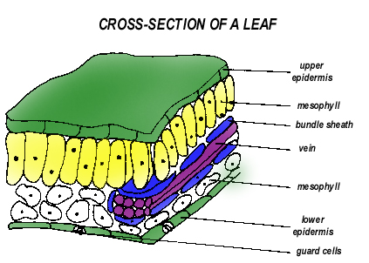
Leaf Structure
Most photosynthesis occurs in the palisade layer.
Gas exchange of CO₂ and O₂ occurs at openings called stomata surrounded by guard cells on the lower leaf surface.
Palisade
Spongy

Slide 11
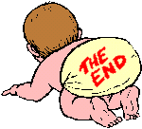
Thanks
Submitted by
Ajit
St. Paul’s Public School

Slide 12
If you also want to share your own or your kid’s presentation(ppt) please send it on info@makemegenius.com

Slide 13
www.makemegenius.com– Full of ingredients to make your child a genius.
“Don’t make me read, make me understand “

