Slide 1
Objective - To represent functions using models, tables, graphs, and equations.
Function - A rule that describes a dependent
relationship between two quantities.
Domain - The set of input values in a
function.
Range - The set of output values in a
function.

Slide 2
Model:
Let n = # of triangles
Let p = the perimeter of each figure
Table:
Graph:
Equation:
Dependent
p
n
p
p = n + 2
8
7
6
5
4
3
2
1
1
3
Dependent
2
4
perimeter
3
5
Line is discrete
4
6
5
7
0 1 2 3 4 5 6 7
n
# of triangles
6
8

Slide 3
Model:
Let n = # of hexagons
Let p = perimeter of figure
Table:
Graph:
Equation:
Dependent
p
n
p
p =
4n + 2
30
25
20
15
10
5
1
6
2
10
Dependent
perimeter
3
14
Line is discrete
4
18
5
22
0 1 2 3 4 5 6 7
n
6
26
# of hexagons

Slide 4
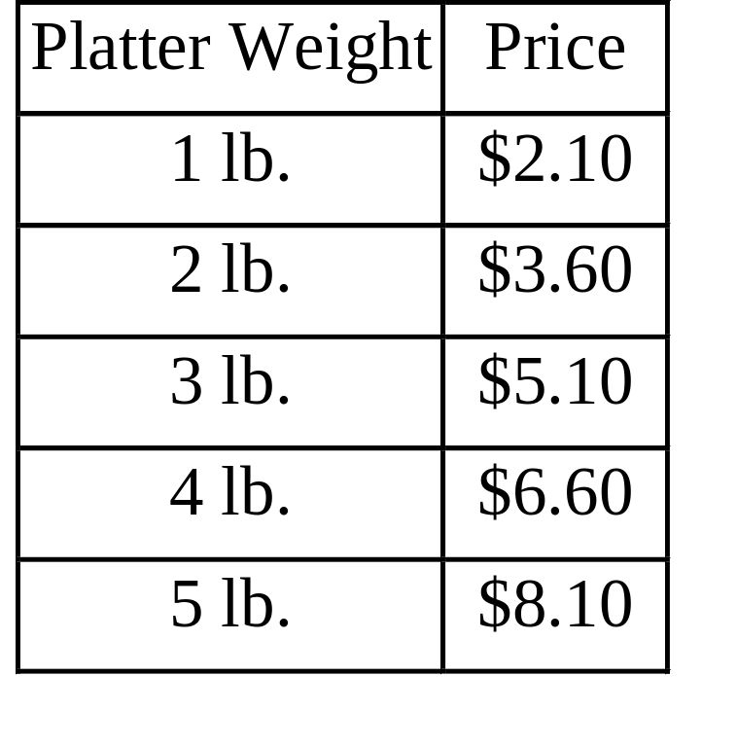
This chart shows the price
of sliced fruit platters.
1) How much would a
6 lb. platter cost?
$8.10 + 1.50 = $ 9.60
1.50
1.50
2) Write an equation for
the cost of a platter that
weighs w lbs.
1.50
1.50
Let p = price of platter
3) How much would a 10 lb.
platter cost?
p = 1.50 w +
0.60
p = 1.50 w + 0.60
Change
Start
Value
p = 1.50 ( 10 ) + 0.60
p = 15.00 + 0.60 = $15.60

Slide 5
A taxi cab charges a flat rate of $2.50 and 15 c
per mile. Write a linear equation for the charge
in terms of the number of miles driven.
Let C = charge in dollars
Let m = # of miles driven
C = 2.50 + 0.15 m
Start
Value
Change

Slide 6
A phone company charges $17.50 per month and 12 c for each additional minute . Write a linear equation for the charge in terms of the number of minutes.
Let C = charge in dollars
Let m = # of minutes
C = 17.50 + 0.12 m
Start
Value
Change

Slide 7
A car’s fuel tank is filled at a rate of 1.6 gal/min.
The tank held 5 gallons of gas before refueling.
Let m = # of minutes
Let V = Volume of gas in tank
Equation:
V = 5 + 1.6m
Table:
Graph:
30
25
20
15
10
5
m
V
0
2
4
6
8
10
5
8.2
11.4
14.6
17.8
21
Volume
of gas
in tank
Line is continuous
0 2 4 6 8 10 12
# minutes

