Slide 1
1.)Simplify
[5 • (3 + 2)] + 6
[5 •(5)] + 6
[ 25] + 6
31

Slide 2
2.) Evaluate 6p - 3q when p = 2 and q = 4
2.) 6p - 3q
6(2) - 3(4)
12 - 12
0

Slide 3
3.) A football field is 120 yards long and 55 yards wide. How many square yards?
L = 120 & W = 55
120 • 55 = 6600

Slide 4
4.) Evaluate the Expression (x + y)² for x = 5 & y =6
(5 + 6)²
(11)²
121

Slide 5
5.) Evaluate the Expression 11+ (4 • 2)² -8.
11+ (4 • 2)² -8
11+ (8)² -8
11 + 64 - 8
67

Slide 6
6.) What is the solution of:
3x - 6 < 15
3x - 6 < 15
3x - 6 + 6 < 15 + 6
3x < 21
3x/3 < 21/3
x < 7

Slide 7
7.) Express the phrase as an equation.
The quotient of 64 and a number is four.
64/x = 4

Slide 8
8.) Find the increase of females employed.
M
60
M
F
10
40
F
Percentage of employees
20
1980
1990
Year

Slide 9
9.) Place the following numbers in order from least to greatest
|-7|, ½, -6, 2.3, 0, -½, 5
-6, -½, 0, ½, 2.3, 5, |-7|

Slide 10
10.) Which country is closest to Greenwich Standard Time?
Country Standard Time
Greenwich 0
Brazil -5
Egypt +3
France -2
China +8

Slide 11
11.) Evaluate |y| - |x| when y = 5 and x = -2
|y| - |x|
|5| - |-2|
5 - 2
3

Slide 12
12.) Evaluate
-14 - 6 + (-10)
-14 - 6 + (-10)
-20 + (-10)
-30

Slide 13
13.) Simplify:
-(-7) - (-2) + 1
-(-7) - (-2) + 1
7 + 2 + 1
10

Slide 14
14.) Find the sum
42 -22 -8 12
21 -10 4 -5
34 -10
25 -15
+

Slide 15
15.) Write the table as a matrix.
45 215
18 290
6 150

Slide 16
16.) Find the difference
3 6 4 9
5 8 -3 6
-1 -3
8 2
-

Slide 17
17.) Find the Product:
(6)(-7)(2)
(6)(-7)(2)
(-42)(2)
-84

Slide 18
18.) Use the distributive property to rewrite the expression 7(x - 2)
7(x - 2)
7x - 14

Slide 19
19.) Simplify 4(3-x) -3(4 -x)
4(3-x) -3(4 -x)
12 - 4x -12 + 3x
-x

Slide 20
20.) Evaluate 2ab when a=6 & b=8 2a - 4
2(6)(8)
2(6) - 4
96
12 - 4
96
8
12

Slide 21
21.) Janice wrote 42 sentences in 14 minutes. How many sentences did she write in 1 minute.
42 ÷ 14 = 3

Slide 22
22.) State the 1st step for solving the equation:
x + 6 = 24
Subtract 6 from both sides
x + 6 - 6 = 24 - 6

Slide 23
23.) Solve ¼x = 28
What’s the Trick?
¼x = 28
(4)¼x = 28(4)
x = 112

Slide 24
24.) State the 1st step for solving the equation:
x - 3 = 28
5
Add 3 to both sides
x - 3 + 3 = 28 + 3
5

Slide 25
25.) Solve 8x + 3 = 67
8x + 3 = 67
8x + 3 - 3 = 67 - 3
8x = 64
8x/8 = 64/8
x = 8

Slide 26
26.) Solve 32 + 6r = -4 + 3r
32 + 6r = -4 + 3r
32 + 6r - 3r = -4 + 3r - 3r
32 + 3r = -4
32 - 32 + 3r = -4 - 32
3r = -36
3r/3 = -36/3
r = -12

Slide 27
27.) Sales tax of 7% on $82
Find the total price.
82 • .07 = 5.74
82
+ 5.74
87.74

Slide 28
28.) Solve for t:
-9 = t - 5s
-9 = t - 5s
-9 + 5s = t - 5s + 5s
-9 + 5s = t

Slide 29

29.) Name the coordinates
(-3, 2)
A
(6, 5)
Y
B
X
D
C
(7, 0)
(-6, -3)

Slide 30
30.) Describe the relationship
100
80
60
40
20
0
6
12
18
24
30
36

Slide 31
31.) Graph y = -2
Y
X

Slide 32

32.) Graph 3x -6 = y
Y
X
-6

Slide 33
33.) Find the x and y intercepts for 4x + 2y = 12
4x + 2y = 12
4(0) +2y=12
2y=12
y = 6
4x + 2y = 12
4x +2(0)=12
4x=12
x = 3

Slide 34
34.) Graph 4x + 2y = 12
using the intercepts in #33
6
Y
X
3

Slide 35
35.) Find the slope of the line passing thru A(-4,-3) & B(-2, 4)
4 - -3
-2 - -4
7
2

Slide 36

36.) Find the slope of the line passing thru (-5, 3) & (6, 3)
3 - 3
6 - -5
0
11
Slope = 0

Slide 37
37.) Given the equation, y = 5x -3, state its slope.
Slope = 5

Slide 38
38.) Rewrite the equation in slope-intercept form.
7x - 2y - 3 = 0
7x - 2y - 3 = 0
7x - 7x - 2y - 3 = 0 -7x
-2y - 3 + 3 = -7x + 3
-2y/-2 = (-7x + 3)/-2
y = 7/2x + 3/2

Slide 39
39.) Graph y = 2/3x - 2
Y
X
-2

Slide 40
40.) Write another equation that is parallel to 3x - 6y = 12.
3x - 6y = 12
3x - 3x - 6y = -3x + 12
-6y = -3x + 12
-6y/-6 = (-3x + 12)/-6
y = 1/2x -2
y = 1/2x + ?

Slide 41
41.) Graph f(x) = |x + 4|
Y
X
-4

Slide 42
42.) Find an equation in slope-intercept form of a line having slope = -3 and y-intercept = -2.
Y = -3x -2

Slide 43
43.) Find an equation in slope-intercept form of a line that passes thru the point (4, -1) with slope = 3.
Y- -1 = 3(x -4)
y + 1 = 3x - 12
y + 1 - 1 = 3x - 12 - 1
y = 3x - 13

Slide 44
44a.) Find an equation with: a.) slope = 0 and passes thru the point (3,2)
Y- 2 = 0(x -3)
y - 2 = 0
y - 2 + 2 = 0 + 2
y = 2

Slide 45
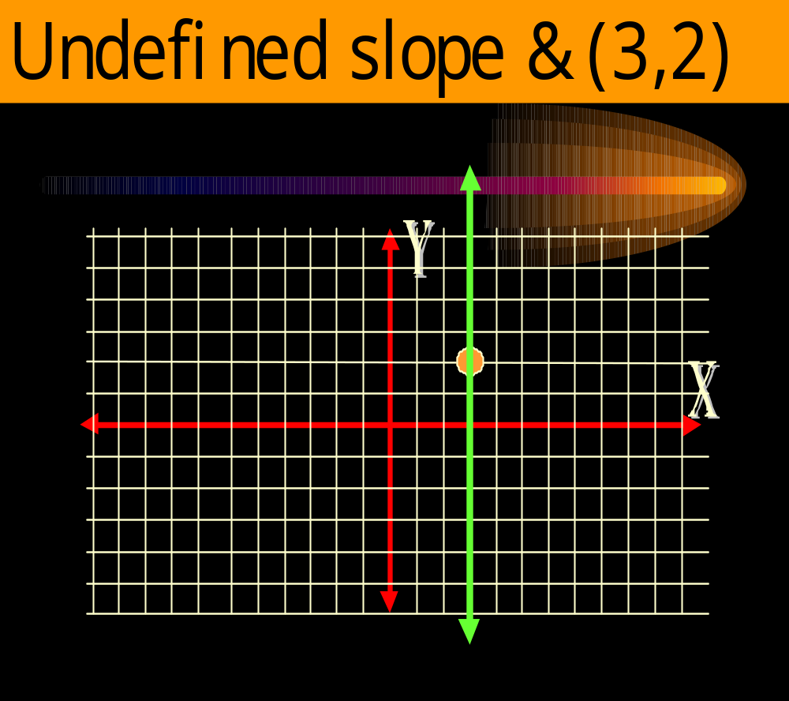
44b.) Find an equation with: b.) undefined slope and passes thru the point (3,2)
x = 3

Slide 46

45.) Write an equation in slope-intercept form of a line that passes thru the points (0, 2) & ( -4, -6)
-6 - 2
-4 - 0
-8
-4
slope = 2

Slide 47
45.) Write an equation in slope-intercept form of a line that passes thru the points (0, 2) & ( -4, -6)
Y- 2 = 2(x - 0)
y - 2 = 2x
y - 2 + 2 = 2x + 2
y = 2x + 2

Slide 48
46.) Write the equation
Y
X
Y = 2/3x + 2

Slide 49
47.) Write the equation y = -1/6x + 5/6 in standard form with integer coefficients.
(6)y =(-1/6x + 5/6)(6)
6y = -1x + 5
6y + 1x = -1x + 1x + 5
1x + 6y = 5

Slide 50


48.) Write a point-slope equation of a line that passes thru the points
(1, 2) & ( 4, -1). Use (1, 2) as (x₁, y₁)
-1 - 2
4 - 1
-3
3
slope = -1
y - 2 = -1(x - 1)

Slide 51
49.) Write the equation of a line that is parallel to y = 2x + 4 and goes thru the point (2, 5).
Y - 5 = 2(x - 2)
y - 5 = 2x - 4
y - 5 + 5 = 2x - 4 + 5
y = 2x + 1

Slide 52
50.) Solve |x +7| = 10
x + 7 = 10
x+7-7=10-7
x = 3
x + 7 = -10
x+7-7=-10-7
x = -17

