Slide 1
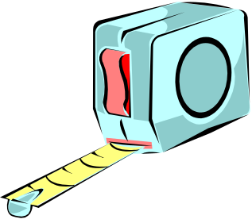

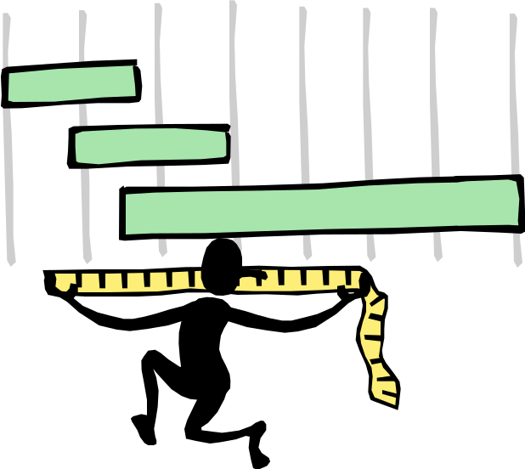
Measurement
Perimeter
Area
Applications
Objectives
By: April Rodriguez, Betty Williams,
Lisa Gilkerson, Catherine Brown

Slide 2
Measurement Objective:
The student will describe and determine the perimeter of a polygon and the area of a square, rectangle, and triangle, given the appropriate measures. SOL 5.8

Slide 3


Do you know how to calculate the perimeter of a polygon?

Slide 4



Polygons come in all shapes and sizes.

Slide 5
To find the perimeter of a polygon, do the following:
STEP 1 Write down the length of every side.
STEP 2 Add the lengths of every side.
STEP 3 Write your answer in the same units labeled on the figure.
4cm
3cm
3cm
4cm
3cm+ 4cm+ 3cm+ 4cm=
14cm

Slide 6
Sometimes a polygon will only be labeled with one or
two measurements. You will have to determine the missing
measurements by using what you know about squares, rectangles and other equal sided polygons.
Click on the polygon to check your answer.
4.5mm
2ft.
1ft.
1ft.
7m
6m
5.6dm
3.4dm

Slide 7
What’s the perimeter?
4.5mm
4.5mm
4.5mm
27 mm
4.5mm
4.5mm
4.5mm

Slide 8
What’s the perimeter?
0.5ft
2ft
1ft
8 ft
1ft
1ft
0.5ft
2ft

Slide 9
What’s the perimeter?
7m
6m
6m
6m
6m
76m
7m
7m
6m
6m
6m
6m
7m

Slide 10
What’s the perimeter?
5.6dm
3.4dm
3.4dm
24.8dm
3.4dm
3.4dm
5.6dm

Slide 11
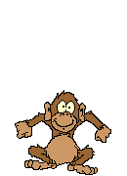
Do you think you can calculate the
perimeter of a polygon now?

Slide 12
MEASUREMENT
-to determine the area of a square, rectangle, and triangle given the appropriate measures

Slide 13
MEASUREMENT - AREA
-the area measures the surface of a simple closed figure
5.8 The student will determine the area of a:
  square
  rectangle
  triangle

Slide 14

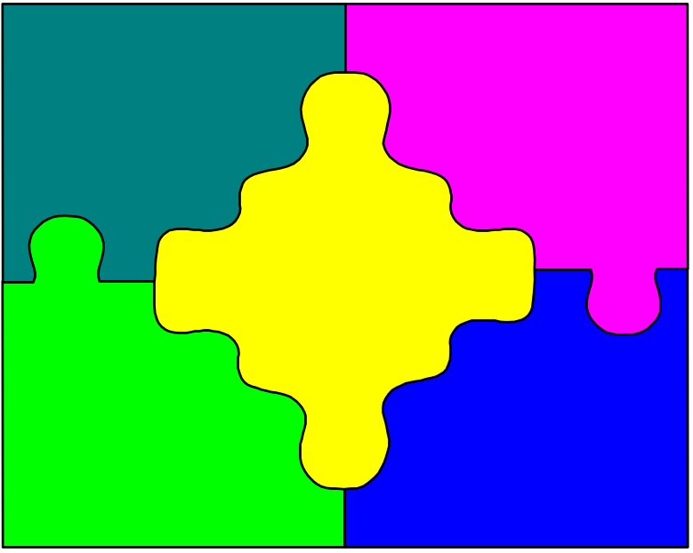
A = l x w
(l=length; w=width)
Area of a Square
8
What do
you mean?
7
A = 8 x 7
A = 56 square units

Slide 15
The area of a figure
is a measure of how much surface is covered
by the figure.
Area is measured in
square units.
This figure contains 2 squares.
The area of this
figure is 2 squares.
Area = 6 sq cm

Slide 16
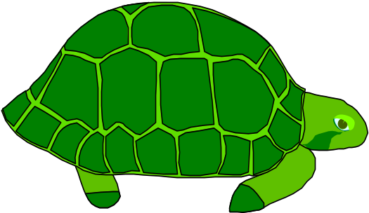

Area of a Rectangle =
base x height
Where's he
going with
the sandbox?
b=30cm
h=5cm
30cm x 5cm=150cm²
Will this
fit in
my house?
30cm
5
cm

Slide 17
Area of a triangle = one half of the base times the height
Formula: A=1/2 x b x h
b = base; h = height
AB = base
c
A = 1/2 x bxh
CD = height
A = 1/2 x(14x8)
height = 8ft.
A = 1/2 x 112
A
B
A = 56 sq.ft.
D
base = 14ft.
triangle - 3-sided polygon

Slide 18

Test Your Knowledge
Find the area of these scale drawings.
7 ft.
17 ft.
10 ft.
7 ft.
7 ft.
7 ft.
10 ft.
12 ft.
Click inside each shape for the answer.

Slide 19
7 ft.
7 ft.
7 ft.
7 ft.
28 ft.

Slide 20
17 ft.
10 ft.
54 ft.

Slide 21
Remember:
A = ½ by B x H
A = ½ x ( 10 x 12)
A = ½ x 120
A = 60 ft.
10 ft.
12 ft.
60 ft.

Slide 22

We need a new fence at our soccer field. What should we do?
Click your mouse on the first thing you must do.
  Buy the materials
  Measure the distance around the field
  Add the measurements up.

Slide 23

Sorry this step would come last
Foul!

Slide 24

Sorry but this would be the second step.
Think,
think,
think!

Slide 25
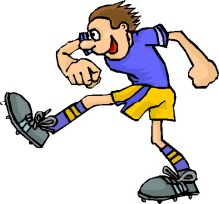
You scored a goal!
First you must measure the distance or perimeter around the field.
Next you can add up the measurement of all sides.
Then you can figure out how much material to buy.

Slide 26


Now, please do the math!
180 yd
180 yd
The fence around the field is a pentagon shape.
Side one is 288 yards.
Sides two and five are 278 yards.
278 yd
278 yd
Sides three and four are 180 yards.
Click here for Answer.
288 yd

Slide 27
The Answer is:
1204 yards.

Slide 28
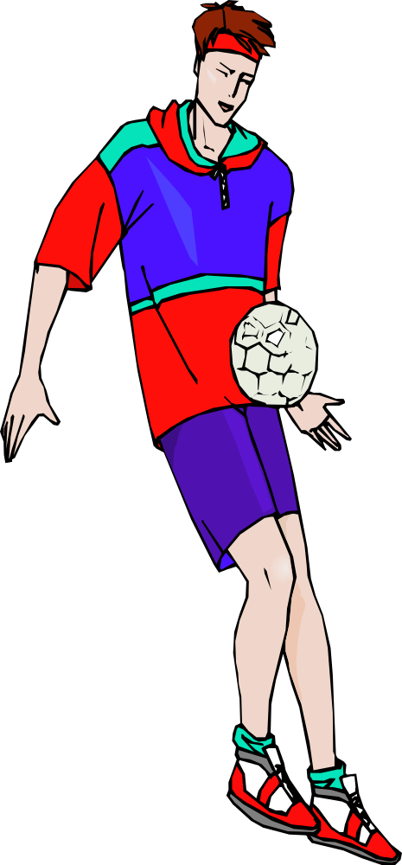
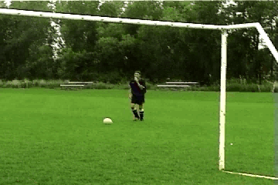
Although I love soccer, my summer job is working at RFK, the old Washington Redskins Stadium. We have to plant new grass. Whew, we have a lot of yardage to cover! Boy, knowing about perimeter and area would really help me right now!

Slide 29
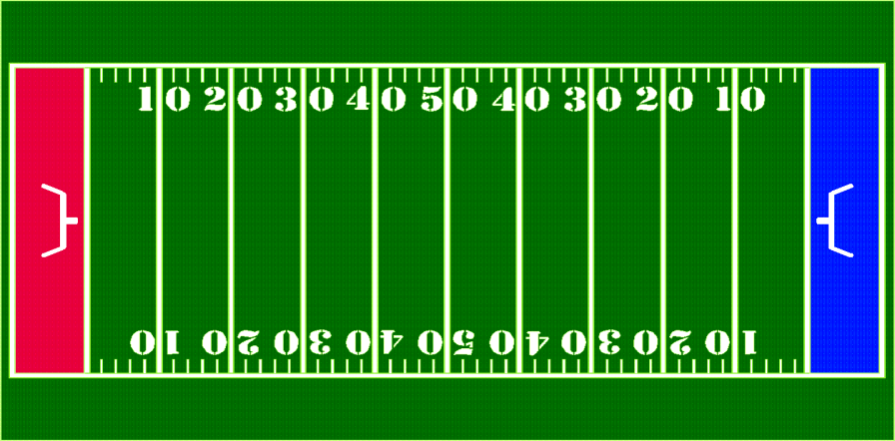
Now, what should we do?
We are planning to sod the Redskins football field. Would we use perimeter or area to find the amount of sod needed to cover the field with grass? Do you know which measurement to use?

Slide 30
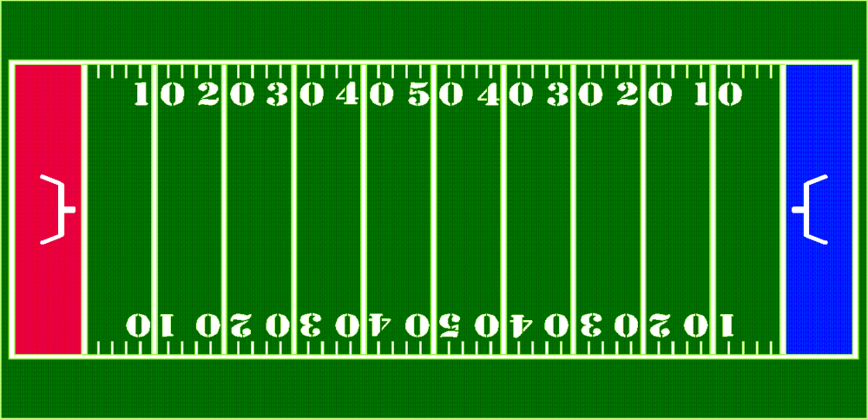
You did say area, right? Remember, area is the number of square units, or units², needed to cover the surface.
length
The formula for finding the area of any rectangular shaped object is:
width
A = length x width = units squared
A= (L x W)²

Slide 31

How much sod is needed to cover the entire football
field with grass? Use the formula to find out.
120 Yards
53 Yards
Click here for your answer.
A. 6,260 yards B. 6,300 yards
C. 6,360 yards

Slide 32
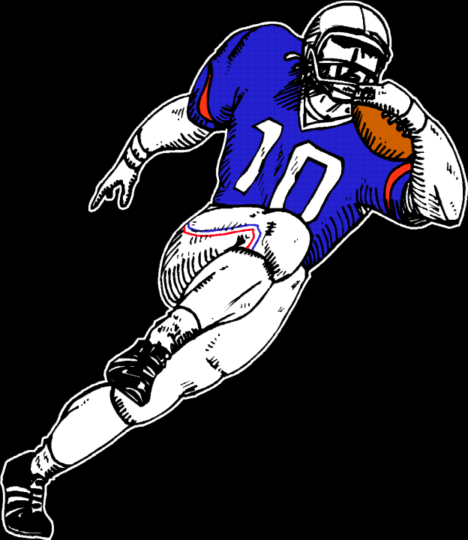
Penalty!
Sorry this answer is not correct!
Click back to return to the question.

Slide 33
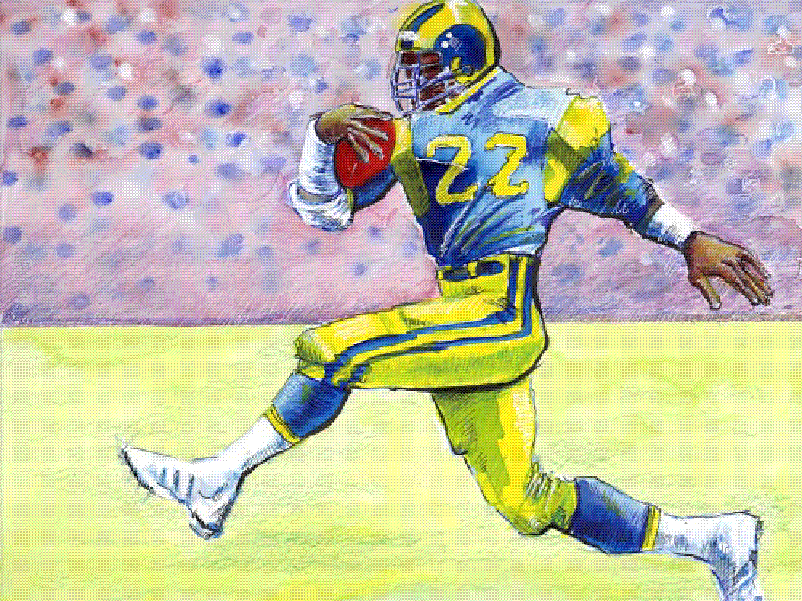
TOUCHDOWN!
Correct !
The area is 6360 yards ²
Area = (L x W)²
Area = (120 X 53) ²
Area = 6,360²
I guess we should get started sodding the field
with the grass.

Slide 34
You know perimeter and area!
Resources

Slide 35
Please use the following resources to make sure you can find the perimeter and area of polygons
http://www.funbrain.com/cgi-bin/poly.cgi?A1=s&A2=1&A15=1&INSTRUCTS=1
http://www.mathgoodies.com/lessons/toc_vol1.shtm
http://www.indiana.edu/~atmat/units/area_perimeter/area_intro.htm

