Slide 1

Problem Solving Strategies and Real World Experience
Presented by:
Angel S. Child

Slide 2
Using problem solving strategies will help me solve a real world problem.

Slide 3

Problem Solving Strategy
Use logical reasoning
Try and check
Find a pattern
Choose an operation
Use a formula
Write an equation
Solve a simpler problem
Work backwards
Make a table, graph, or diagram

Slide 4
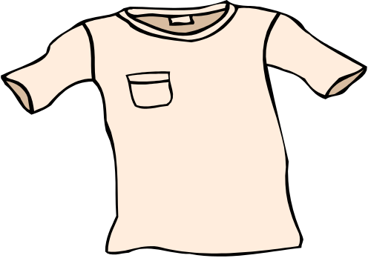

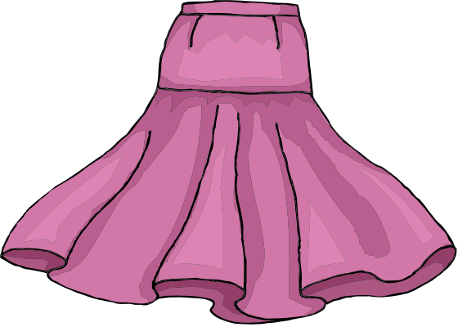
MY PROBLEM
I have 4 shirts one is red, one yellow, one white, and one blue. I have 2 pairs of pants that are black and khaki and one skirt that is dark blue. I can wear all these with all 4 shirts. How many different outfits do I have?

Slide 5

The method I have chosen to solve my problem is to use diagrams to show how many different outfits I can make.

Slide 6

Red Shirt

Slide 7

Yellow Shirt

Slide 8

Blue Shirt

Slide 9

White Shirt

Slide 10
Results
3 outfits with the red shirt
3 outfits with the yellow shirt
3 outfits with the blue shirt
3 outfits with the white shirt
I have a total of 12 outfits with the clothes that I have in my closet.

