Slide 1
Minimum, Maximum, Range
Maximum
Minimum
2, 3, 10, 30, 39, 63
Draw a line from the terms to the correct number.
What is the range of this group of numbers? _____

Slide 2
Median
1
8
7
6
9
2
5
7
3
Arrange these numbers sequentially. Draw a circle around the median number.

Slide 3
Mode & Mean
5, 7, 3, 12, 5, 8
Change font color of Mode to RED.
Calculate the mean of these numbers by following this hyperlink to the calculator. _____

Slide 4
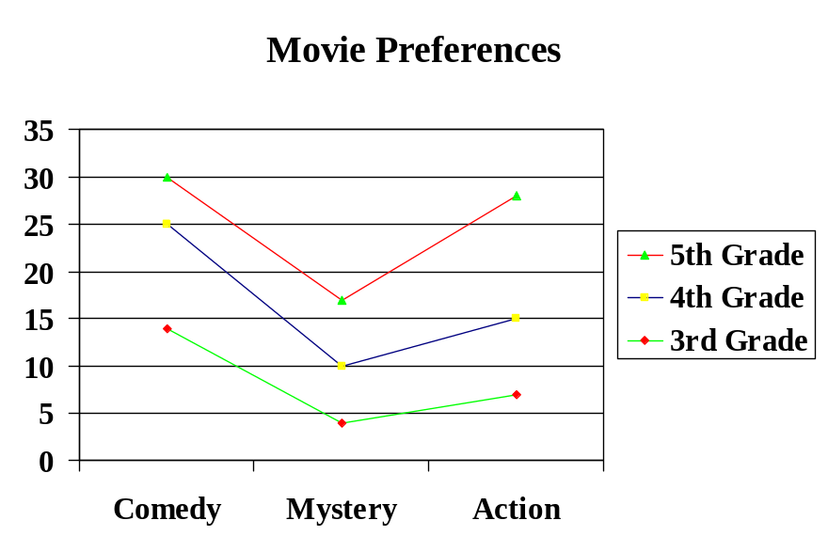
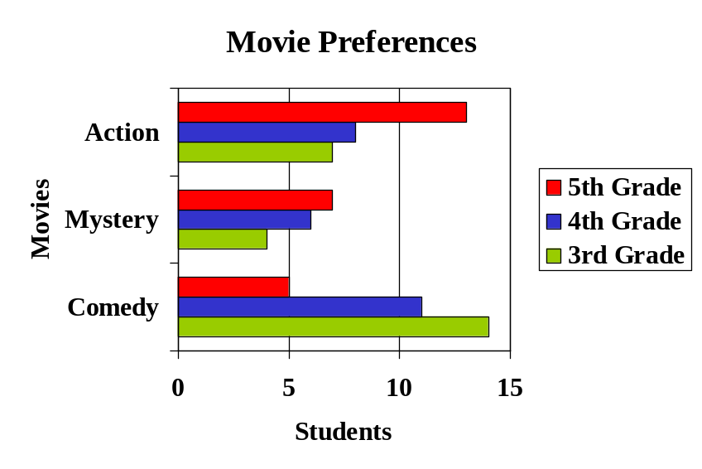
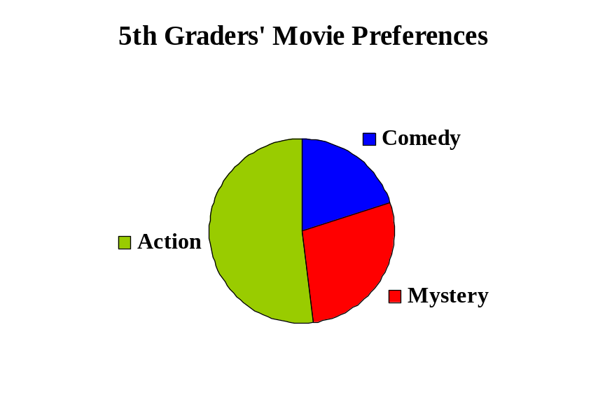
Types of Graphs
One of these graphs is a bar graph, another is a broken line graph. Draw a text box under each graph and type its name in the text box. Do you know what type of graph the third graph is?

