Slide 1
Today’s Objective
6th Period click here

Slide 2
Today’s Objective
To be able to use Sine and Cosine ratios to determine the angle measures and lengths of a right triangle.
Use the packet to follow along with the rest of the lesson

Slide 3
1.) Relationship to Angle
A
Side opposite
angle A
Hypotenuse
A
Side adjacent
angle A

Slide 4
2.) Label the side opposite B, b and the side adjacent to B, a and the hypotenuse c
A
c
b
B
C
a

Slide 5
3.) Right Triangle XYZ with X having a measure of 30⁰.
Z
Read as Angle X
30⁰
X
Y

Slide 6
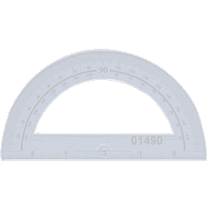
Construct a right triangle with a 30⁰ angle.
With a straight edge draw a line

Slide 7
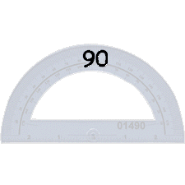
Construct a right triangle with a 30⁰ angle.
Move the protractor and mark a 90⁰ angle

Slide 8
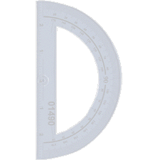
Construct a right triangle with a 30⁰ angle.
Draw the 90⁰ angle

Slide 9
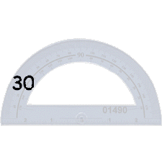
Construct a right triangle with a 30⁰ angle.
Move the protractor and mark a 30⁰ angle

Slide 10
Construct a right triangle with a 30⁰ angle.
Draw the 30⁰ angle.
30⁰

Slide 11
Construct a right triangle with a 30⁰ angle.
A right triangle with a
30⁰ angle.
30⁰

Slide 12
3.) Draw the Triangle
Measure the lengths of the sides and complete the table on the bottom of page 1.
Then do 4 & 5

Slide 13
Calculator
Use the calculator to find the decimal value for each part of #4 as well as the fraction.
Calculator ~ Start, programs, Accessories, calculator

Slide 14
4.) Ratios of the lengths of sides
XY (adjacent)
XZ (hypotenuse)
.866
YZ (opposite)
XZ (hypotenuse)
.5

Slide 15
6.) Right Triangle XYZ with X having a measure of 45⁰.
Z
45⁰
X
Y

Slide 16
6.) Draw the Triangle
Measure the lengths of the sides and complete the table on the bottom of page 2.

Slide 17
Ratios of the lengths of sides
XY (adjacent)
XZ (hypotenuse)
.707
YZ (opposite)
XZ (hypotenuse)
.707
Back

Slide 18
Starting page 3
The word ____________ comes from the Greek term meaning “measure of triangles”.
Trigonometry

Slide 19
Trigonometry
For any right triangle, there are two common trigonometric ratios of the lengths of the sides of the triangle. These ratios are called the ______ and _________.
Sine
Cosine

Slide 20
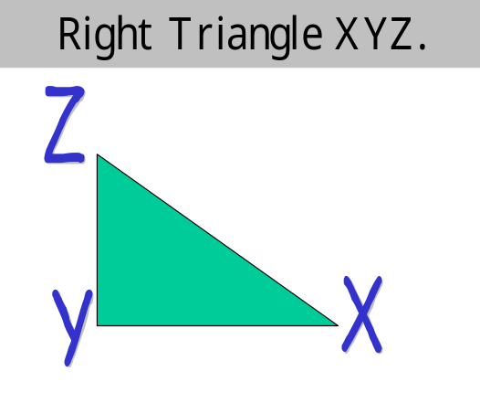
Trigonometry
Sin x = length of Opp side
length of Hyp
Cos x = length of Adj side
length of Hyp

Slide 21
Consider the right triangle XYZ
Z
Opp
hyp
Sin X =
Cos X =
adj
hyp
X
Y
What is the Opposite side?
What is the Adjacent side?

Slide 22
Sin = opp/hyp
30
18
A
Sin A = 18/30 = .6

Slide 23
Cos = adj/hyp
30
A
24
Cos A = 24/30 = .8

Slide 24
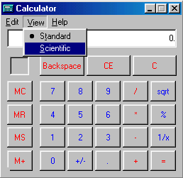
Log on, then…..
Open the calculator in the accessories group of the programs on the start menu.
Click on view and then click Scientific

Slide 25
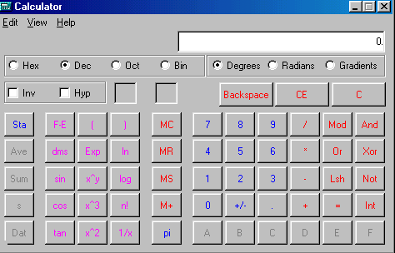
Scientific Calculator
Your calculator should look like the following:

Slide 26
Bellwork 12/4-5
1.) What is Sine?
2.) What is Cosine?
3.) What is the Sin (30)?
4.) What is the Cos (60)?
Compare the 2 answers for 3 & 4, what did you notice?

Slide 27
Bellwork 12/4-5
1.) What is Sine?
A ratio of Opp/Hyp
2.) What is Cosine?
A ratio of Adj/Hyp
3.) What is the Sin (30)?
4.) What is the Cos (60)?

Slide 28
Bellwork 12/4-5
3.) What is the Sin (30)?
.5
4.) What is the Cos (60)?
.5

Slide 29
Cosine Ratios
Use a Calculator to plot the Cosine ratio for the angle in the graph.
Example: Cos(60) = .5

Slide 30
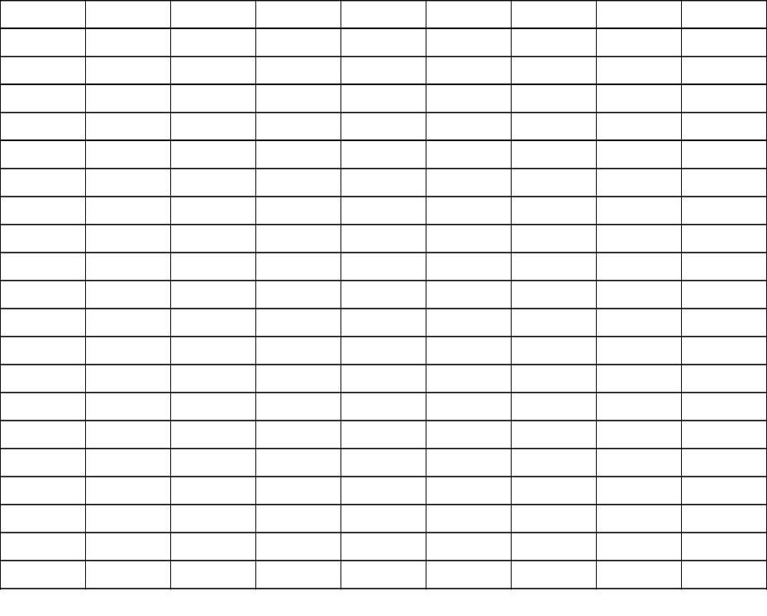
Cosine Ratios
1.0
.90
.80
.70
.60
.50
.40
.30
.20
.10
.00 0 10 20 30 40 50 60 70 80 90
Plot the points and draw the line.

Slide 31
Sine Ratios
Use a Calculator to plot the Sine ratio for the angle in the graph.
Example: Sin(60) = .866

Slide 32
Sine Ratios
1.0
.90
.80
.70
.60
.50
.40
.30
.20
.10
.00 0 10 20 30 40 50 60 70 80 90
Plot the points and draw the line.

Slide 33
Sin = opp/hyp
Using the Chart
30
18
A
Sin A = 18/30 = .6
Find the measure of
angle A on the Sine chart

Slide 34
Sine Ratios
1.0
.90
.80
.70
.60
.50
.40
.30
.20
.10
.00 0 10 20 30 40 50 60 70 80 90
37º

Slide 35
Cos = adj/hyp
Using the Chart
30
A
24
Cos A = 24/30 = .8
Find the measure of
angle A on the Cos chart

Slide 36
Cosine Ratios
1.0
.90
.80
.70
.60
.50
.40
.30
.20
.10
.00 0 10 20 30 40 50 60 70 80 90
37º

Slide 37
Sine and Cosine ratios
Why are they the same measure of 37⁰ ?

Slide 38
Trigonometry
For Triangle ABC, determine the value of each trigonometric ratio named on the bottom of page 4.
Write the ratio as a fraction and as a decimal.

Slide 39
Trigonometry
1.) cos B adj/hyp
2.) Sin B opp/hyp
3.) cos C adj/hyp
4.) sin C opp/hyp

Slide 40
Classwork 12/4-5
1.) Do the Skill and practice (1-15)
2.) Do the Sine and Cosine Applications
You must show your work.

Slide 41
Classwork 12/4-5
Again I say,
You must show your work if you want to get credit for the packet.
Show your work exactly as you see it in the examples.

Slide 42
Using Sine ratios (1-3)
1.) Sin 60⁰ =
Sin 60⁰ = n/54
.866 = n/54
(54).866 = n/54(54)
46.765 = n
54
n
60⁰

Slide 43
Using Sine ratios (1-3)
Now you do 2 & 3
See the example for #4.

Slide 44
Using Cos ratios (4-6)
4.) Cos 35⁰ =
Cos 35⁰ = n/112
.819 = n/112
(112).819 = n/112(112)
91.745 = n
112
35⁰
n

Slide 45
Using Sine ratios (4-8)
Now you do 5 – 8.
See the example for #9.

Slide 46
Find the Angle Measure
31
9.) Cos B =
Cos B = 28/31
Cos B = .903
Watch the next slide to see how to convert .903 to degrees.
B
?
28

Slide 47
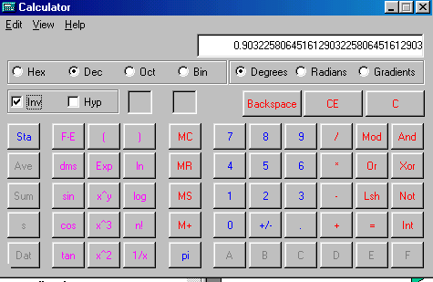
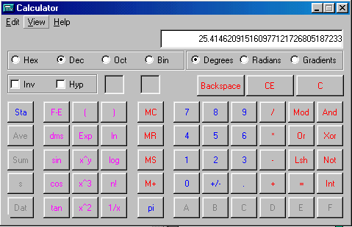
Find the Angle Measure
9.) Cos B = .903
Don’t delete the decimal
25.41
Click this box
Click Cos

Slide 48
Find the Angle Measure
31
9.) Cos B =
Cos B = 28/31
Cos B = .903
B
?
28
B = 25.41

Slide 49
Find the Angle Measure
Now you do 10 –15.
See the example for #1 of the sine & cosine application worksheet.

Slide 50
Sine & Cosine Applications
1.) Cos 45 =
Cos 45 = n/350
(350).707 = n/350(350)
n = 247.487
n
350
45⁰

Slide 51
Sine & Cosine Applications
Now you do 1 – 6 and #7.

Slide 52


Sine & Cosine Applications
7.)
Why 75⁰
9
75⁰
n

Slide 53
Sine & Cosine Applications
Why 75⁰
7.)
9
75⁰
n

Slide 54
Sine & Cosine Applications
7.) Cos 75 =
Cos 75 = n/9
(9).259 = n/9(9)
n = 2.3feet

Slide 55
List of Clicks
Read the 1st paragraph and then click on the links and see each example.
Start
Internet
High School
Favorite links
Student
High School Hub
Mathematics
Discovering Trigonometry

