Slide 1
Personal Hygiene and You
M-DCPS
PHYSICAL EDUCATION AND
HEALTH LITERACY

Slide 2

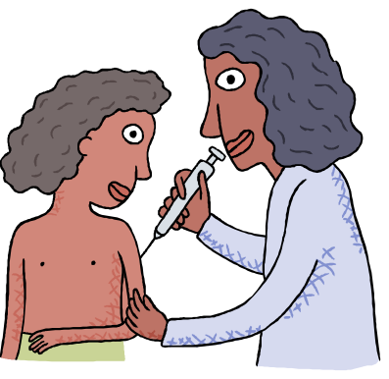
Health
According to the World Health Organization, health is a state of complete physical, mental and social well-being and not merely the absence of disease or infirmity.

Slide 3


Hygiene
The definition of hygiene is healthy habits that include bathing, keeping the mouth clean, keeping the skin protected from the sun and washing hands frequently before handling edibles to insure the safe delivery of food.

Slide 4

Good and Bad Hygiene
The difference between good and bad hygiene is:
Good hygiene keep you protected from things, like germs and dangerous UV rays from the sun, in the environment that can hurt you
Bad hygiene allows these things to affect your body and probably make you sick

Slide 5

The Benefits of Good Hygiene
According to the Centers for Disease Control and Prevention, addressing the spread of germs in schools is essential to the health of our youth, our schools, and our nation
Good hygiene prevents the spread of germs
It also helps to give a good first impression to others

Slide 6

Healthy Skin: Hand Washing
According to the Centers for Disease Control (CDC) 22 million school days are lost each year due to the common cold.
Some viruses and bacteria can live from 20 minutes up to 2 hours or more on surfaces like cafeteria tables, doorknobs, and desks

Slide 7
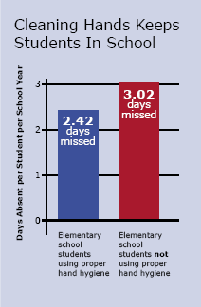

Slide 8


How to Wash Your Hands
Use warm running water
Use soap
Scrub hands together and under nails for at least 15-20 seconds
Dry hands on a clean cloth or paper towel or use an automatic hand dryer if possible

Slide 9

Healthy Teeth and Gums
The health and cleanliness of your mouth is important, if you don’t brush and floss…
Cavities (holes in your teeth) may form
Your breath will probably smell bad
You may be at higher risk for serious disease later in life, such as heart disease, stroke, and diabetes

Slide 10
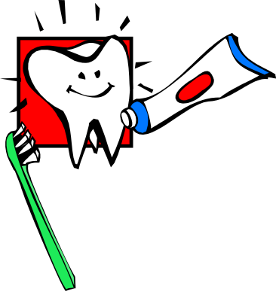
Choosing a Toothbrush and Toothpaste
Choose a toothbrush certified by the American Dental Association (ADA)
A soft bristle brush is good, and it should fit to your mouth
Get a new toothbrush at least every 3 or 4 months
Choose a fluoride toothpaste also certified by the ADA

Slide 11

How Often and When to Brush and Floss
At least two times a day
One time in the morning, and one time at night
Consider brushing between meals, too!
Floss at least one time a day
Floss if you feel food stuck in your teeth

Slide 12
Brushing Technique and Skills
Place your toothbrush against the gums.
Move the brush back and forth gently in short (tooth-wide) strokes.
Brush the outer tooth surfaces, the inner tooth surfaces, and the chewing surfaces of the teeth.
Clean the inside surfaces of the front teeth, using a gentle up-and-down stroke.
Brush your tongue to remove bacteria and freshen your breath.

Slide 13

Proper Flossing Skills
Hold the floss tightly between your thumbs and forefingers.
Guide the floss between your teeth using a gentle rubbing motion. Never snap the floss into the gums.
When the floss reaches the gum line, curve it into a C shape against one tooth. Gently slide it into the space between the gum and the tooth.

Slide 14
Proper Flossing Skills (cont’d)
Hold the floss tightly against the tooth. Gently rub the side of the tooth, moving the floss away from the gum with up and down motions.
Repeat this method on the rest of your teeth.
Don't forget the back side of your last tooth.

Slide 15


Foods to Avoid
Bacteria in your mouth grow on sugar
Try to eat as little “junk food” as possible
=candy, chocolate, and other sweets
Avoid drinking soda and sweet tea
If you do eat these things, you may want to brush immediately afterwards

Slide 16

Protection From the Sun
Cancer researchers believe childhood sunburns may increase a person's risk of developing melanoma, the most serious skin cancer.
Most of the more than 1 million cases of nonmelanoma skin cancer diagnosed yearly in the United States are considered to be sun-related.

Slide 17

Protection From the Sun
80% of the average person's lifetime sun exposure happens before age 18.
Skin cancer is the most common of all cancers. It accounts for nearly half of all cancers in the United States.

Slide 18

How to Protect Yourself
Avoid the sun between 10 a.m. and 4 p.m.
Seek shade: Look for shade, especially in the middle of the day when the sun's rays are strongest.
Cover your head with a wide-brimmed hat, shading your face, ears, and neck.

Slide 19

How to Protect Yourself
Wear sunglasses
Cover up with protective clothing to guard as much skin as possible when you are out in the sun. Choose comfortable clothes made of tightly woven fabrics that you cannot see through when held up to a light.

Slide 20

Sunscreen
Use sunscreen with a sun protection factor (SPF) of 15 or higher.
Apply a generous amount about a palmful all over areas of your skin that are exposed.
Put it on 15-20 minutes before going out in the sun.

Slide 21

Sunscreen
Reapply after swimming, toweling dry, or perspiring.
Reapply every two hours
Use sunscreen even on hazy or overcast days.

Slide 22

Sunscreen
More time in the sun!
If you could spend 10 minutes in the sun without sunscreen and you apply SPF 15… Now you can stay in the sun for 2 hours!
If you do get a sunburn, use a lotion or aloe vera on the skin.

Slide 23

Review
Hygiene: Lather, Rinse, Repeat.
Teeth: Brush, Floss, Rinse.
Sunscreen: Slip, Slop, Slap

Slide 24

Resources
National Food Service Management Institute (2002). Wash Your Hands. Retrieved May 18, 2005 from http://www.nfsmi.org/Information/handsindex.html
Lesson Plans (2004). Why Wash? Retrieved May 19, 2005 from http://www.lessonplanspage.com/PEWhyWashHygieneComics2.htm
American Dental Association (2005). Animation and Games. Retrieved May 20, 2005 from http://www.ada.org/public/games/animation/interface.asp
Centers for Disease Control and Prevention (2004). Stopping Germs at Home, Work, and School. Retrieved May 26,2005 from http://www.cdc.gov/germstopper/home_work_school.htm
World Health Organization(1948-2005). Definition of Health. Retrieved May 26, 2005 from http://www.who.int/about/definition/en/
American Cancer Society (2005). Skin Cancer Facts. Retrieved May 22, 2005 from
http://www.cancer.org/docroot/PED/content/ped_7_1_What_You_Need_To_Know_About_Skin_Cancer.asp?sitearea=PED

