Slide 1



Slide 2
MEANING OF PERCENT
Percent means parts per hundred
The word comes from the Latin phrase per centum, which means per hundred.

Slide 3
SYMBOL OF PERCENT
Percent has a special symbol.
%

Slide 4






PERCENTAGE IN DAILY LIFE

Slide 5
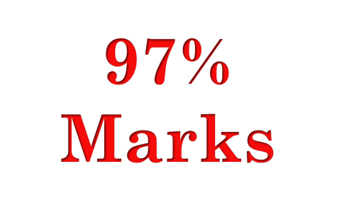

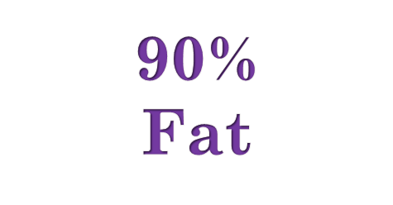

PERCENTAGE IN DAILY LIFE

Slide 6
ADVANTAGES OF PERCENTAGE
Comparison
Calculation becomes easier.
Communication becomes simpler.

Slide 7
HOW TO CALCULATE PERCENTAGE
Example: 60% of 200 mangoes are ripe . How many mangoes are ripe ?
200* 60/100= 120 Mangoes

Slide 8
THANKS

