Slide 1

www.makemegenius.com– Full of ingredients to make your child a genius.
“Don’t make me read, make me understand “

Slide 2
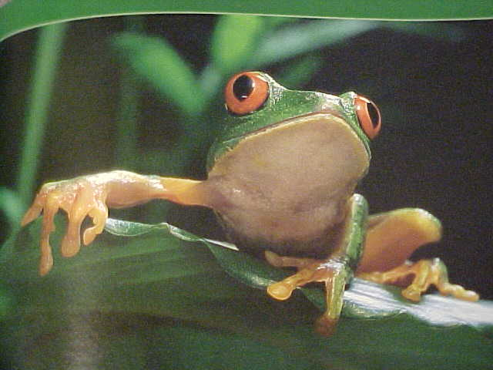
So, you have been studying about animals! Can you guess what I am?

Slide 3


You guessed it!
I’m an amphibian!
Amphibians . . .
live part of their lives in water and the other part on land
are vertebrates- have backbones
are cold blooded- body temperature depends on the temperature of the environment
return to the water to lay eggs.

Slide 4
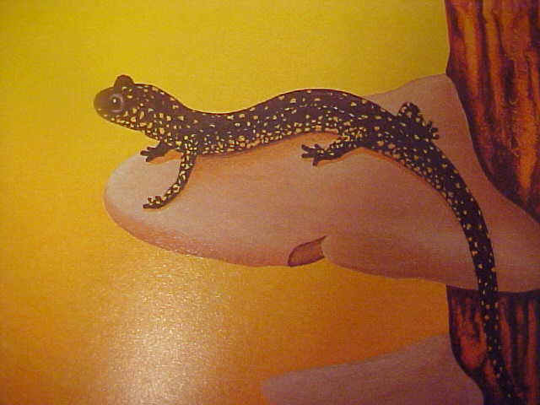
Salamanders and Newts
(brightly colored Salamanders)
Keep their tales as adults.
Have 4 legs

Slide 5
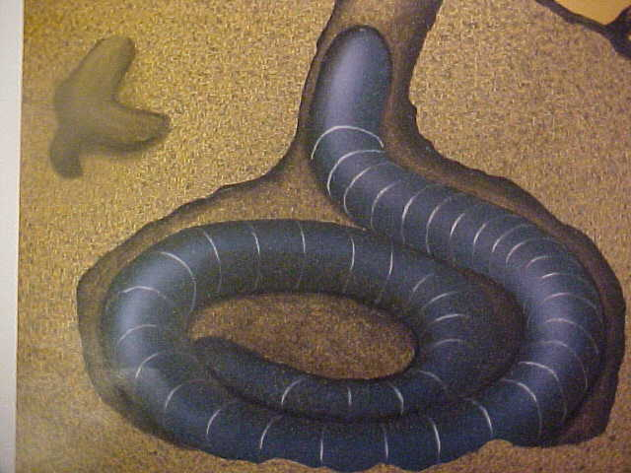
Caecilians
A worm like amphibian

Slide 6
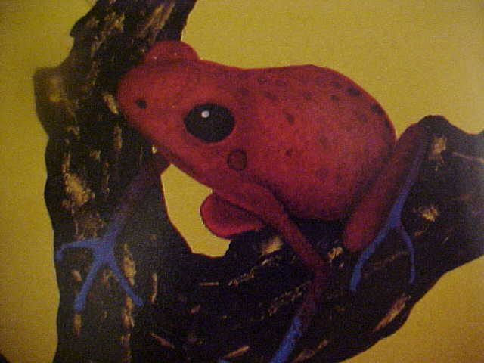
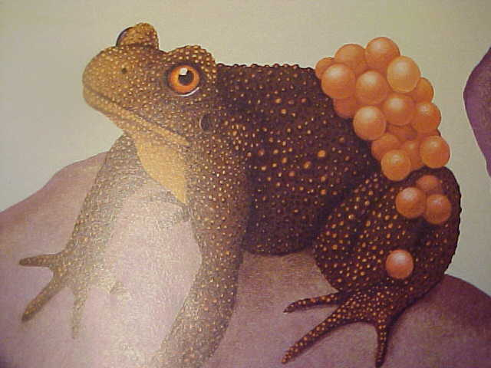
Frogs and Toads
Lose their tales
Eat insects, fish, and worms
Go through metamorphosis

Slide 7

Thanks
Submitted by
Ashi Shrivashtawa
DPS , Delhi

Slide 8
If you also want to share your own or your kid’s presentation(ppt) please send it on info@makemegenius.com

Slide 9
www.makemegenius.com– Full of ingredients to make your child a genius.
“Don’t make me read, make me understand “

