Slide 1
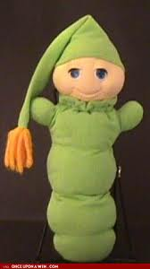
Glow Worms
Fire Flies

Slide 2
For children education videos ,visit
MMG Science Videos at
www.makemegenius.com

Slide 3
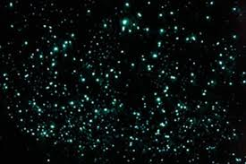
A Glow Worm (Fire Fly) glows to attract small insects .
The glow worms construct snares made from silk threads and sticky droplets to capture the insects attracted to their glow

Slide 4
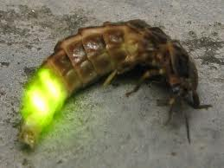
Glow Worms are Larvae
Glow worms are larvae (immature stage) of a small fly.
The larvae stage is only stage in their life cycle when they can glow

Slide 5
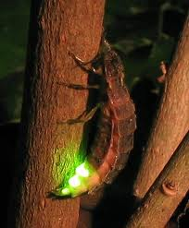
Glow Worms Adults
Glow worms adults are delicate & don’t have mouth-parts & only live for small no. of days.
Female adults live for two days & males only for 6 days

Slide 6
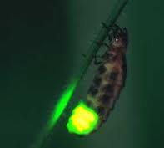
Glow Worms Life
As Adults can’t feed itself ,so glow-worms must gain enough strength at larval stage to spend adult life .
The larvae are believed to live for approximately one year

Slide 7
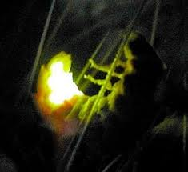
Glow Worms Life
The light produced by it is 99% light & 1% heat.
The chemicals needed to generate light are all produced within glow-worm body

Slide 8
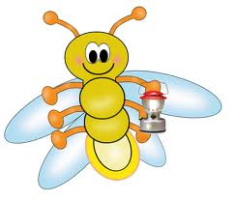
Glow Worms Habitat
Glow worms require permanently ,moist habitat for their survival .
So they are dependent on rain forests & wet caves.

Slide 9
Glow Worm Poem
I wish I was a glow-worm,
a glow-worm is never glum
Because how can you be grumpy
When the sun shines out of your bum

