Slide 1



Slide 2

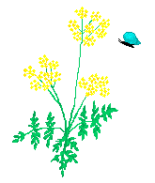
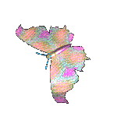
Interesting Animals

Slide 3
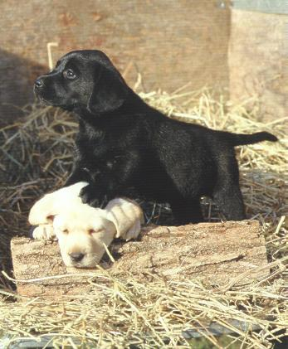
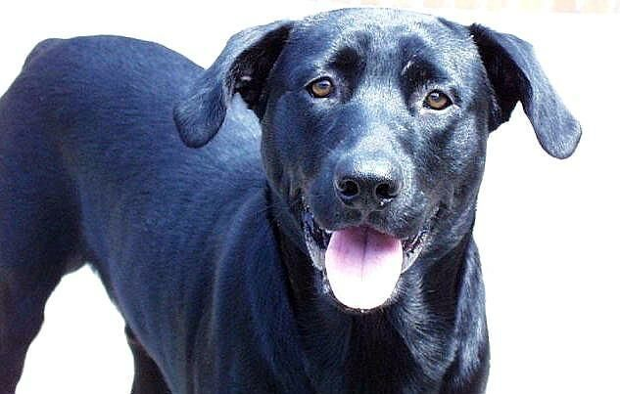
We know that a puppy is a baby dog…

Slide 4
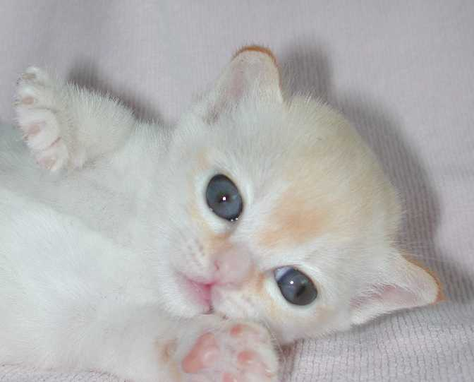
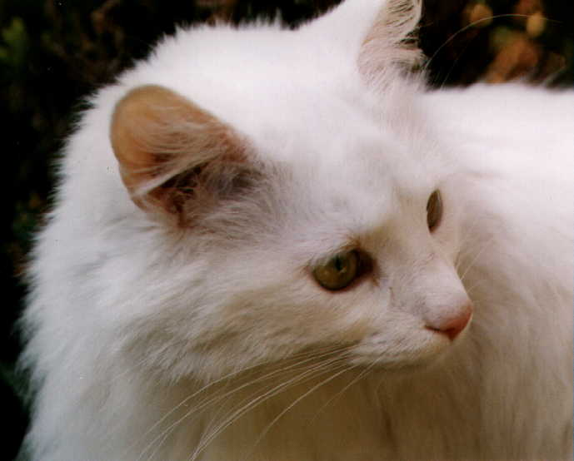
and a kitten is a baby cat.

Slide 5
Look again at these pictures.
What can you tell me about these baby animals and their parents?
They look
Alike!!!!

Slide 6

I am sure all of you have seen a mother cat with kittens or a mother dog with puppies. Think what that cat and kitten looked like

Slide 7
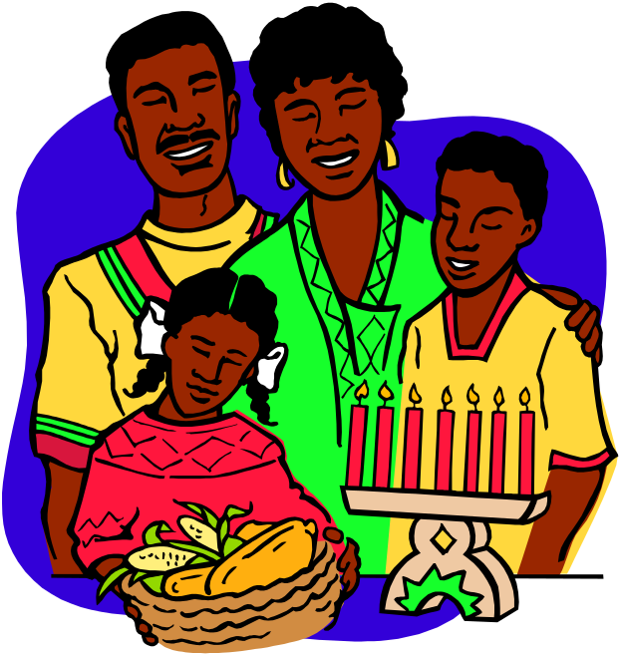
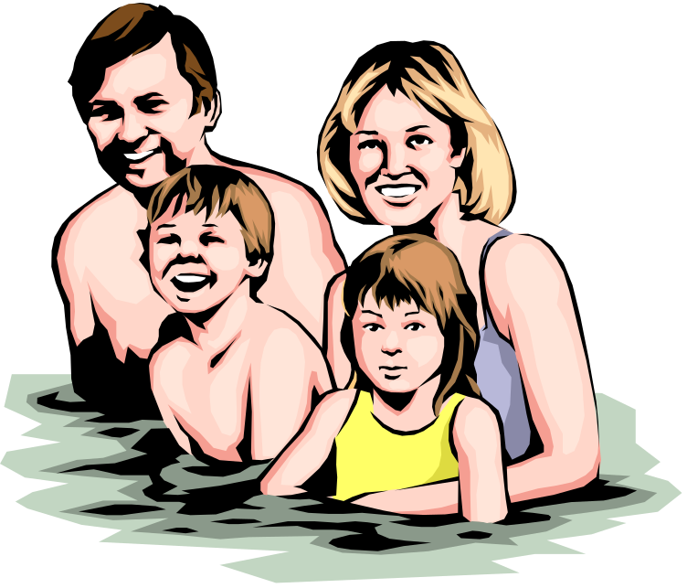
Many animals do not change that much as they grow up. Think about it: Someone your age looks a lot like their parents. Although parents may have more wrinkles and grey hair! But they still have two arms, two legs and one head—just like you!

Slide 8
Today we're going to meet an animal that's very different from its mother when it is born. Can you think this animal might be?

Slide 9
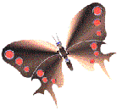
It’s a…
Butterfly
It was originally known as FLUTTER BY
later on these three Pink colored alphabet exchange their places

Slide 10

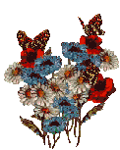
Butterflies go through four life stages, and they look very different at each stage…

Slide 11


Stage One
The mummy butterfly lays her eggs safely on a leaf.
She tries to find a nice large, healthy plant so that the newly born caterpillars will have lots of fresh leaves to eat

Slide 12

Stage Two
Once the baby caterpillar hatches from its egg it begins growth stage.
The caterpillar eats lots and lots of leaves so that it grows big and healthy.

Slide 13

Stage Three
Soon the caterpillar is ready to become a butterfly. He weaves a chrysalis out of silk which will keep him safe whilst he transforms into a butterfly.

Slide 14
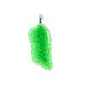
Stage Four
When he is ready he will split open the chrysalis and emerge as a fully formed butterfly.

Slide 15
Can anybody think of another animal that looks completely different to its parents when it is born?

Slide 16




I thought about frogs…

Slide 17

Stage One
O
G
S
P
R
A
W
F
N
Here are hundreds of eggs that have been
laid by the mummy frog.
Can you think what’s the
special name given to frog eggs?

Slide 18

Once the eggs hatch the baby frogs swim free in the pond. They don’t look very much like frogs though because they do not have any legs yet, instead they have a tail-can you see? Does you know what baby frogs are called?
Stage Two
d
p
o
a
l
e
T
s

Slide 19


Stage Three
After a short while the tadpole begins to grow some legs. First he grows two back legs to help him swim quicker.
.

Slide 20

Stage Four
Soon the baby frog grows two front legs as well. Once the baby frog have all four legs he doesn’t need his tail anymore and as he grows up into a big frog you can hardly tell that he had one tail. Although if you look closely at this picture you can see
still a tail there, really-just very small!

Slide 21
What does the baby frog have in common with the baby butterfly? Just think about it.
Like the baby butterfly, baby frogs come from eggs.
Do baby puppies or kittens come from eggs?
Why other animals do not come from eggs?

Slide 22
What happens when the baby butterfly and the young frogs hatch from their eggs? Is anybody around to take care of them?
What about puppies and kittens? Do their mummies and daddies look after them while they are babies?
What does mummy do to look after them?
Would a little human baby be able to look after himself?

Slide 23

Thanks
Submitted by
Ishan
DPS, Mumbai

Slide 24
If you also want to share your own or your kid’s presentation(ppt) please send it on info@makemegenius.com

