Slide 1
For Free
Science Videos for Kids
www.makemegenius.com Free Science Videos for Kids

Slide 2

Visit
www.makemegenius.com
www.makemegenius.com Free Science Videos for Kids

Slide 3
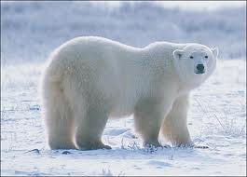
Polar Bear
www.makemegenius.com free science videos for kids

Slide 4
Polar bears live only in Arctic areas
Polar bears live only in Arctic areas that surround the North Pole—not in Antarctica, which surrounds the South Pole.
School children often see illustrations of penguins and polar bears together, but this could never happen. In fact, the word arctic comes from the Greek word for bear, and Antarctic comes from the Greek meaning the opposite, without bear.
www.makemegenius.com free science videos for kids

Slide 5
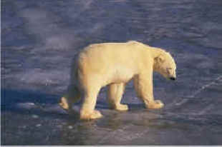
Polar Bears are not all White!
A polar bear's fur is not white. Each hair is clear hollow tube. Polar bears look white because each hollow hair reflects the light. On sunny days, it traps the sun's infrared heat and keeps the bear warm at 98 degrees F
Polar bears have black skin under which there is a layer of fat that can measure 4.5 inches
www.makemegenius.com free science videos for kids

Slide 6
What they Eat?
Polar bears primarily eat seals. They often rest silently at a seal’s breathing hole in the ice, waiting for a seal in the water to surface. Once the seal comes up, the bear will spring and sink its jagged teeth into the seal’s head.
www.makemegenius.com free science videos for kids

Slide 7
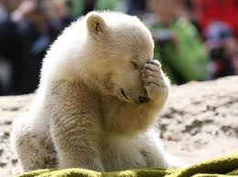
Babies!
The babies are much smaller than human babies when they're born. They are the size of a rat and weigh little more than a pound. They can grow to full man size in a year if they have lots of food.
www.makemegenius.com free science videos for kids

Slide 8
Submitted by
Raveena , Navi Mumbai
www.makemegenius.com free science videos for kids

