Slide 1

www.makemegenius.com– Full of ingredients to make your child a genius.
“Don’t make me read, make me understand “

Slide 2
DANGER!!!!!
If not used properly electricity can be dangerous.
Follow the safety rules!!!!

Slide 3

Number 1
Do not have wires where people can trip over them…

Slide 4

Number 2
Never stick your fingers into a plug socket…

Slide 5
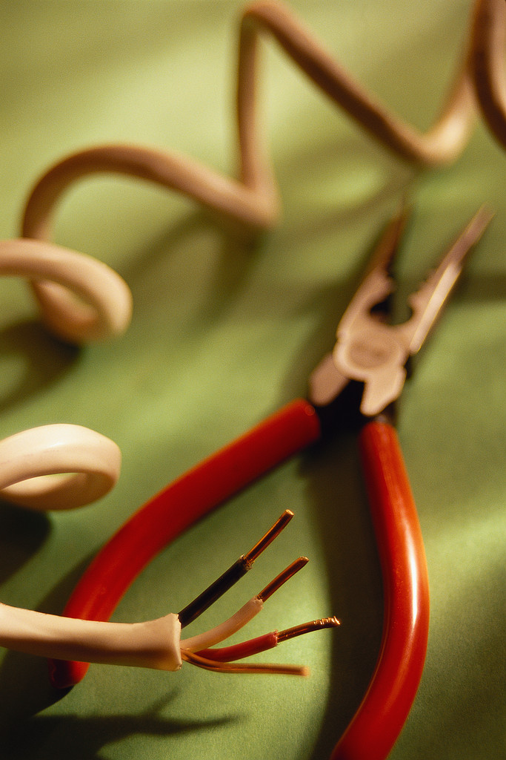
Number 3
Never use electrical appliances with frayed wires …

Slide 6
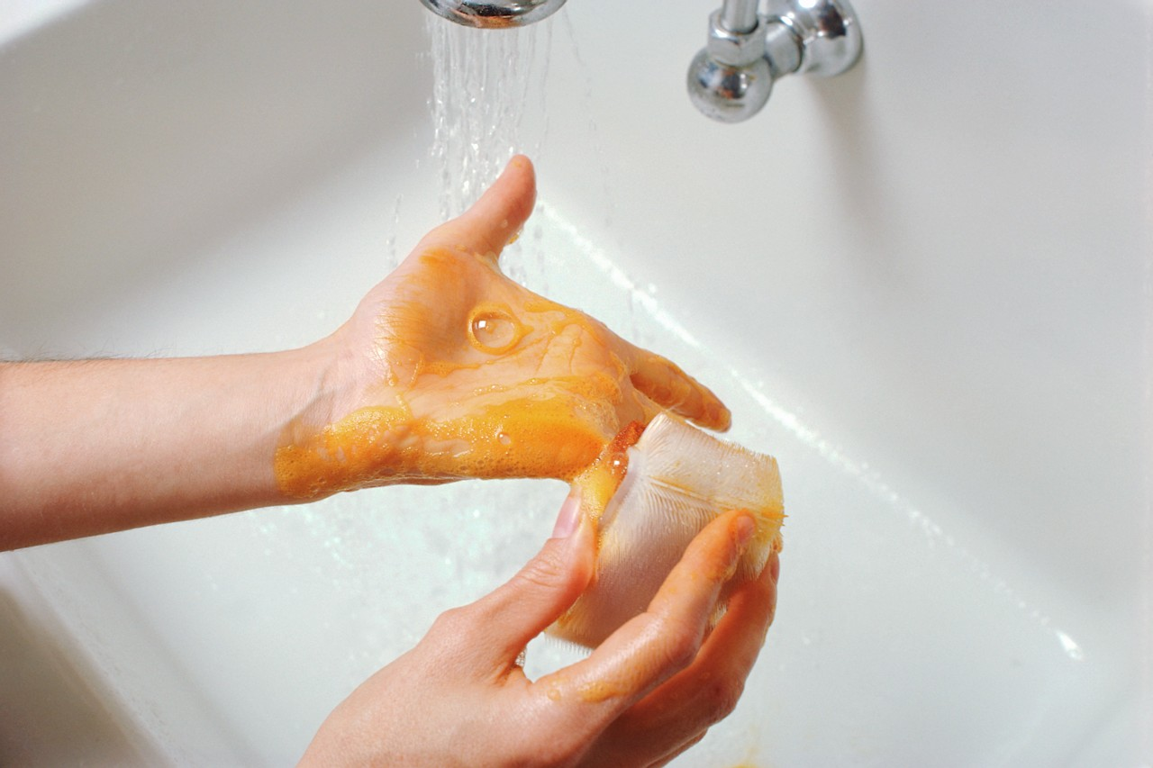

Number 4
Never touch a socket with wet hands …

Slide 7
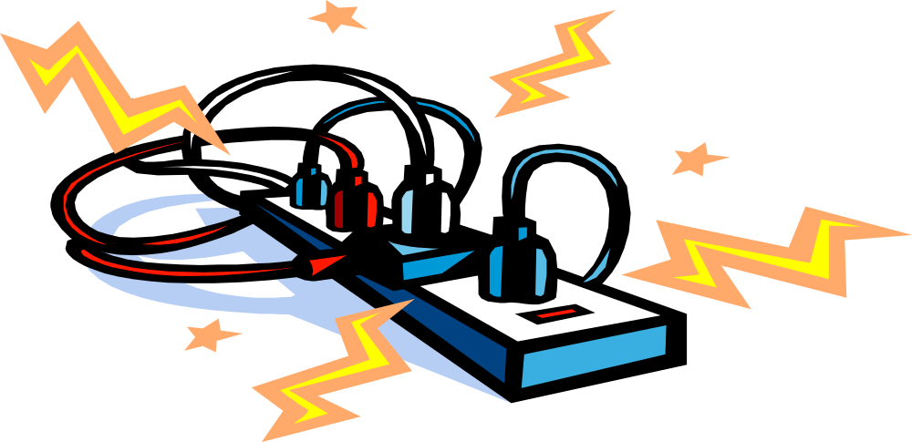
Number 5
Never overload a plug socket …

Slide 8

Number 6
Never use electrical appliances with broken plugs …

Slide 9

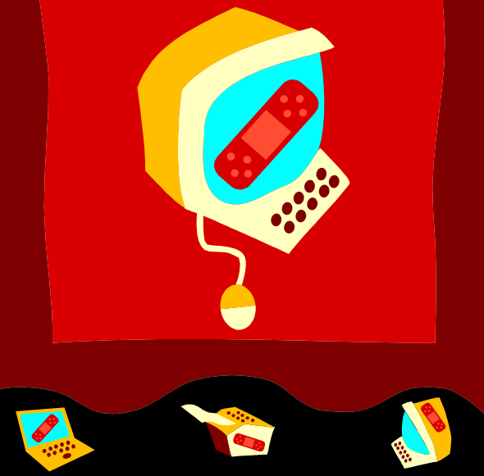
Number 7
Always make sure an adult fixes broken electrical appliances …

Slide 10
As long as electricity is used in the correct way it will be safe.
What safety rules can you remember?
Do not have wires where people can trip over them.
Never stick your fingers into a plug socket.
Never use electrical appliances with frayed wires.
Never touch a socket with wet hands.
Never overload a plug socket.
Never use electrical appliances with broken plugs.
Always make sure an adult fixes broken electrical appliances.

Slide 11

Thanks
Submitted by
Deepanka Mishra
DAV Public School
Chandigarh

Slide 12
If you also want to share your own or your kid’s presentation(ppt) please send it on info@makemegenius.com

Slide 13
www.makemegenius.com– Full of ingredients to make your child a genius.
“Don’t make me read, make me understand “

