Slide 1
Nutrients Essential for Plant Growth

Slide 2

Introduction
Plants, just like humans require certain elements for normal growth. When any of these are left out the plant will develop definite symptoms related to its shortage.

Slide 3
Nutrient Classifications
Primary: Nitrogen (N)
Potassium (K)
Phosphorus (P)
Secondary: Sulfur (S)
Calcium (Ca)
Iron (Fe)
Magnesium (Mg)
Micronutrients: Molybdenum (Mo)
Boron (B)
Copper (Cu)
Manganese (Mn)
Zinc (Zn)
Chlorine (Cl)

Slide 4
Primary Nutrients

Slide 5
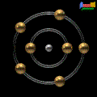
Nitrogen (N)
Function: Promotes rapid vegetative growth and gives plants healthy green color.
Symptoms: Stunted growth, pale, yellowish color, burning of tips and margins of leaves starting at the bottom of the plant.

Slide 6
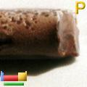
Phosphorus (P)
Function: Stimulates early growth and root formation, hastens maturity, promotes seed production and makes plants hardy.
Symptoms: Small root growth, spindly stalk, delayed maturity, purplish discoloration of leaves, dying of tips of older leaves, and poor fruit and seed development.

Slide 7
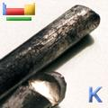
Potassium (K)
Function: Improves plant’s ability to resist disease and cold, aids in the production of carbohydrates.
Symptoms: Slow growth, margins on leaves develop a scorched effect starting on the older leaves, weak stalk, shriveled seed or fruit.

Slide 8
Secondary Nutrients

Slide 9
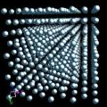
Calcium (Ca)
Function: Aids in the movement of carbohydrates in plants, essential to healthy cell walls and root structure.
Symptoms: Terminal bud dies under severe deficiency, margins of younger leaves scalloped, blossoms shed prematurely, weak stalk or stem structure.

Slide 10
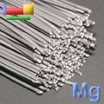
Magnesium (Mg)
Function: An ingredient of chlorophyll, aids in the translocation of starch within the plant, essential for formation of oils and fats.
Symptoms: Yellowing of leaves between veins starting with lower leaves, leaves abnormally thin, tissue may dry and die, leaves have tendency to curve upward.

Slide 11
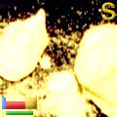
Sulfur (S)
Function: Aids in the formation of oils and parts of protein molecules.
Symptoms: Young leaves light green to yellowish in color. In some plants older tissue may be affected also. Small spindly plants, retarded growth and delayed maturity. Interveinal chlorosis on corn leaves.

Slide 12
Micronutrients

Slide 13
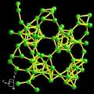
Boron (B)
Function: Aids in the assimilation of calcium; amount required is extremely small.
Symptoms: Death of terminal growth, causing lateral buds to develop and produce a “witches’ broom” effect. Thickened, curled, wilted and chlorotic leaves. Soft or neurotic spots in fruit or tubers. Reduced flowering or improper pollination.

Slide 14
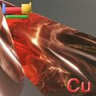
Copper (Cu)
Function: Promotes formation of Vitamin A, excess is very toxic.
Symptoms: Stunted growth, dieback of terminal shoots in trees, poor pigmentation, wilting and eventual death of leaf tips, formation of gum pockets around central pith in oranges.

Slide 15
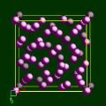
Manganese (Mn)
Function: Serves as an activator for enzymes in growth processes, assist iron in chlorophyll formation, generally required with zinc in foliar spraying of citrus.
Symptoms: Interveinal chlorosis of young leaves, gradation of pale color next to veins, development of gray specks (oats), interveinal white streaks (wheat) or interveinal brown spots or streaks (barley).

Slide 16
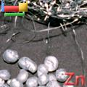
Zinc (Zn)
Function: An essential constituent of several enzymes, controls synthesis of indoleacetic acid - an important growth regulator. The micronutrient most often needed by western crops - trees, grapes, beans, onions, tomatoes, cotton & rice.
Symptoms: Decreased stem length and rosetting of terminal leaves. Reduced fruit bud formation, mottled leaves and stripping of corn leaves.

Slide 17
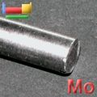
Molybdenum (Mo)
Function: Required for N utilization, needed to transform NPN into amino acids, and legumes cannot fix atmospheric N symbiotically without Mb.
Symptoms: Stunting and lack of vigor, very similar to N deficiency due to the key role Mb plays in N utilization. Marginal cupping and scorching of leaves. Whiptail in cauliflower and yellow spotting in citrus.

Slide 18
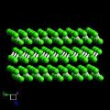
Chlorine (Cl)
Function: Required in photosynthetic reactions of plants. Deficiency is not seen in the field due to its universal presence in nature.
Symptoms: Wilting, followed by chlorosis. Excessive branching of lateral roots. Bronzing of leaves, chlorosis and necrosis in tomatoes and barley.

Slide 19
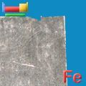
Iron (Fe)
Function: Essential for formation of chlorophyll, releases energy from sugars and starches.
Symptoms: Leaves yellowish or white (young leaves first), veins green, affected leaves curl up.

