Slide 1

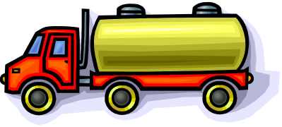
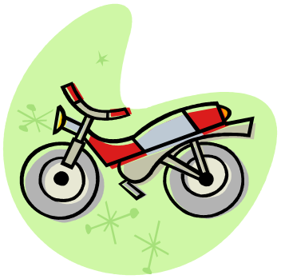





Types of Transport

Slide 2




There are many different types of transport.
Land
Air
Water

Slide 3


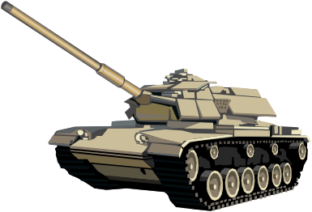
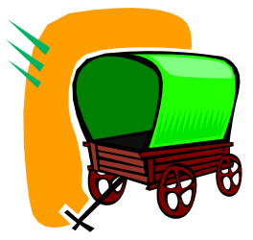

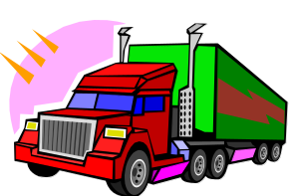

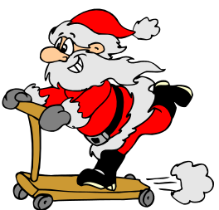


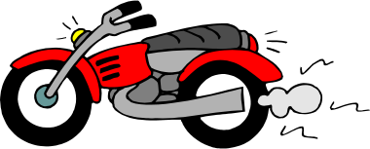
Land
There are many types of transport that are used on the land.

Slide 4
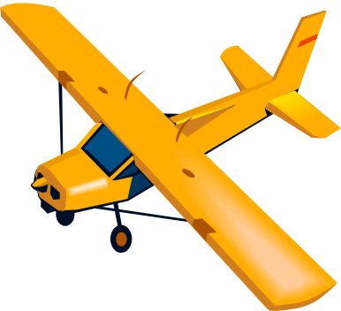




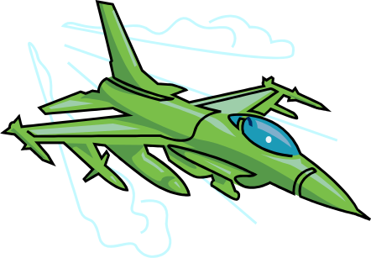
Air
We can see many different types of transport in the sky.

Slide 5



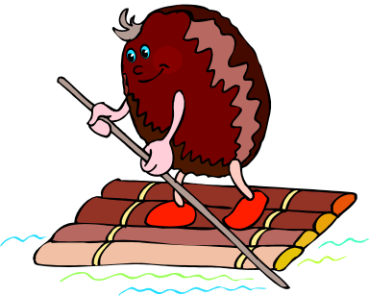
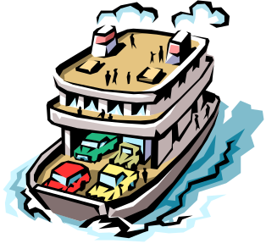

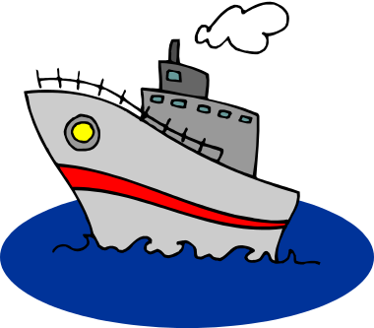


Water
We can see many different types of transport in the water.

Slide 6

Think about all of the different types of transport you have seen.
What was your favourite?
Which ones have you been in?
What makes them similar/different?

Slide 7

Thanks
Submitted by
Priyanka Shrivashtawa
Kanpur

