Slide 1

Vegetables

Slide 2
asparagus

Slide 3
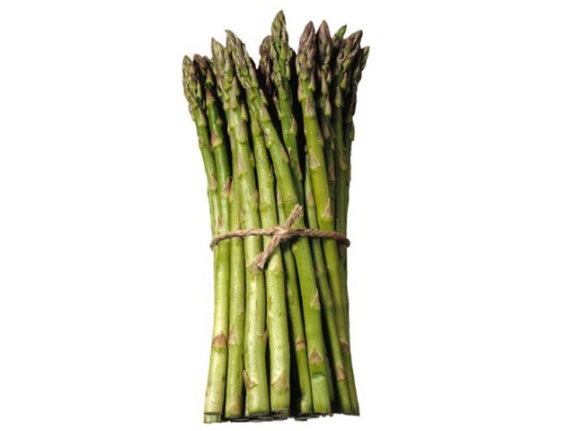

Slide 4
cabbage

Slide 5
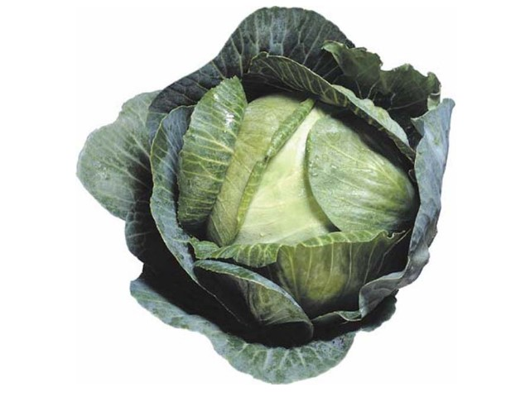

Slide 6
carrot

Slide 7
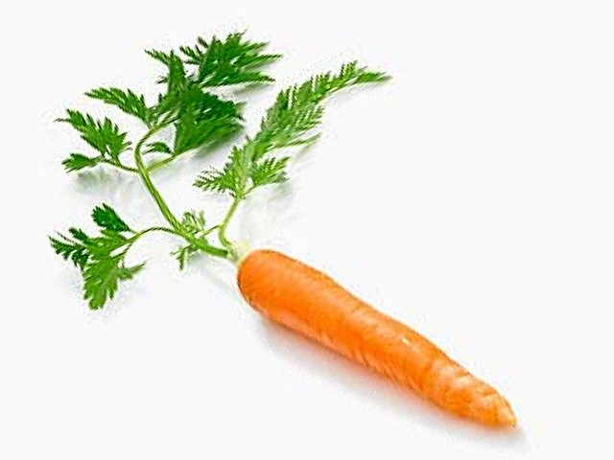

Slide 8
cauliflower

Slide 9
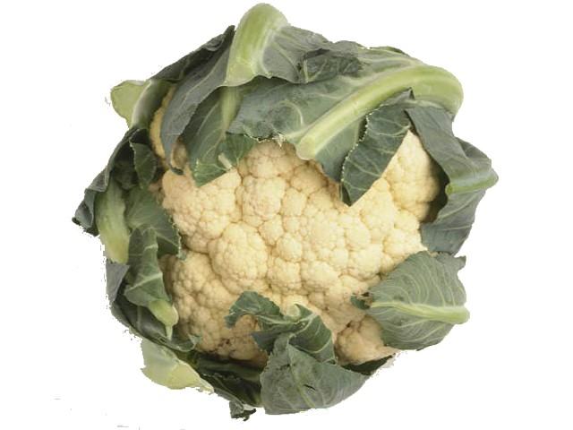

Slide 10
cucumber

Slide 11
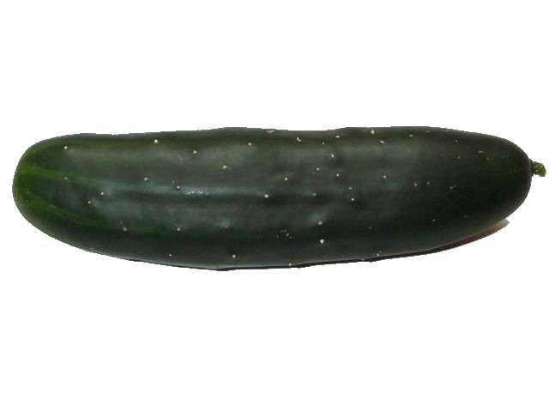

Slide 12
onion

Slide 13
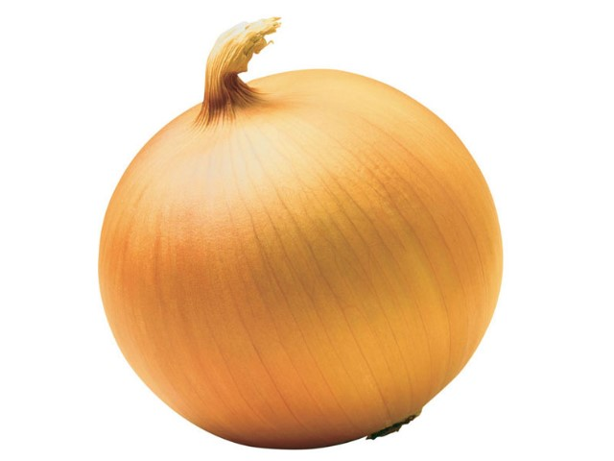

Slide 14
potato

Slide 15
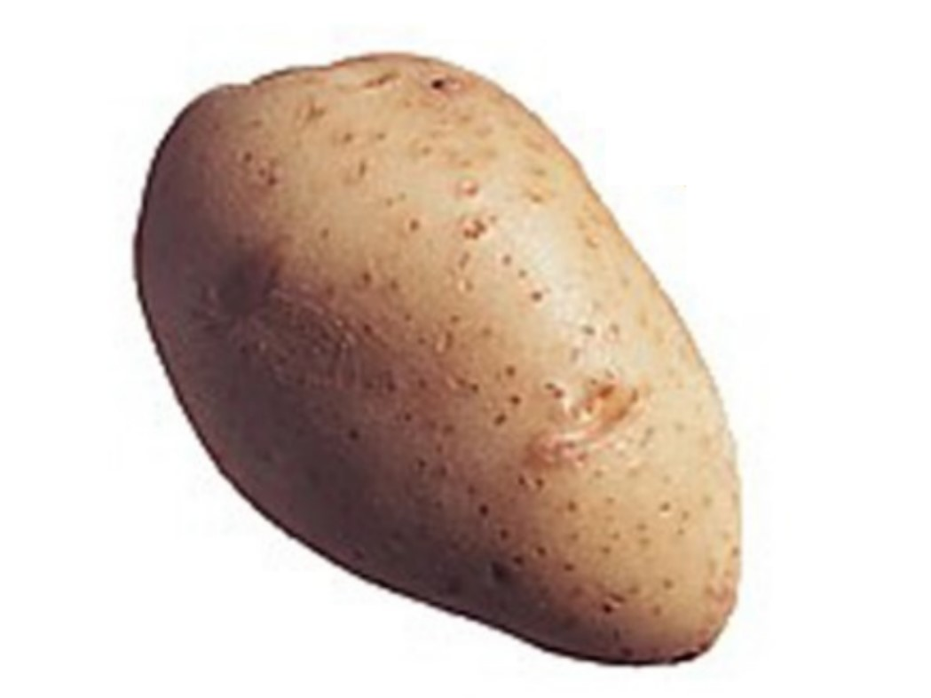

Slide 16
pumpkin

Slide 17
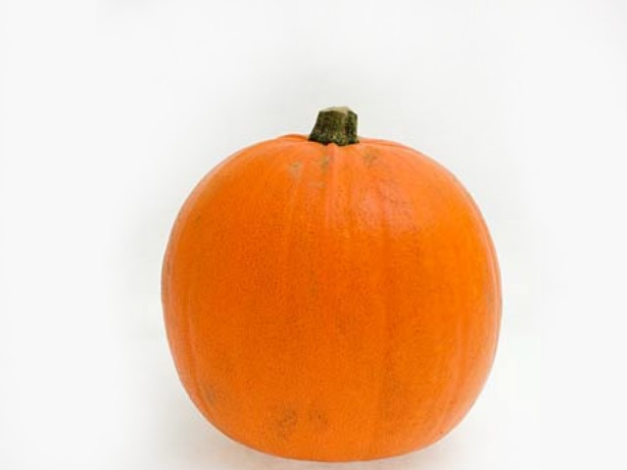

Slide 18
tomato

Slide 19
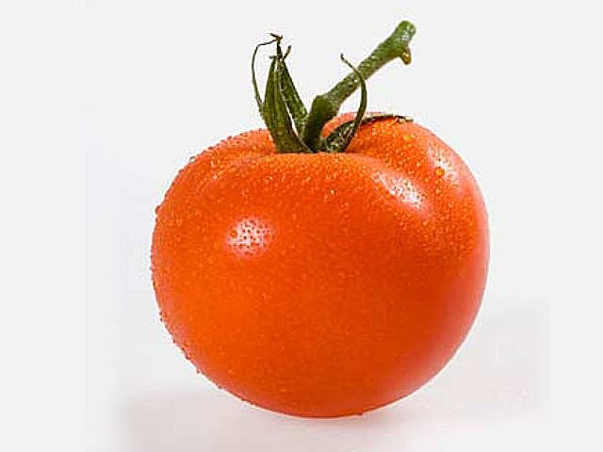

Slide 20
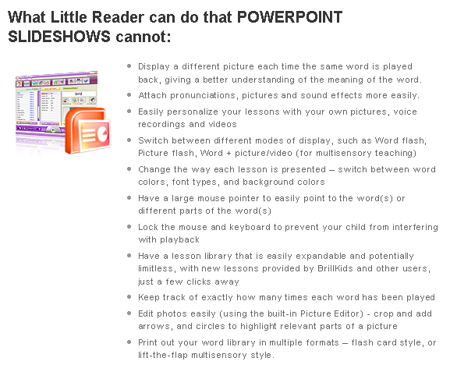
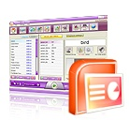
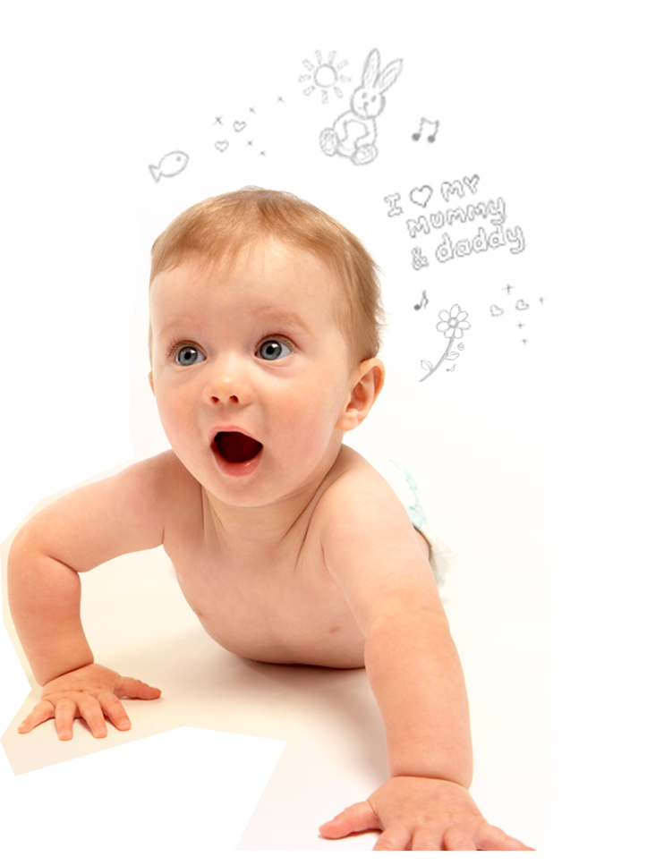

What Little Reader can do that PowerPoint cannot:
Display a different picture each time the same word is played back
Attach pronunciations, pictures and sound effects more easily.
Personalize your lessons with your own pictures, pronunciations and videos
Easily switch between different modes of display, such as Word flash and Multisensory mode
Change the way each lesson is presented – switch between word colors, font types, and background colors
Have a large mouse pointer to easily point to the word(s) or different parts of the word(s)
Lock the mouse and keyboard to prevent your child from interfering with playback
Have a lesson library that is easily expandable and potentially limitless, with new lessons provided by BrillKids and other users
Help you keep track of exactly how many times each word has been played
Edit photos easily (using the built-in Picture Editor) - crop and add arrows, and circles to highlight relevant parts of a picture
Print out your word library in multiple formats – flash card style, or lift-the-flap multisensory style.

