Slide 1

Good Habits

Slide 2
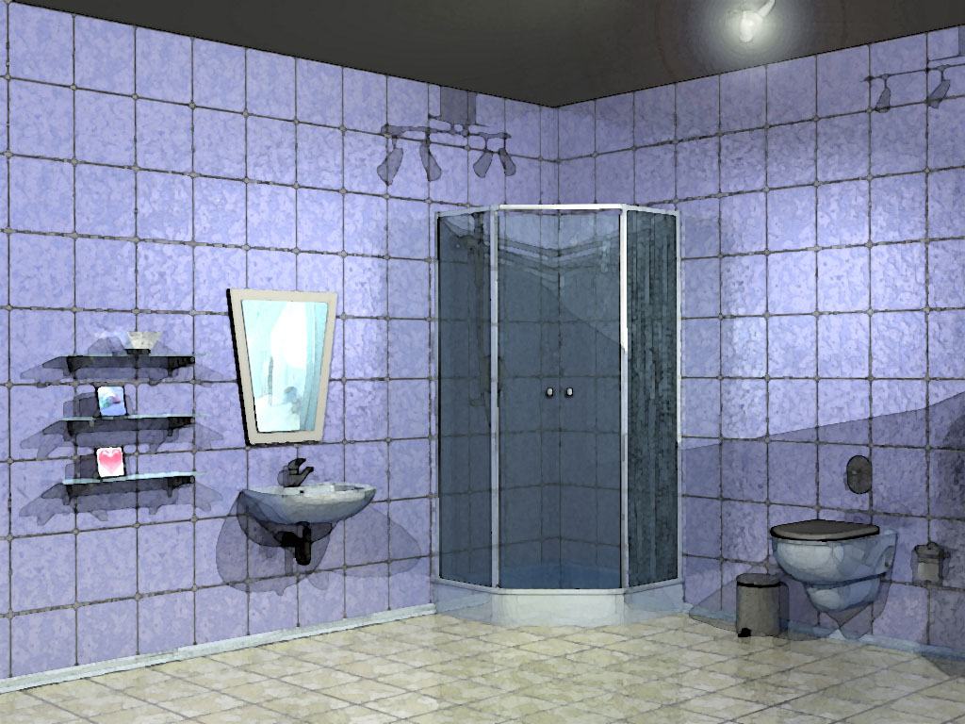


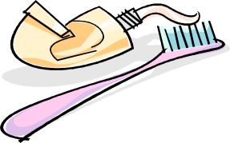
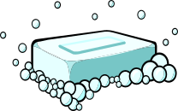



CLICK ON DIFFERENT PICTURES TO LEARN ABOUT GOOD HYGIENE!

Slide 3
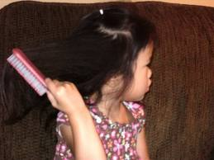
PERSONAL HYGIENE
Take a bath or shower every day
Brush your teeth every morning
Comb your hair
Put on clean clothes every morning
Wash your hands often
Brush and floss your teeth before going to bed

Slide 4
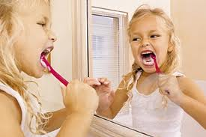
WHY DO WE BRUSH OUR TEETH?

Slide 5


BRUSHING YOUR TEETH!
Dentists recommend that adults and children brush their teeth at least twice a day, floss everyday, and go see the dentist regularly!
You must brush your teeth to remove all the food and sticky bacteria, called plaque, from your teeth!
While brushing your teeth, you must always be sure to use toothpaste, and toothpaste with fluoride is what helps to prevent cavities. (Goss, & Inga, 2008)

Slide 6

BRUSHING YOUR TEETH!
Step One: Get out your toothbrush and toothpaste (with flouride!)
Step Two: Wet your toothbrush, and add a pea-sized amount of toothpaste to it.
Step Three: Hold your brush at a 45 degree angle to the gumline (Goss, & Inga, 2008).
Step Four: Gently brush in short, little circular motions.
Step Five: Continue step four for two minutes.
Step Six: Spit out toothpaste and rinse your mouth!
Step Seven: Repeat process again at least once more throughout the day (Goss, & Inga, 2008).

Slide 7
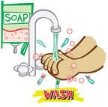
HOW TO KEEP OUR HANDS FREE FROM GERMS:
*WASH THEM OFTEN!
*USE SOAP AND WARM WATER

Slide 8
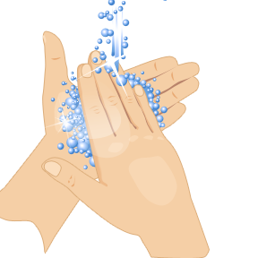
WASHING YOUR HANDS!
Washing your hands is a very important part of staying clean and healthy. This is how we try to prevent the spread of disease and germs to others!
Clean water and soap is the best way to keep your hands clean. However, if clean water is not available, use soap and whatever available water. If soap is not an option, use an alcohol based sanitizer. (Center for Disease, 2010)
We will learn the best times and ways to wash your hands to keep yourself and others around you healthy!

Slide 9
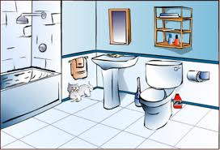
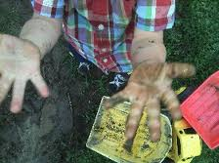


WHEN SHOULD WE WASH OUR HANDS?

Slide 10



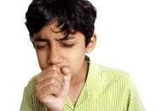
WHEN SHOULD WE WASH OUR HANDS?

Slide 11


KEEP GERMS AWAY
BY COVERING YOUR MOUTH!
Sneezing
Coughing

Slide 12
TAKING A BATH!
Taking a bath or a shower is a very important part of being hygienic!
Reasons for bathing are very similar to the reasons to wash your hands. You need to bathe to be able to get rid of germs that can cause illnesses. Bathing is also important for us to keep all parts of our body clean.
Bathing can be quick, or it can be relaxing! You can bathe by taking a shower, or by taking a bath in a tub!
Bathing also helps you not be so stinky! ☺ ("Bathing," 2011)

Slide 13
TAKING A BATH!
Safety Tips/Hazards
  Be sure if taking a bath that you or the child you are bathing doesn’t submerge their head under the water.
  Swimmer’s Ear can result from water in the ears.
  Infections can occur if water is not clean enough
  Falling can happen due to wet feet and wet floors; be sure to step out very carefully! ("Bathing," 2011)
Healthy bathing techniques:
  Bathe regularly (every few days)
  Be sure to use soap
  Use Shampoo (and conditioner if desired!)
  Be sure water is not too hot

Slide 14

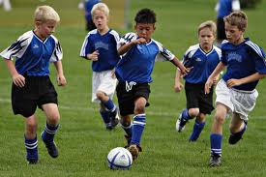
GET ACTIVE & HAVE FUN!
What do you like to do for fun?

Slide 15
LET’S GET MOVING!
Touch your toes and touch your nose.
Reach up to the sky!
Start marching and flap your wings.
Pretend that you can fly!
Bend to your left and to your right.
Swing your arms up high!
Now touch your toes and touch your nose.
Reach up to the sky!

Slide 16
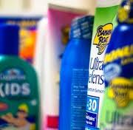
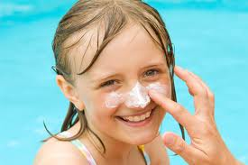
IS SUNBLOCK GOOD OR BAD FOR YOUR BODY?
When should we put sunblock on?
Whenever we play in or near water (swimming, boating, playing at the beach, etc.)
Whenever we play outside (sports, bike rides, etc.)

Slide 17



BE HEALTHY
& HAVE FUN!

