Slide 1

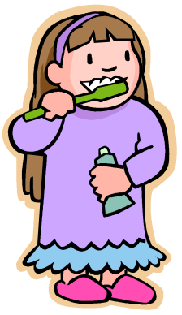
Personal Hygiene
Mrs.Puvaneswari Ramesh
Assoc. Professor
NHCON

Slide 2
Contents
Hygiene and Elements
Personal hygiene – Definition
Care of
Hair
Skin and Face
Teeth
Ears
Hands
Nails and cuticles
Feet

Slide 3
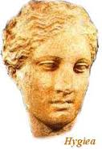
Hygiene
From the Greek word “hygies”(Hygiea- Goddess of Health)
Meaning
“healthy, sound”

Slide 4

Hygiene – Common elements
Personal hygiene
Environmental hygiene
Personal hygiene
Environmental hygiene

Slide 5
Personal hygiene - Definition
Personal hygiene may be described as the principle of maintaining cleanliness and grooming of the external body.
Failure to keep up a standard of hygiene can have many implications. Not only is there an increased risk of getting an infection or illness, but there are many social and psychological aspects that can be affected.

Slide 6
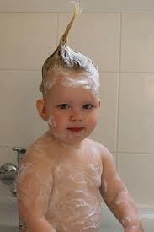
What is Personal Hygiene?
Regular Routine of Personal Care
Washing and Grooming of
Hair
Face and Skin
Teeth
Ears
Hands
Nails
Feet

Slide 7

Hair
Hair is made of dead cells.
Hair is important because it brings oil to the surface of the skin.
Hair helps warm the body by trapping a layer of air next to the scalp.

Slide 8
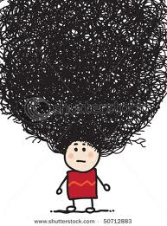
Hair Care Tips
Wash regularly with shampoo. Rinse hair thoroughly with clear water after shampooing to remove all the soap
Don't scrub or rub too hard . It may irritate your scalp or damage your hair.

Slide 9
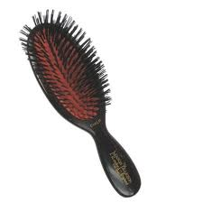
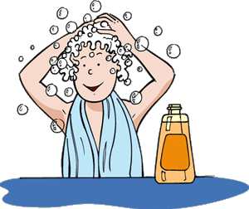
Massage your scalp well. It will remove dead skin cells, excess oil and dirt
Brush hair daily
Wash combs and brushes frequently
Don’t share combs, brushes etc.

Slide 10
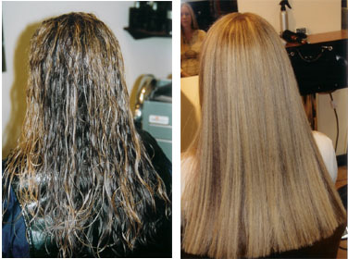
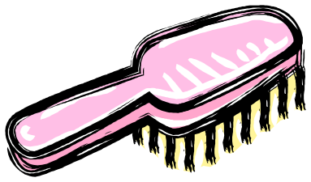
Why Brush Your Hair?
Brushing helps keep the scalp clean by loosening and removing dust and dead cells.
It also adds shine

Slide 11
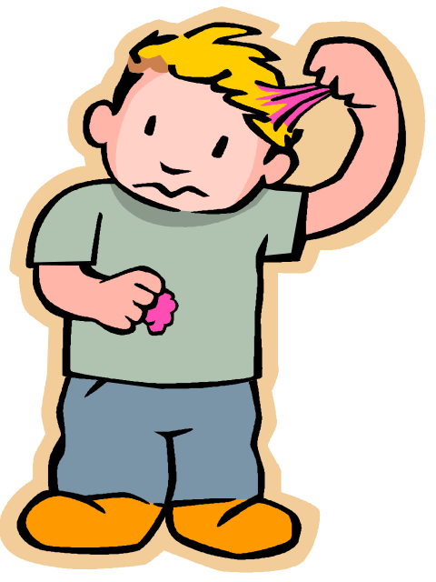
Hair & Scalp problems
Dandruff
Head lice
Splitting and breaking

Slide 12
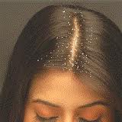
Dandruff
A flaking of the outer layer of dead skin cells on the scalp. This condition is usually caused by dry skin. There is no cure for dandruff, but it can be controlled with special shampoos.

Slide 13
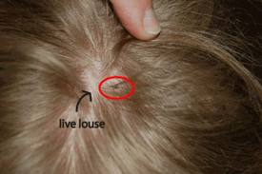
Head Lice
Parasitic insects that live on the hair shaft and cause itching.
Lice can’t fly or jump from person to person, but they are easy to catch from other people.

Slide 14
Avoiding and Treating Head Lice
Don’t share:
Combs, brushes, hats ,barrettes or other hair things, headphones
Use special shampoo and wash your hair immediately.
Any linens and clothes you have used should be washed in hot water or
dry-cleaned.

Slide 15
Splitting & Breaking
Too much heat can cause the layered cells of your hair to split apart and even break off.
Wind, chlorine, chemical treatments, and permanent hair dye can weaken hair in the same way.
If you put your hair in a ponytail , use a coated rubber band or soft cloth hair band.
Noncushioned or uncovered elastic bands can cause severe breakage.

Slide 16
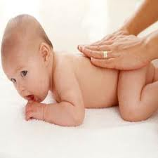
Skin
The human skin is the outer covering of the body.
Functions of Skin
Protection.
Vitamin D formation
Temperature control
Sensation
Water resistance
Control of evaporation
Excretion
Absorption

Slide 17
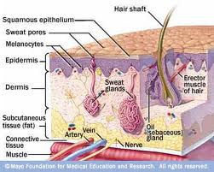
Three layers of skin
Epidermis- Outer most layer of skin. Cells in the epidermis make melanin
Dermis-Inner layer of skin which contains blood vessels, nerve endings, hair follicles, sweat glands, and oil glands
Layer of fat cells

Slide 18

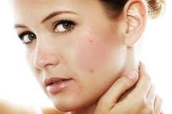
Common Skin problems
Bad odor
Acne

Slide 19
Body odor
Perspiration itself doesn’t smell. However, during sweating, another liquid called apocrine is also secreted. When apocrine combines with the bacteria naturally present on the skin, odor results
Bad odor is Caused by
Poor hygiene
Foods such as onions and garlic

Slide 20
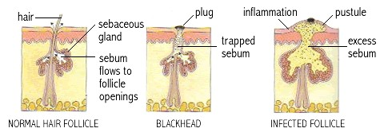
Acne
Acne is created when oil from the oil glands mix with the dead cells and plug up the hair follicles in the skin it creates a “whitehead.”
A “blackhead” is when the air touches the plug, the plug turns black

Slide 21
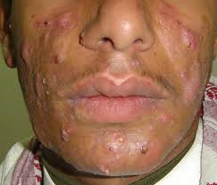
What makes acne worse?
Oil-based makeup, suntan oil, hair jells and spray.
For girls, menstruation
For Boys it may get worse because they have more skin oil.
Squeezing or picking at blemishes
Hard scrubbing of the skin

Slide 22
Daily baths or showers using soap and scrubbing the entire body with a washcloth Do not need to scrub violently.
The use antiperspirants decreases perspiration and cover odor with a manly smell
Wash the face two times a day with a mild soap or gentle cleanser. It is best to
Use lotions only if needed, and use ones that are oil-free and water-based.
Try to stay out of the sun, and use a sunscreen every day during summer and winter.

Slide 23
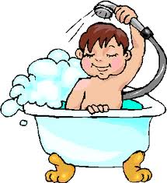
Skin Care Tips
Bathe or shower regularly using soap
Do not scrub violently
If possible, bathe or shower after exercise – especially after sweating
Use antiperspirants decreases perspiration and cover odor with a manly smell
Wear clean clothes
Reduce stress levels which
irritates the skin
Maintain a healthy diet

Slide 24
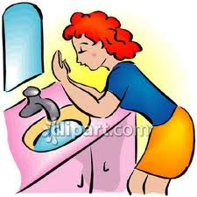
Skin Care Tips
Wash your face 2 times a day.
Avoid washing too often, as the skin will become irritated and dry out.
Keep oily hair away from your skin
Avoid touching acne except when washing
Don’t squeeze or pick the pimples
Try to avoid touching the face.
Keep hands clean by washing them often.

Slide 25



Protect yourself from the sun
Wear sunscreen and reapply it every hour.
Wear a hat, T-shirt, and sunglasses.
Drink plenty of fluids.
Protect yourself from UV Rays

Slide 26

Teeth
Healthy teeth and gums enable you to:
Chew food thoroughly
Speak clearly
Give shape and structure to your mouth

Slide 27
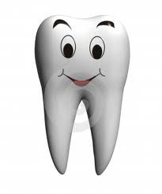
Structure of teeth
Enamel (top)
The hard material on the outer surface of the tooth.
Dentin (middle)
Below the enamel – the bonelike material that surrounds the sensitive inner parts of the tooth.
Pulp (inside)
Tissue that contains nerve endings and blood vessels.

Slide 28
Dental problems
Dental problems are caused by the activity of certain types of oral bacteria
Other causes:
Tongue not cleaned
Food stuck in teeth
Sinus problems
Stomach problems

Slide 29
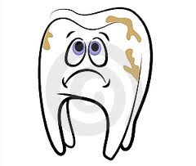
Dental Problems
Halitosis
Tooth decay
Plaque
Tartar
Periodontal Disease

Slide 30
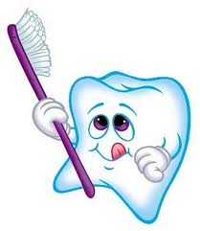
How to avoid Dental problems- Brushing & Flossing
Daily dental hygiene routine that consist of brushing for 2-4 minutes and flossing
I f possible, brush after every meal or rinse your mouth with warm water.
Use a soft-bristled brush.

Slide 31
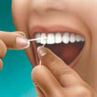
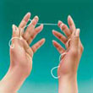
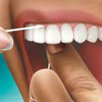
Brushing & Flossing
Replace your toothbrush every 2-3 months or after an illness.
Use toothpaste that contains fluoride.
Flossing removes food trapped between your teeth and gum lines that rinsing and brushing miss.
FLOSSING

Slide 32

Dental care
Eat at least 5 servings of fruits and vegetables each day.
Include foods that contain calcium, such as milk and yogurt.
Limit intake of sugar.
See a dentist every 6 months

Slide 33
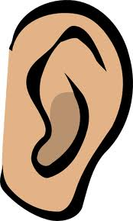
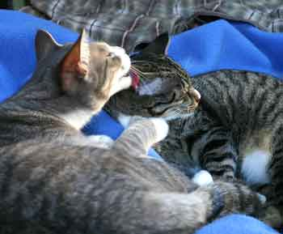
Ears
Wash ears daily with a wash cloth don’t forget behind the ears
Do not use Q tips in ears it will smash the ear wax deep into the ear canal
Usually Ear wax is usually removed when you chew food or gum

Slide 34
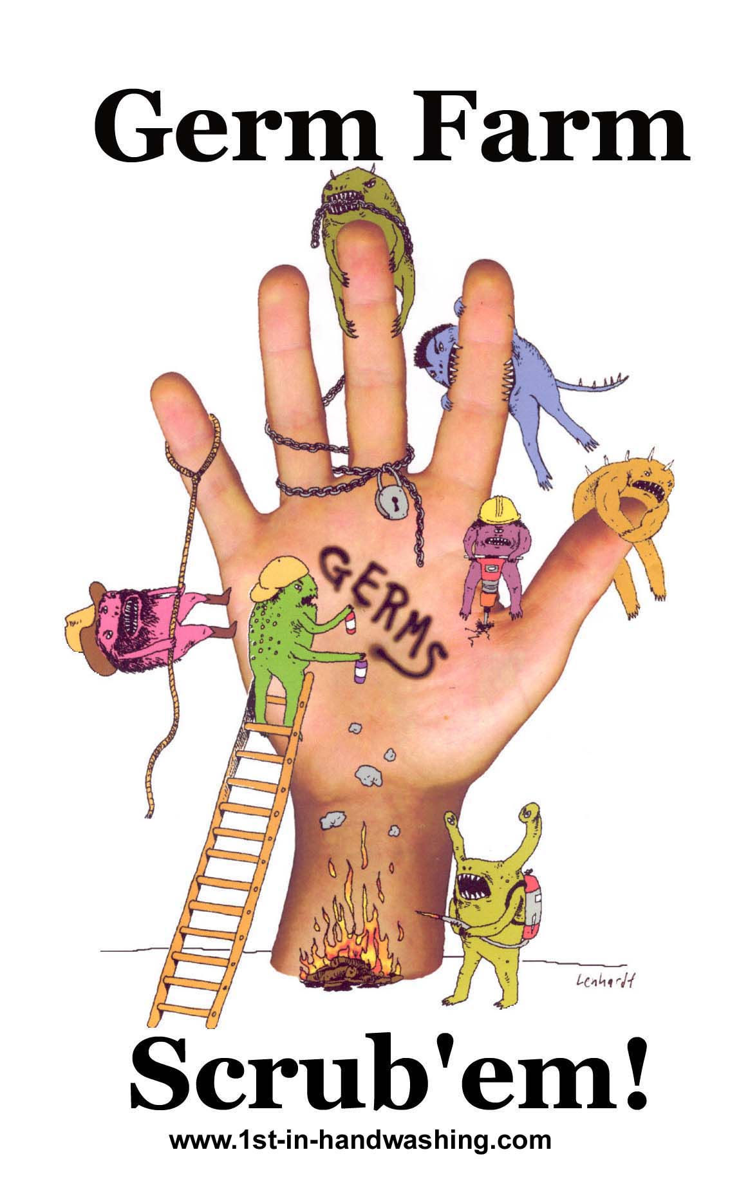
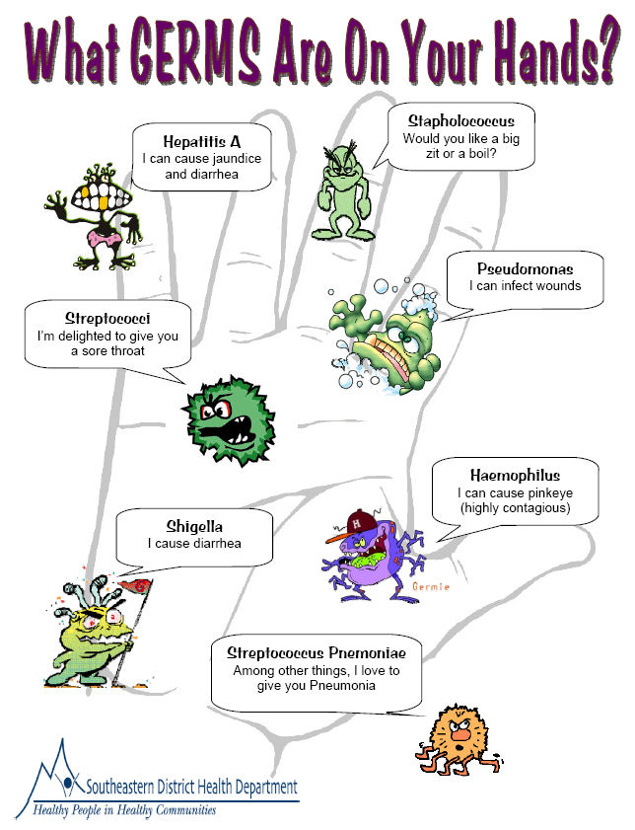
Hands

Slide 35
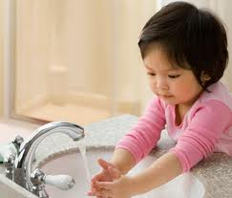
HAND HYGIENE
First, wet hands and apply liquid or clean bar of soap.
Next, rub your hands together and scrub all surfaces (palms, fingers, and in between).
Continue for 10-15 seconds. Soap combined with the scrubbing action that helps remove germs.
Rinse well and dry your hands.

Slide 36
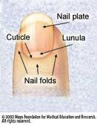
Nails and cuticles
The part of the nail that can be seen and touched is composed of dead cells. Thin skin-like layer at the base of each nail is called cuticle .A non-living band of tissue.
Nails protect the sensitive tip of our fingers and toes.
Without proper care they can become weak, ingrown or infected.

Slide 37
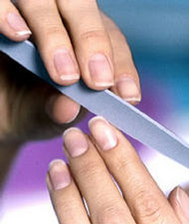
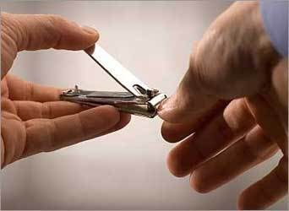
Nail Care
Keep nails trim but do not cut nails shorter than skin level.
Keep nails clean.
Round your fingernails slightly when trimming them.
Cut toe nails straight across.
Smooth rough nail edges with a file or emery board.

Slide 38
Cuticles Care
Clean and soften your hands in warm water.
To keep your cuticles neat, push them back after soaking your hands, while they are soft.
You may also use cuticle remover , a chemical that dissolves the cuticle

Slide 39
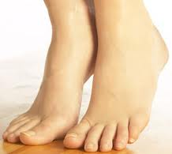
Feet Care
Large collection of sweat glands live in our feet
Wash your feet well at least once a day.
Dry them carefully, especially between the toes.
Keep feet and skin clean and dry
Change socks daily
Avoid walking barefoot in public areas

Slide 40
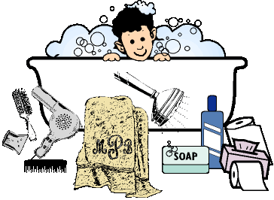
Make Hygiene part of your daily routine

Slide 41


