Slide 1
Numbers 0 - 9
Mr. Blank
Notes:
Introduce the lesson as a kindergarten math lesson

Slide 2
Introduction
There are ten different numbers that represent different quantities of objects. These numbers are represented by different symbols.
Objectives
Learn the numbers from 0 to 9 in order
Identify which numbers are larger or smaller
Identify the symbols that correspond to each number value
Notes:
Discuss the objectives

Slide 3
The Number “Zero”
Symbol
0
Notes:
Talk about the number zero
Lowest integer

Slide 4
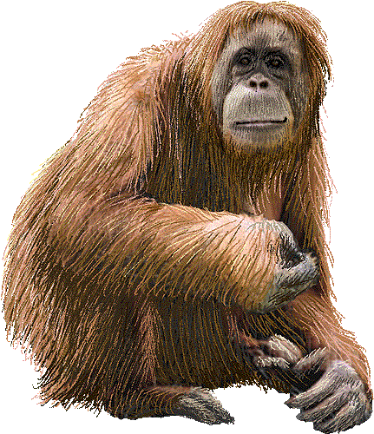
The Number “One”
Symbol
1
Notes:
Number one and its symbol

Slide 5

The Number “Two”
Symbol
2
Notes:
The number two and its symbol
Two Toucans

Slide 6

The Number “Three”
Symbol
3
Notes:
The number 3 and its symbol
3 tigers

Slide 7

The Number “Four”
Symbol
4
Notes:
The number four and its symbol
4 foxes

Slide 8

The Number “Five”
Symbol
5
Notes:
The number 5 and its symbol
5 falcons

Slide 9

The Number “Six”
Symbol
6
Notes:
The number 6 and its symbol
6 scorpions

Slide 10
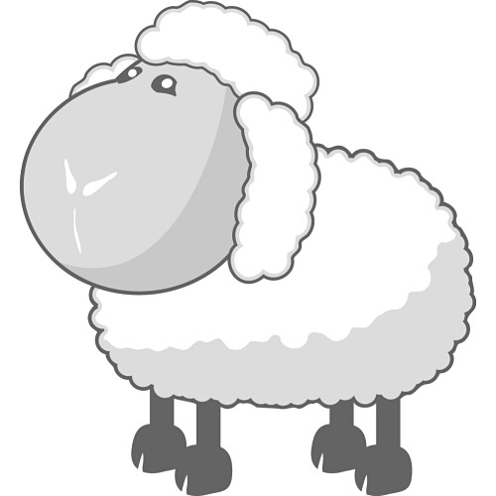
The Number “Seven”
Symbol
7
Notes:
The number 7 and its symbol
7 sheep

Slide 11

The Number “Eight”
Symbol
8
Notes:
The number 8 and its symbol
8 eagles

Slide 12
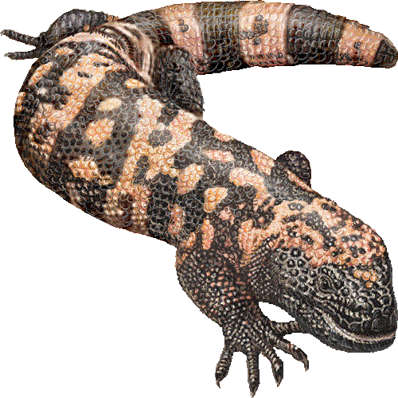
The Number “Nine”
Symbol
9
Notes:
The number nine and its symbol
9 newts

Slide 13
RECAP
The numbers in order from least to greatest…
0 1 2 3 4 5 6 7 8 9
Zero One Two Three Four Five Six Seven Eight Nine
Notes:
A recap of the numbers 0-9

Slide 14
Teacher Web Page
Mr. Blank's Website

