Slide 1

www.makemegenius.com– Full of ingredients to make your child a genius.
“Don’t make me read, make me understand “

Slide 2
Addition
Subtraction
Problem Solving

Slide 3
Addition
3 5 8 9 7
+4 +5 +6 +9 +6
7
10
14
18
13

Slide 4
Three Digit Addition
2 9 2
3 5 8
+5 +1 +4
10 15 14

Slide 5

Word Problem
Corell likes to paint pictures of lions. She has painted 8 pictures so far. If she paints 3 more pictures how many will she have.
Corell now has 11 pictures

Slide 6
Subtraction
13
- 9
19
- 1
4
18

Slide 7
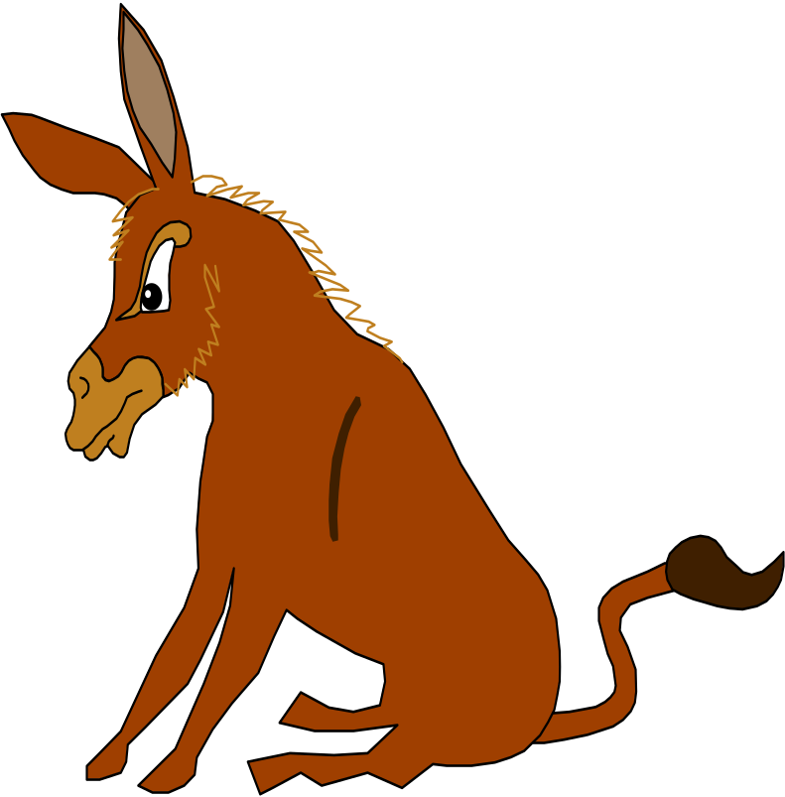
Word Problem
Do you
ADD
Do you
Subtract
A donkey makes 5 friends then he makes 2 more. How many does he have now?
He now has 7 friends.

Slide 8
Three Digit Subtraction
9
3
- 2
4
2
-1
4
1

Slide 9
Bonus get it right get a sucker
100 - 45 =
55

Slide 10
All Kinds of Problems
There are 3mice and 3 more join them. How many do they have now?
9
-3
9
+3
There are now 6 mice
6
12

Slide 11

Thanks
Submitted by
Adesh
Ahmadabad

Slide 12
If you also want to share your own or your kid’s presentation(ppt) please send it on info@makemegenius.com

Slide 13
www.makemegenius.com– Full of ingredients to make your child a genius.
“Don’t make me read, make me understand “

