Slide 1

www.makemegenius.com– Full of ingredients to make your child a genius.
“Don’t make me read, make me understand “

Slide 2
Welcome to a world full of machines!
There are machines all around us!
Turn to your neighbor and discuss what kinds of machines you saw on your way to school today.

Slide 3
The 6 Simple Machines
All machines are made up of some of the 6 simple machines. They are:
Wheel and axle
Pulley
Lever
Wedge
Screw
Inclined Plane

Slide 4
Why do we need simple machines?
Work means that we are exerting force and moving something. The 6 simple machines make our work easier. We won’t have to use as much force with our simple machines.

Slide 5
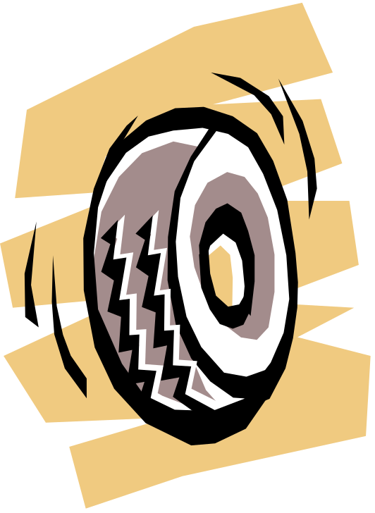
The Wheel and Axle
Two or more wheels are connected by an axle.
The wheel turns with or around the axle.
This car wheel has a big axle that it rotates around when the car moves.

Slide 6
Why do we need wheels?
Wheels help us move heavy objects.
They roll easily.
Did you know a doorknob is really two wheels connected by an axle? You can’t see the axle because it’s inside the wheels, but it’s there!
If there wasn’t an axle, the doorknob wouldn’t turn!

Slide 7
Another kind of wheel is called a gear!
A gear is a wheel with teeth.
The teeth fit in between each other and turn.
When one gear turns, its teeth push against the teeth of the other gear and they both turn.
There are gears on your bike, on a can opener and on an egg beater.

Slide 8
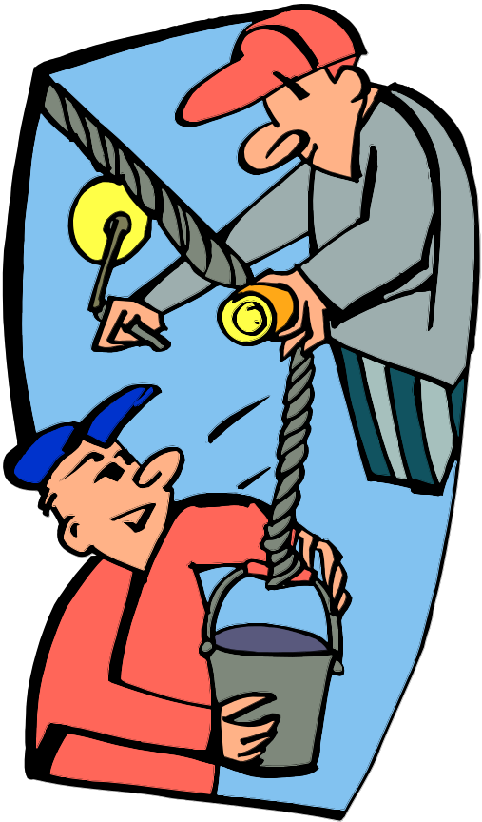
Pulleys
Lifting a bucket full of water is a lot of work!
A pulley is a wheel with a rope running over it. The wheel has a groove, called a sheave, and it keeps the rope from slipping off the wheel.
Remember, since there is a wheel in a pulley there also has to be an axle!
These two men are using a pulley to help them lift their heavy bucket.

Slide 9
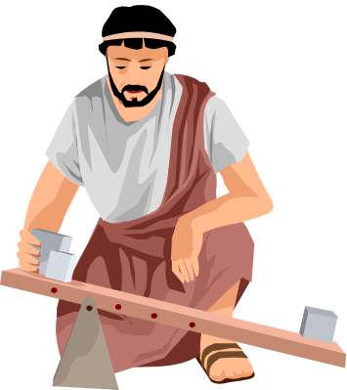
Levers
There are three parts to a lever:
Load
Force
Fulcrum: support or balance

Slide 10
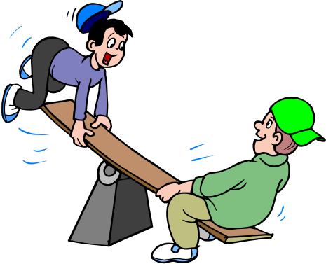
A seesaw is a lever
Let’s pretend you are riding a seesaw with your friend.
The center support is the fulcrum, which does not move.
The load is your friend sitting on one end.
You exert the force at the other end trying to lift your friend off the ground.
When you push down on your seat, (the force) you can lift your friend (the load) while the fulcrum acts as the pivot point, making the seesaw go up and down.
It’s easy to lift your friend this way instead of just picking her or him up by yourself!

Slide 11
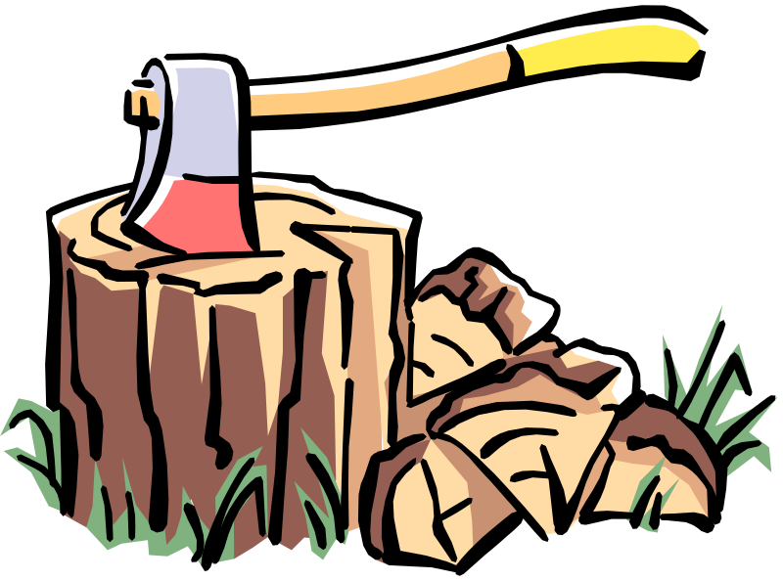
The Wedge
A wedge is used to split, tighten, or secure a hold.
A wedge is usually a triangle shape with a sharp point.
If you apply force at one end, the wedge will go between something, in this case an ax splits a piece of wood.

Slide 12
Where can we find wedges?
Wedges that split:
Your teeth!
Every time you bite into something, you are using a wedge.
Wedges that cut:
A saw!
A knife!
Wedges that tighten:
A doorstop to keep the door open.
Wedges that hold things together:
A nail holds wood to a wall or other wood.

Slide 13
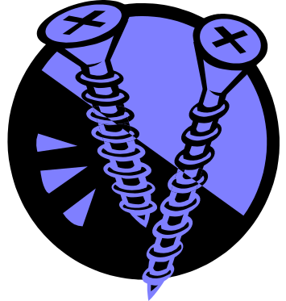
The Screw
The three parts to a screw:
Head
Shaft
Tip
The head is the part that you exert a force on.
The shaft has ridges, called threads that wind around the screw. If it doesn’t have the threads, it is probably just a nail.
The tip is sharp.

Slide 14
How to use a screw:
Fasten two things together
When you turn it, the threads cut a groove in the material, making a hole. The groove holds the screw tightly in place.
To remove the screw you turn it the opposite way, you can’t just pull it out.

Slide 15
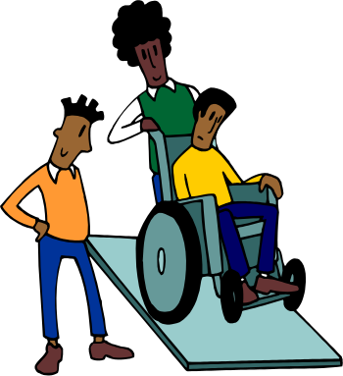
The Inclined Plane
It is a slanted surface or ramp.
It makes moving objects easier.
Roads are also inclined planes. Instead of going straight up, like this: roads go up at small angles, like the picture.

Slide 16
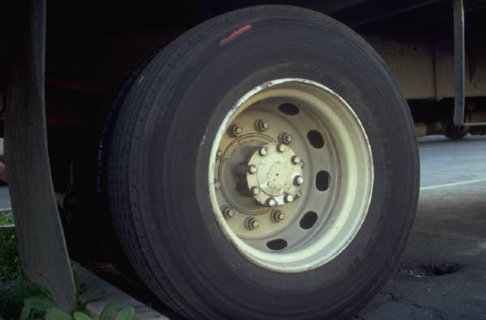
The 6 Simple Machines
Lever
Inclined Plane
Pulley
Wedge
Wheel and Axle
Screw

Slide 17
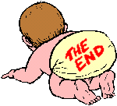
Thanks
Submitted by
Prateek
Gurgaon

Slide 18
If you also want to share your own or your kid’s presentation(ppt) please send it on info@makemegenius.com

Slide 19
www.makemegenius.com– Full of ingredients to make your child a genius.
“Don’t make me read, make me understand “

