Slide 1
Landforms
By make me genius.com
www.makemegenius.com Free Science Videos for Kids

Slide 2
Meaning
Landforms are natural features of the landscape, natural physical features of the earth's surface.
www.makemegenius.com Free Science Videos for Kids

Slide 3
Visit
www.make me genius.com
foe free video on Landforms
It is free.
www.makemegenius.com Free Science Videos for Kids

Slide 4
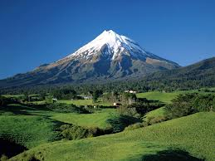
Mountain
A mountain is a very tall high, natural place on Earth
www.makemegenius.com Free Science Videos for Kids

Slide 5
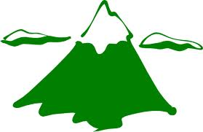
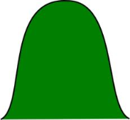
Difference between Mountain & Hill
mountain
hill
A hill is a natural and small elevation of the surface of the earth.
Mountain is also a natural elevation but it attains an altitude greater than a hill.
www.makemegenius.com Free Science Videos for Kids

Slide 6
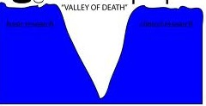
VALLEY
MOUNTAIN
MOUNTAIN
Low land Area between two mountains
www.makemegenius.com Free Science Videos for Kids

Slide 7
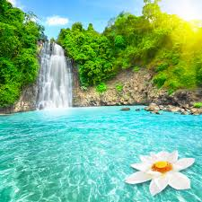
Waterfall
When a river falls off steeply, there is a waterfall.
www.makemegenius.com Free Science Videos for Kids

Slide 8
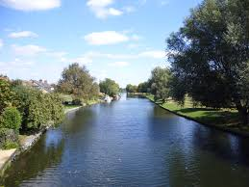
River
A river is a large, flowing body of water that usually empties into a sea or ocean.
www.makemegenius.com Free Science Videos for Kids

Slide 9
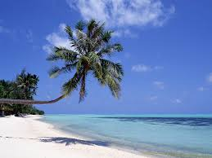
Ocean
An ocean is a large body of salt water that surrounds a continent. Oceans cover more the two-thirds of the Earth's surface
www.makemegenius.com Free Science Videos for Kids

Slide 10
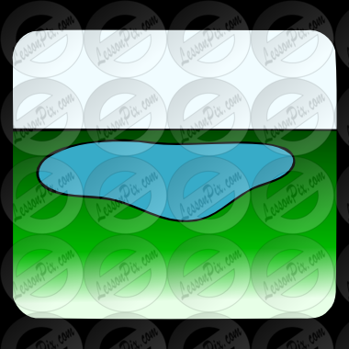
Lake
Water body
Land on all sides
www.makemegenius.com Free Science Videos for Kids

Slide 11
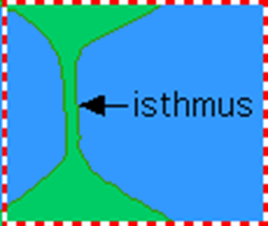
land
water
water
land
Strip of Land
Water on 2 sides
www.makemegenius.com Free Science Videos for Kids

Slide 12
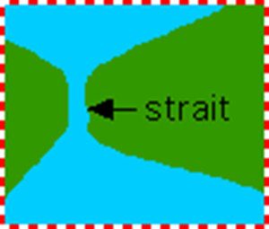
water
land
land
water
Strip of water
Land on 2 sides
www.makemegenius.com Free Science Videos for Kids

Slide 13
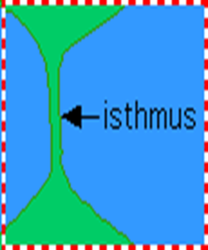

Difference
Lake
Strip of Land
Water on 2 sides
Strip of water
Land on 2 sides
Water body
Land on all sides
www.makemegenius.com Free Science Videos for Kids

Slide 14
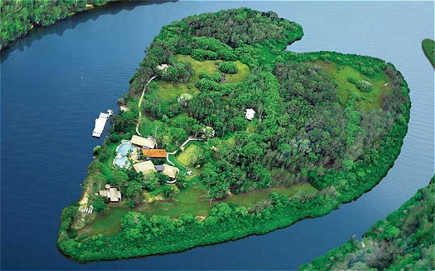
Island
An island is a piece of land that is surrounded by water.
www.makemegenius.com Free Science Videos for Kids

Slide 15
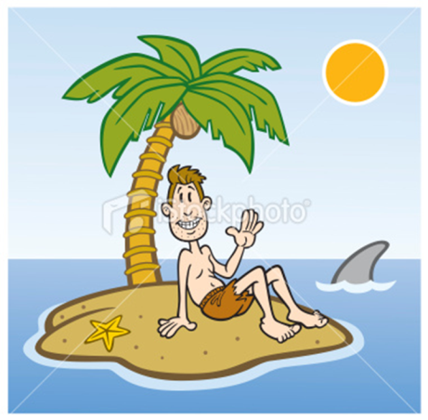

Island and lake Difference
Lake
Water body with land on all side
Island
Piece of land with water on all side
www.makemegenius.com Free Science Videos for Kids

Slide 16
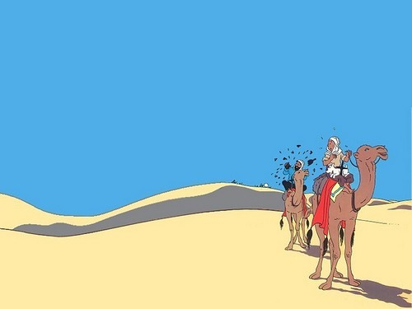
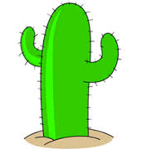
Desert
A desert is a very dry area with lots of sand.
www.makemegenius.com Free Science Videos for Kids

Slide 17
Visit
www.make me genius.com
foe free video on Landforms
It is free.
www.makemegenius.com Free Science Videos for Kids

