Slide 1

www.makemegenius.com Free Science Videos for Kids

Slide 2

Visit
www.makemegenius.com
www.makemegenius.com Free Science Videos for Kids

Slide 3
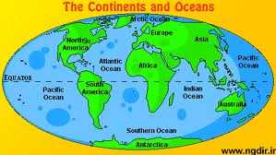
Oceans –Facts
www.makemegenius.com Free Science Videos for Kids

Slide 4
Mnemonic for Oceans
The first letter of each word corresponds with the first letter of an ocean
A Pool Around Islands
Arctic Pacific Antarctic Indian
www.makemegenius.com Free Science Videos for Kids

Slide 5
The World’s Oceans
71% of the Earth’s surface is covered by ocean water.
The oceans contain 97% of the earth’s water.
All the oceans and seas are in reality one continuous body of water.
90% of all volcanic activity occurs in the oceans.
www.makemegenius.com Free Science Videos for Kids

Slide 6
Oceans
There are 4 oceans:
-Atlantic, Pacific, Indian.,Arctic
The Pacific Ocean is the largest ocean.
www.makemegenius.com Free Science Videos for Kids

Slide 7
Seas
A sea is a part of an ocean that is nearly surrounded by water.
The Mediterranean, Arctic and Black Sea are really part of the Atlantic Ocean.
www.makemegenius.com Free Science Videos for Kids

Slide 8
Properties of Ocean Water
Ocean water is a mixture of gases and solids dissolved in pure water.
Oceanographers believe oceans contain all the natural elements on Earth.
85 of 90 natural elements have been found in the ocean.
www.makemegenius.com Free Science Videos for Kids

Slide 9
Major Elements in the Ocean
Ocean water is 96% pure water.
Chlorine (1.9) and sodium (1.1) make up the next largest concentration of elements.
Sodium chloride is table salt.
www.makemegenius.com Free Science Videos for Kids

Slide 10
Salinity
Salinity describes the amount of dissolved water in the ocean.
Salinity is expressed in parts per thousand.
The salinity level of the ocean is expressed in parts per thousand.
The average salinity of ocean is 35 parts per thousand.
Sources of Salt in the Ocean
When volcanoes erupt, rock materials and gases, such as chlorine, spew forth.
As rivers, streams and glaciers move over rock and soil, they dissolve salts, such as magnesium, sodium and potassium, in them.
As waves pound the shoreline, they dissolve salts from the rocks.
www.makemegenius.com Free Science Videos for Kids

Slide 11
Gases in Ocean Water
The most abundant gases in ocean water are nitrogen, carbon dioxide and oxygen.
The amounts of these elements vary with depth. They are more abundant at the ocean’s surface where sunlight causes more plant life.
www.makemegenius.com Free Science Videos for Kids

Slide 12
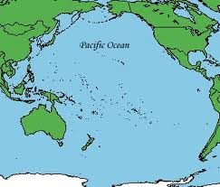

www.makemegenius.com Free Science Videos for Kids

Slide 13
The Pacific Ocean
The Pacific Ocean is the largest of all the oceans.
The area and volume of the Pacific Ocean are greater than the Atlantic and Indian combined.
The Mariana Trench in the Pacific ocean is the deepest point in the world, reaching a depth of 10,911 metres.
Its name was given by a Portuguese explorer Ferdinand Magellan , Mar Pacifico in Portuguese, meaning "peaceful sea“.
The International Date Line passes through the Pacific Ocean .
www.makemegenius.com Free Science Videos for Kids

Slide 14
The Pacific Ocean
The Pacific Ocean has approximately 1/3rd of the Earth's surface
The Pacific ocean is larger than Earth's entire landmass.
The Pacific ocean is also the deepest of all the oceans.
There are more than 25,000 islands in the Pacific Ocean, the number being more than count of islands in the rest four oceans.
The Great Barrier Reef in Pacific Ocean, is the longest reef in the world.
www.makemegenius.com Free Science Videos for Kids

Slide 15
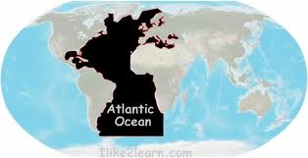

www.makemegenius.com Free Science Videos for Kids

Slide 16
The Atlantic Ocean
Atlantic Ocean is the second largest ocean in the world.
Of all the world's oceans, Atlantic Ocean is the youngest. It is believed to have been formed during the Jurassic Period.
It is one of the busiest sea routes in the Western and Eastern Hemispheres.
The name 'Atlantic' is derived from the legendary island of 'Atlantis', as described by Plato - one of the ancient writers.
www.makemegenius.com Free Science Videos for Kids

Slide 17
The Atlantic Ocean
Atlantic Ocean was the first ocean to be crossed by ship and airplane.
The warm Gulf Stream of Atlantic Ocean keeps harbors in the Northern Europe away from ice, during winters.
he name Atlantic comes from the Greek word Atlantikos which was known in the English languauge at the time, as the Sea of Atlas.
The Atlantic Ocean is the world's saltiest sea
www.makemegenius.com Free Science Videos for Kids

Slide 18
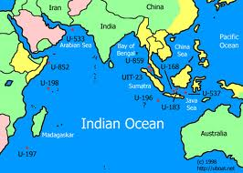

www.makemegenius.com Free Science Videos for Kids

Slide 19
The Indian Ocean
Indian Ocean, the third largest saline-water body of the world, derives its name from India
The only ocean which derives its name from the name of a country.
Indian Ocean is the warmest ocean in the world.
Indian Ocean is known as 'Ratnakara' in the ancient Sanskrit literature. Ratnakara means 'the maker (creator) of jewels'.
its limited marine animal life which is due to higher water temperature of this ocean.
Waters in the Indian Ocean have one of the lowest oxygen content of the world owing to greater evaporation rate in this ocean
www.makemegenius.com Free Science Videos for Kids

Slide 20
The Indian Ocean
The world's only closed ocean
due to it being land locked to it's north by the continent of Asia.
It is about half the size of the Pacific Ocean
The Indian Ocean is getting 20 cm wider every year
www.makemegenius.com Free Science Videos for Kids

Slide 21
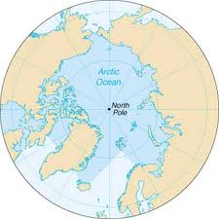

www.makemegenius.com Free Science Videos for Kids

Slide 22
The Arctic Ocean
The Arctic Ocean is the smallest and shallowest
It is also the coldest of all the oceans.
The north pole is situated in the middle of the Arctic ocean , there is no land on at the north pole, it is a floating raft of ice.
Once called the Frozen Ocean, the Arctic Ocean is covered with ice (2—14 ft/.6—4 m thick) throughout the year in most of its central and western portions.
The Arctic Ocean is roughly 8% the size of the Pacific Ocean.
During winter the Arctic Ocean is almost completely covered in sea ice.
www.makemegenius.com Free Science Videos for Kids

