Slide 1

www.makemegenius.com– Full of ingredients to make your child a genius.
“Don’t make me read, make me understand “

Slide 2
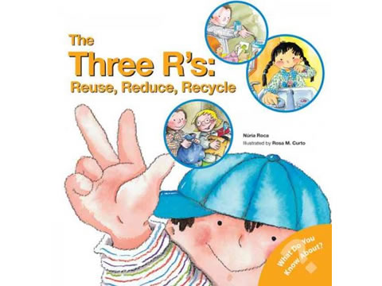
Environment Safety

Slide 3

Save Environment
???
Why
&
HOW
???

Slide 4
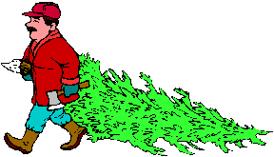
Re-use ,Reduce Paper Usage
Why
Paper is made by cutting trees.
If we reduce paper usage ,we can save trees
HOW
We can use papers on both sides.
Paper can also be recycled
Use Cloth towels, not paper towels

Slide 5
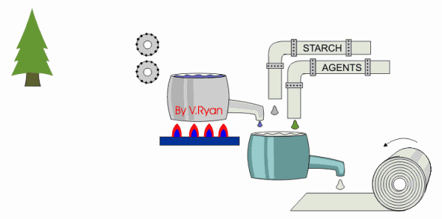
How paper is made ?
Tree
Paper

Slide 6
How paper is made ?
A tree is cut down and the trunk is fed into a machine where it is cut into very small pieces.
The small pieces of wood are boiled in water to form a thick pulp.
Chemicals are added.
The pulp is poured over a machine and the water escapes leaving paper behind.
This forms the paper.

Slide 7

Reduce- Electricity Usage
HOW
Why
Electricity is used by using oil & fossil fuel
More Electricity means more use of oil, fossil fuels.
Switch off lights when not required.
Do not open fridge again & again
Use CFL s lights

Slide 8

Reduce Water Usage
Why
HOW
Only 1% of Earth water can be used by People
Rest is salted or frozen.
If we keep using more, there would not be any water in future
Turn off Tap when not required.
Take short Showers
Recycle ,like give used waters to Plants

Slide 9
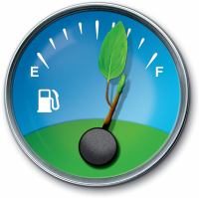
Reduce Fuel Usage
Why
HOW
Usage of fuel causes pollution
If we keep using more, there would not be any fuel in future
Walk more
Use public transport like buses, trains
Use CNG cars

Slide 10


Slide 11

Save fuel , Slow down

Slide 12
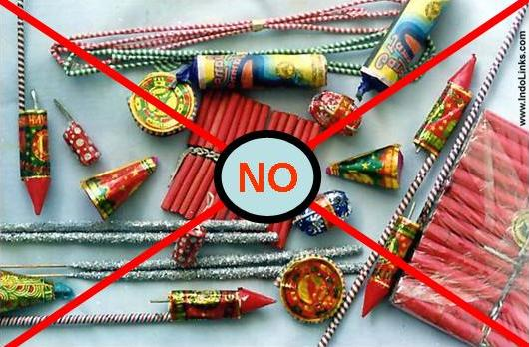
Reduce crackers usage

Slide 13
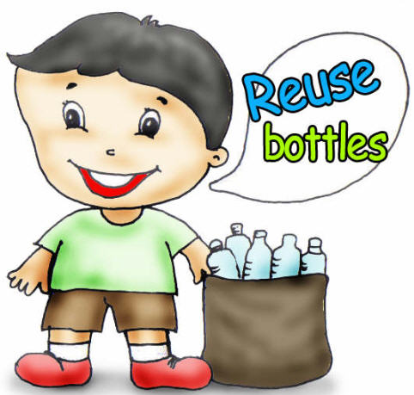

Slide 14
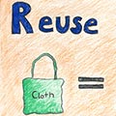

Save Plants

Slide 15

Recycle water
By using the AC water .
After washing clothes ,use waste water for plants

Slide 16

Thanks
Submitted by
Adit
Scotish High School
Gurgaon

Slide 17
If you also want to share your own or your kid’s presentation(ppt) please send it on info@makemegenius.com

Slide 18
www.makemegenius.com– Full of ingredients to make your child a genius.
“Don’t make me read, make me understand “

