Slide 1
KEEP GERMS AWAY, EVERY DAY!
Notes:
Speaker notes:
Welcome the participants
Objective of presentation : give participants an introduction on how to prevent the spread of infection in health care setting, other workplaces and at home
_______________
T3 notes
Can be used:
• to talk about prevention of flu
• can be incorporated into pandemic preparedness training as component of pandemic prevention
• potential audiences include health care workers, workplaces in general, community, your family!

Slide 2
How to Protect
Yourself and Others from
“the Flu”
Proper Hand Washing
Cover Your Cough
Get an flu shot every year
Stay Home if You are Sick
Don’t visit people in hospitals or long-term care homes when you are sick with influenza
Exercise regularly and eat a healthy, well balanced diet
Notes:
There are really 5 basic steps that will help you to avoid the flu.
1 Proper hand washing
2 Cover your cough / sneeze
3 Get a flu shot every year
4 Stay at home if you’re sick
5 Exercise regularly and eat a balanced diet.
We’ll talk a bit more about each of these as we go through the presentation.

Slide 3

WASH YOUR HANDS OFTEN WITH SOAP AND WATER
Notes:
Hand hygiene is the single most important way to prevent the spread of germs.
Proper hand-washing is an effective “habit” that you can learn to help you prevent the spread of any germs like the “flu” or the “common cold” .

Slide 4
PROCEDURE
Wet hands and wrists with warm water
Lather soap and scrub hands well for 15 to 20 seconds
Scrub between and around fingers, nail beds, back of each hand, thumbs, and wrists
Rinse thoroughly under running water
Dry hands well on a clean towel or a disposable towel – you can also air dry
Turn off water using a paper towel if possible
Open door with paper towel if possible
Notes:
This slide provides an opportunity to do an exercise with the participants to get away from the lecture format.
If you have a short video re hand washing, it can be played here.
There is also “glow-germ” cream available that can be done here. People spread the cream on their hands and then go wash them as they normally would. The residue will show up under ultra-violet light.
After reviewing or generating this procedure with the group, you can refer to any pamphlets / posters you have to hand out to group participants.
And, a note about hand washing in general . . . There is no need to use anti-bacterial soap. Regular soap is just as effective and there are concerns being raised that anti-bacterial soaps may be contributing to the development of “super-bugs” like the over-use of antibiotics.
In health care setting, may include step of removing jewelry, speak to issues of finger nails

Slide 5
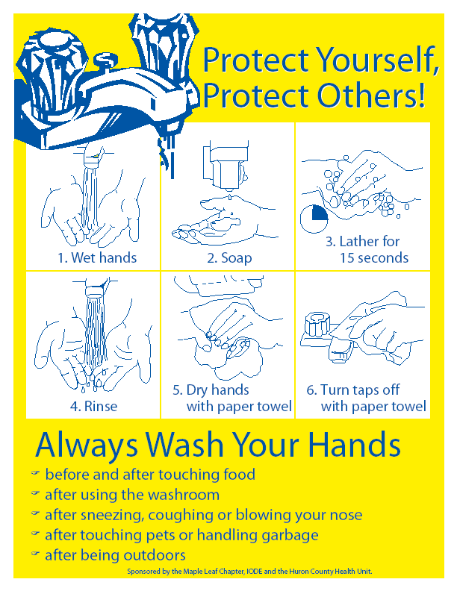
Notes:
Here is a poster produced by the Huron County Health Unit – one for all participants to take away.
Participants will see posters like this in almost every public washroom, many public kitchens in the county – either this one or one similar to it.
When you see these posters – pay attention to them. They’re a reminder to wash you hands.
We also developed one for school age kids – which we’re handing out. Take this home and show your children. Talk to them about hand washing. Put it beside the bathroom sink that your kids use most.

Slide 6
Using an Alcohol-Based Hand Sanitizer
Notes:
Alcohol based sanitizers are becoming more and more common – especially in places like doorways to public buildings and as handy things to throw in a purse or knapsack.
Alcohol based hand rubs are considered the best way to clean your hands unless they are visibly dirty or have fluids on them. If you can see dirt on your hands then you must use soap and water
If you can access them, this is a good time to hand out samples of hand sanitizers and get people to try them out as you go through the next slide.

Slide 7
PROCEDURE
Use only if hands are not visibly dirty
Use on dry hands
Use enough sanitizer to wet both hands thoroughly ( loonie size)
Rub in between and around fingers, back of each hand, thumbs, and nail beds
Keep rubbing until hands are dry
Notes:
Note that the alcohol can sometimes “bleach” out the colour in your clothes. Rub your fingers until they are dry – don’t rub excess off on to your clothes.

Slide 8
When To Wash Your Hands
Wash before…
  preparing and serving meals
  eating and drinking
  feeding an infant
  tending to someone who is sick
  treating a cut or wound
  putting in or taking out contact lenses
  any time hands are visibly dirty
  gloving
Notes:
When this slide comes up – just leave the title up – this is an opportunity to do a group exercise . . .
Using flip chart and marker ask the group to generate as many examples of “when to wash you hands”.
It next two slides break this down into “before” and “after” activities so it might help if you record the list that way.
After the group has generated the list, you can then see what they – or you – might have missed.
The exercise also allows an opportunity to discuss why any particular example is important if people have questions.

Slide 9
When To Wash Your Hands
Wash after…
  coughing, sneezing or blowing your nose
  using the bathroom or helping in the bathroom
  tending to someone who is sick
  handling dirty laundry & garbage
  playing with or touching your pet
  after touching “high-traffic” items like doorknobs or shopping carts
  gloving
Notes:
This is the follow-up slide from the previous “before” slide . . . .

Slide 10
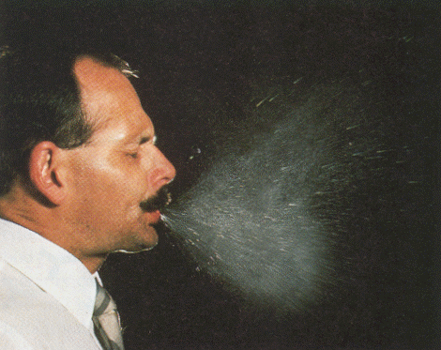
COVER YOUR COUGH
OR SNEEZE!
Courtesy of CDC
Notes:
This is one of the most common way that the flu virus is spread . . .
When you sneeze or cough, droplets that contain the virus are “sprayed” into the room / into your hand.
The influenza virus can survive for 24-48 hours on hard, porous surfaces, like countertops – it can then be transferred onto the hands and from their, into your mouth, on your food . . .
When you sneeze or cough . . .
- Use a tissue and dispose appropriately
- Cough or sneeze into your arm or sleeve
- Wash your hands immediately afterwards

Slide 11
COVER YOUR COUGH
OR SNEEZE!
Use a tissue and dispose appropriately
Cough or sneeze into your arm or sleeve
Wash your hands
Maintain a distance of one metre with people who are coughing or sneezing
Notes:
This slide repeats what was talked about with the previous slide – for those who “learn visually” and need to see it written down.
Also an opportunity to re-state the steps.
This is also an opportunity to raise the issue of cleaning in the home when someone has the flu:
If someone in your home has the flu (and really all the time) it’s good idea to:
- Wash hard surfaces (like counter-tops) frequently – you don’t need to use “special” or anti-bacterial soap
- Wash laundry, utensils and dishes with detergent and water after use
- Don’t share personal items such as towels, cups, utensils, toothbrushes, etc.

Slide 12
Other Steps to Avoid Getting Sick
Get a flu shot every year
Stay home if you’re sick
Exercise regularly & eat well
Notes:
The annual “flu shot” (vaccine) is free in Ontario to everyone.
It will help to prevent seasonal flu.
There’s some thought that annual flu shots may also help to build a cumulative immunity that may provide some people with protection against pandemic influenza, depending on what that virus ends up looking like.
Stay home is you’re sick:
Don’t go to work or school.
Don’t visit people in hospitals or long term care facilities.
Don’t go to public gatherings where you might pass on the flu – like sports events, theatres, other places where people congregate in close proximity
Exercise regularly and eat a healthy, well balanced diet.
This is a basic, staying-well strategy. Regular exercise and a well-balanced diet will keep your immune system healthy and allow you to fight off diseases as much as possible.

Slide 13
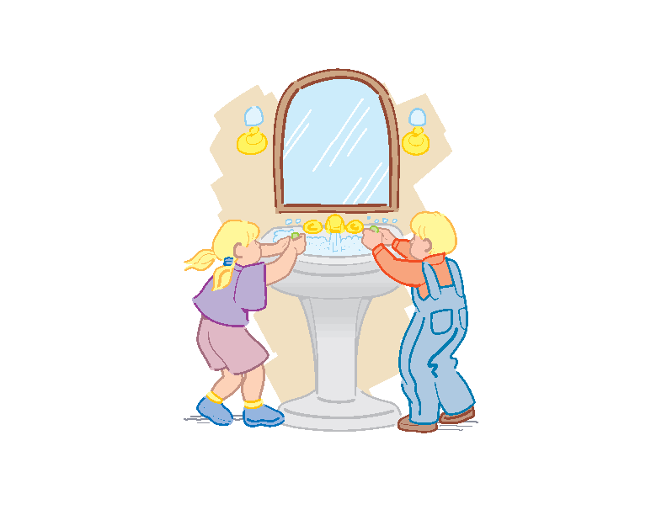
Teach Children How To Protect Themselves
“Twinkle, twinkle little star,
Look how clean my two hands are,
Soap and water, wash and scrub
Get those germs off rub-a-dub.
Twinkle, twinkle little star,
Look how clean my two hands are!”
Notes:
Teach your children how to protect themselves and others from the flu – how to wash their hands and cover their cough / sneeze.
If children ask “ how long do I wash my hands” Answer” as long as it takes to sing twinkle, twinkle little star”
These are good basic infection control habits to learn early in life – and, if they become habits, kids will always do them automatically.

Slide 14
Any Questions?
October 20, 2006
For more info contact
Huron County Health Unit
77722B London Rd, RR#5, Clinton, ON, N0M 1L0
519-482-3416 or 877-837-6143

