Slide 1
Q-LINK · KDB+/Q
A New Module Is Six JSON Files
The Architecture of openQ
.prime.allocate · .oq.idb.pivotAndHarvest · .util.gw.checkResults
A domain-generic kdb+ tick-database core — six schema-agnostic roles, config-driven module plug-in, zero business logic in core/.

Slide 2
SUMMARY
Four things worth being deliberate about
› The core is schema-agnostic and business-logic-free
tp/rdb/idb/hdb don't know what a “spread” or a “locate” is — a module is a schema file + one script the core loads by name.
› Redundancy is two processes and an honest question, not magic
An RDB is an active/standby pair sharing one config — it works because nothing ever trusts a cached belief about which half is active.
› Every durable write is staged, then atomically made real
EOD promotion and intraday idb checkpoints both stage-then-rename table-by-table — a design that exists because the naive version broke, for real.
› A query goes to however many backends it needs to
The gateway is a generic async scatter-gather engine — route, fan out in parallel, join once every target has replied — zero domain-specific code.
q-link · openQ architecture
2

Slide 3
TOPOLOGY
The six steady-state roles
tp
cep
rdb
tp.q
cep.q
rdb.q
Tickerplant — ingestion, log, fan-out
Complex-event processor — dispatch, chainable
Today's data — active/standby pair
idb
hdb
gw
idb.q
hdb.q
gw.q
Intraday durability — pulls, never subscribes
Prior days, on disk, auto-reloaded
Query gateway — routes + joins
Three more roles (fh, eod, housekeeping) round out all nine -procType values — see the article.
q-link · openQ architecture
3

Slide 4
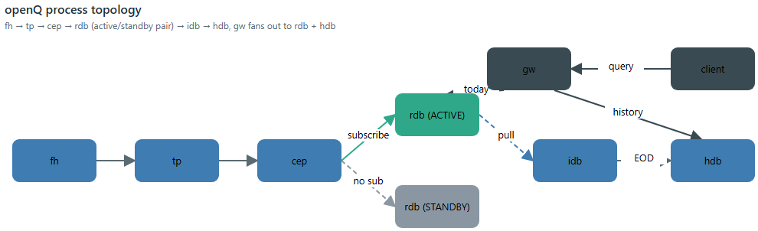
TOPOLOGY
fh → tp → cep → rdb pair → idb → hdb
tp/rdb/idb/hdb never choose a schema — they load whatever they're told to (-schema). Nothing under core/ contains an if module=`primeFinance.
q-link · openQ architecture
4

Slide 5
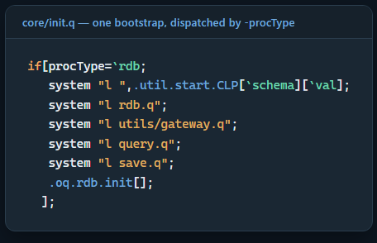
BOOTSTRAP
One bootstrap script, one dispatch table
› core/init.q loads shared utils once, then dispatches by -procType
Only ever needs to know WHICH files a role needs, never HOW it starts.
› Each role owns its own startup sequence
tp.q's .oq.tp.init, rdb.q's .oq.rdb.init — never duplicated elsewhere.
› core/initFromCfg.q reads JSON instead of CLI flags
Calls the exact same .oq.rdb.init[] — the dispatch is written once.
› A CLI flag always wins over the same JSON key
.oq.cfg.merge only fills gaps the command line left open.
q-link · openQ architecture
5

Slide 6
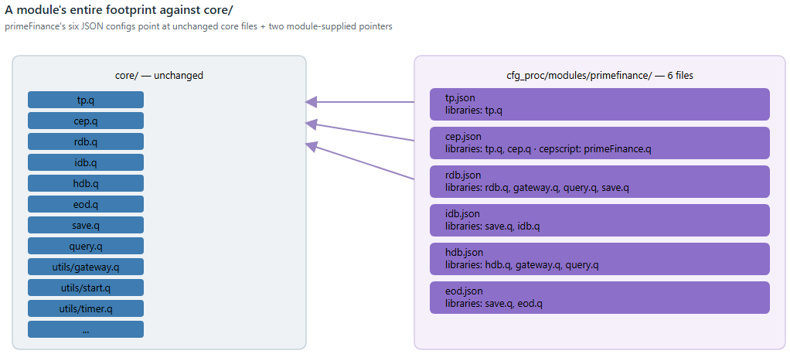
MODULE PLUG-IN
A module is six JSON files
primeFinance's six configs (tp/cep/rdb/idb/hdb/eod) reference core files by name and add exactly two module-specific pointers — a schema, a -cepscript. Zero lines under core/ changed.
q-link · openQ architecture
6

Slide 7
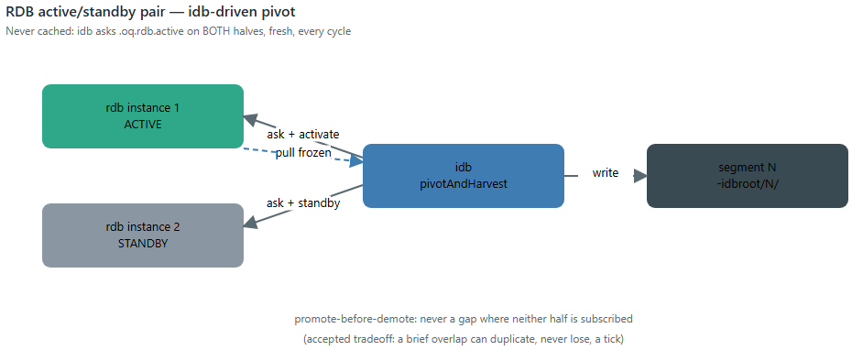
REDUNDANCY
Two processes pretending to be one
› Never cached
idb asks .oq.rdb.active on both halves, fresh, every cycle — not a locally-cached label.
› Promote before demote
Never a gap where neither half is subscribed. Tradeoff: a brief overlap can duplicate, never lose, a tick.
› Two real bugs, left as comments
.u.pub's per-handle protected send; .u.unsub called synchronously before hclose.
q-link · openQ architecture
7

Slide 8
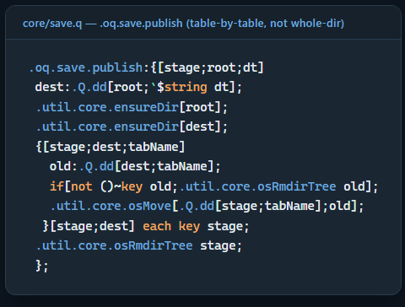
DURABILITY
idb doesn't subscribe to anything
1
Ask both rdbs which is ACTUALLY active (never cached)
2
Activate the standby — starts receiving live ticks
3
Standby the old active — its tables are now frozen
4
Pull the frozen snapshot, write it as the next segment
5
Tell that rdb to flush its memory — it's durable now
Modeled on a real kdb+tick TmpHDBWriter — idb buffers nothing of its own.
q-link · openQ architecture
8

Slide 9
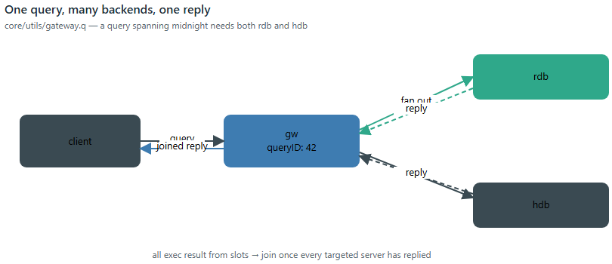
QUERY ROUTING
One query, many backends, one reply
› Routing is one boolean expression
eTime>=today needs rdb; sTime<today needs hdb. Both, if the range spans midnight.
› Fan-out is domain-blind
core/utils/gateway.q knows nothing about FX, spreads, or locates.
› One reply, once everyone's answered
all exec result from slots — then join and reply exactly once.
q-link · openQ architecture
9

Slide 10
COMPOSITION
CEPs chain, and they remember what they missed
› A CEP's output is just another .u.sub source
Same replay-on-first-connect a tickerplant gives an RDB.
› report has no tp/rdb/idb/hdb of its own
Its cep.json is the only config file the module has.
› Combines three modules' pure functions, unmodified
spread.wavgBy, markout.calc, prime.positionCoverage — reused as-is.
› Two integration styles, side by side
Subscribes to primeFinance's CEP directly; pulls spread/markout over plain IPC.
Bringing report up
./scripts/startupAllByModule.sh spread
./scripts/startupAllByModule.sh markout
./scripts/startupAllByModule.sh primeFinance
./scripts/startupAllByModule.sh report
q)h:hopen `:localhost:5080
q)h "select from .report.latest"
q-link · openQ architecture
10

Slide 11
Known limitations
What the code itself says it doesn't do
— No automatic failover — .oq.rdb.activate/standby are plain IPC calls; idb's timer drives them on a fixed schedule, not a detected failure.
— The promote-before-demote window can duplicate, never lose, a handful of ticks — documented and accepted, not silently absorbed.
— housekeeping.q is illustrative, not an exhaustive health-check suite — its own header says so directly.
— Log replay assumes a co-located or shared filesystem — no remote-log replay proxy is built.
— This deck and its source article are static-only — no process was started, stopped, or queried to build them.
q-link · openQ architecture
11

Slide 12
Core discipline is the whole story
None of the individual mechanisms are exotic — a staged-then-renamed write, an active/standby pair, a scatter-gather query engine are all well-worn kdb+tick patterns. What holds them together is narrower: core/ genuinely doesn't know what any module is for. A schema file and, optionally, one -cepscript pointer are the entire surface a module gets to touch — and primeFinance's own six JSON configs are the proof that discipline is real, not aspirational documentation.
Full article, code excerpts, and diagrams: articles/openQ/openQ.md

