Slide 1
Detecting Chest Conditions
from X-rays
Predicting 14 conditions from a chest X-ray with deep learning
MSBA 645 Final Project
Team: [add names here]
Notes:
[0:00-0:15] SAY: Good morning. For our project, we built a tool that looks at a chest X-ray and predicts which of 14 different chest conditions might be present, things like pneumonia, fluid around the lungs, or an enlarged heart. We used a large public collection of real chest X-rays called NIH ChestX-ray14. Over the next few minutes we'll show you the data, how the model works, how well it does, and then we'll run it live. I'm [name] and this is [name].

Slide 2
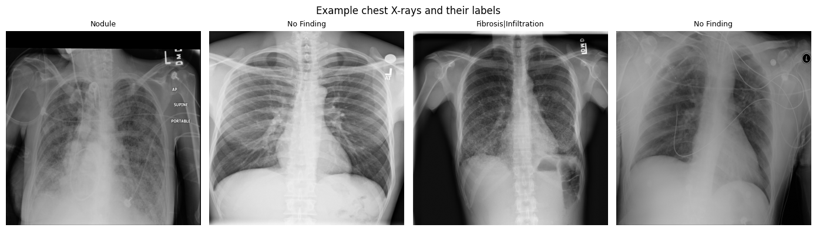
The problem, and the data
Given one chest X-ray, predict which of 14 conditions are present. An X-ray can have several at once, so the model gives a yes/no for each one.
112,120
chest X-rays
30,805
patients
14
conditions
Real examples with their labels. For this project we used about 25,000 of the 112,120 images (a laptop-friendly slice).
NIH ChestX-ray14 · MSBA 645 Final Project
2
Notes:
[0:15-1:15] SAY: Here's the problem we set out to solve. You give the model one chest X-ray, and it gives back a yes or no for each of 14 conditions. The important part is that a single X-ray can have more than one thing wrong with it at the same time, so the model isn't picking just one answer, it's judging all 14 at once. The full dataset is huge: about 112,000 X-rays from around 30,000 patients, each labeled for these 14 conditions. We didn't use all of it. We used about 25,000 images, split into a training set, a validation set, and a test set, so the whole project runs on a normal laptop. On the screen are a few real examples with their actual labels, so you can see what the model is working with.

Slide 3
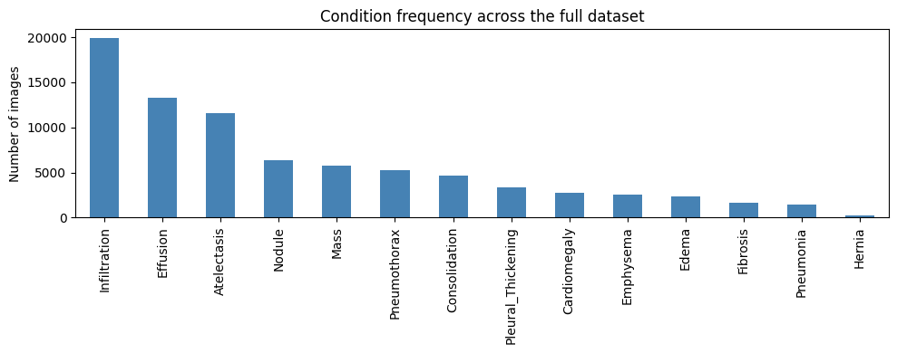
The catch: the data is lopsided
Why this matters
About half of all X-rays are normal, and some conditions are rare.
So a lazy model that always says “nothing’s wrong” is right ~95% of the time, but it’s useless.
That’s why we don’t trust accuracy alone. We judge by AUC (how well it tells sick from healthy) and recall (how much real disease it catches).
NIH ChestX-ray14 · MSBA 645 Final Project
3
Notes:
[1:15-2:15] SAY: Now the catch, and this is the most important idea in our whole project. The data is very lopsided. About half of all the X-rays are completely normal, and several of the conditions are quite rare. So imagine a lazy model that just says 'nothing is wrong' on every single image. Because most images really are normal, that model would be right about 95 percent of the time. Ninety-five percent sounds great, but it caught zero actual disease, so it's useless. That's why, for the rest of this talk, we don't judge our model on accuracy. We use two better measures instead: AUC, which is how well the model separates sick patients from healthy ones, and recall, which is how much of the real disease it actually catches.

Slide 4
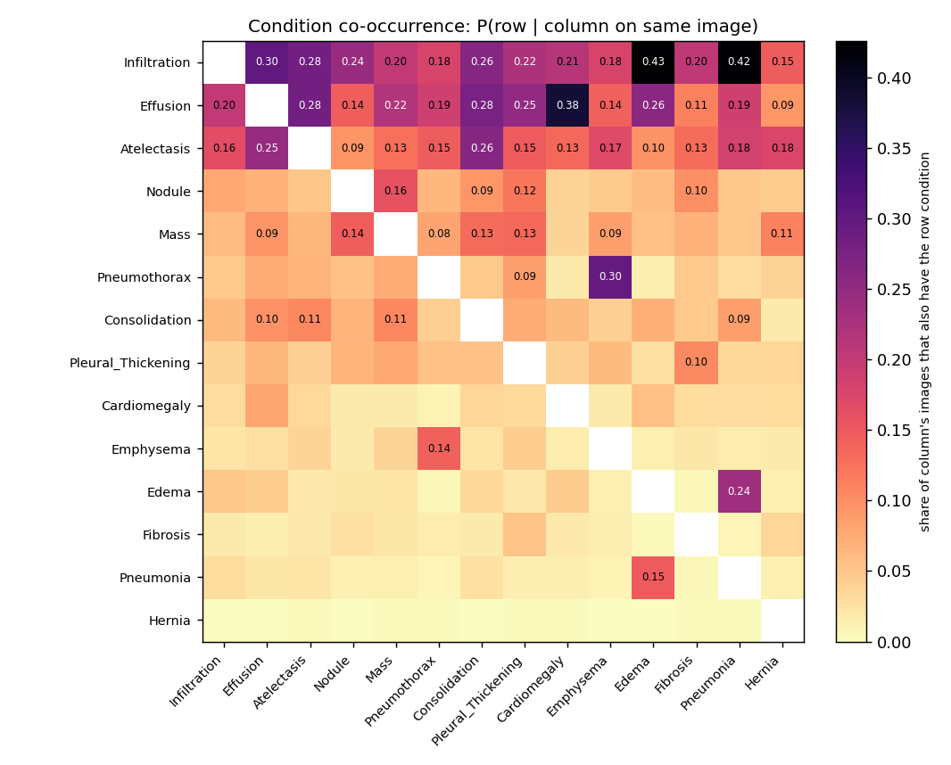
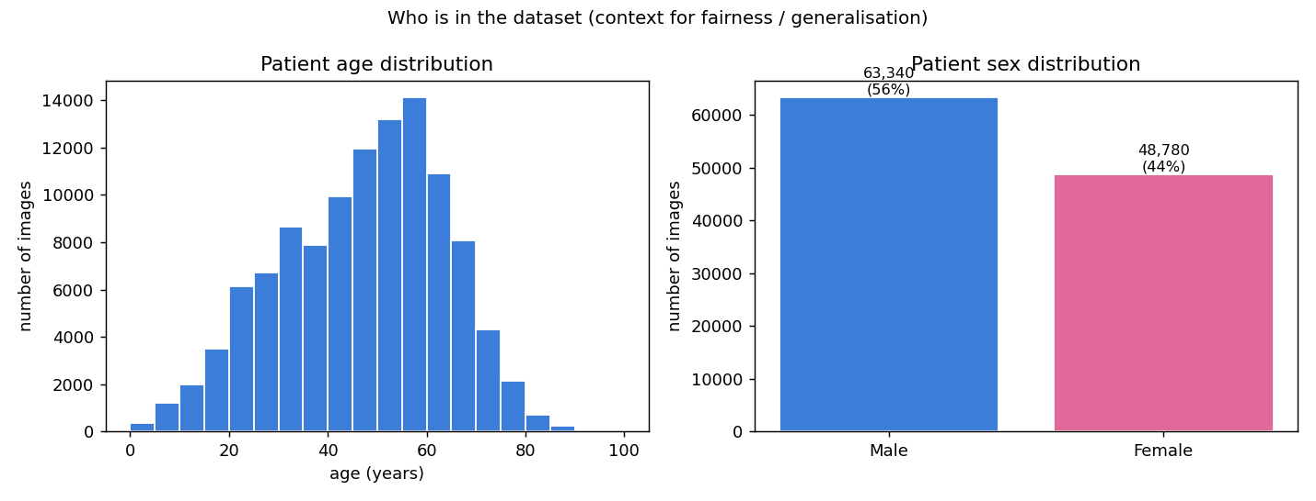
A closer look at the data
Conditions overlap
• Findings travel together: Effusion + Infiltration, Atelectasis + Effusion, Pneumothorax + Emphysema.
• So the 14 labels aren’t independent, one image can carry several at once.
• That overlap is why we score each condition on its own with AUC and recall, not one accuracy number.
Who’s in the data
How often two conditions appear on the same X-ray (brighter = more often together).
Mostly middle-aged adults (median 49), 56% male / 44% female, a generalisation flag.
NIH ChestX-ray14 · MSBA 645 Final Project
4
Notes:
[2:15-3:00] SAY: Before building anything, we looked closely at the data and found two things worth sharing. First, this heat map shows that the conditions often appear together on the same X-ray. The brighter squares are the pairs that show up together a lot, for example fluid around the lung often comes with infiltration. This matters because it means the 14 conditions aren't separate, independent things, which is another reason a single accuracy score doesn't fit here. Second, we looked at who's actually in the data. Most of the patients are middle-aged adults, the median age is about 49, and there are a few more men than women. We point this out because a model only really learns the kind of patients it was trained on, so that's something to keep in mind before trusting it on a different group.

Slide 5
Our approach: borrow a trained network
Training an image model from scratch needs a GPU and tons of data. Instead we reuse a network already trained on millions of images, and train small models on top of it.
Chest X-ray
Pretrained network (frozen)
A list of numbers
Train simple models
14 condition probabilities
This is called transfer learning. It’s one of several deep-learning techniques we use:
transfer learning, a CNN built from scratch, fine-tuning, dropout, and Grad-CAM.
NIH ChestX-ray14 · MSBA 645 Final Project
5
Notes:
[3:00-3:45] SAY: Here's how the model actually works. Training an image model completely from scratch needs a massive amount of data and a powerful graphics card, which we didn't have. So instead, we borrowed a network called EfficientNet that was already trained on millions of everyday photos. It already knows how to pick out edges, shapes, and textures. We freeze it, meaning we don't change it at all, and just use it to turn each X-ray into a list of 1,280 numbers. Then we train small, simple models on those numbers to predict the 14 conditions. Following the arrows: the X-ray goes in, the pretrained network turns it into numbers, and our model turns those numbers into a probability for each condition. This is called transfer learning, and it's what let us do this without a fancy GPU.

Slide 6
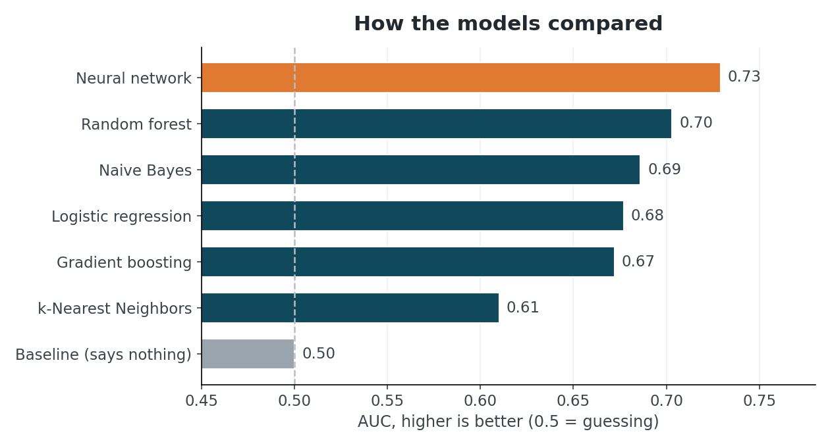
We tried several models
What we found
• Our deep-learning model (a neural network) came out best, around 0.73.
• The classical models (logistic regression, random forest, etc.) are simpler baselines for comparison.
• It's the one we keep, tune, and build on in the next slides.
The catch: random forest came close on AUC, but it memorized the training data (perfect on train, 0.70 on new data) and rarely says “yes,” so it misses real cases. A high AUC isn’t enough, so we also check recall.
NIH ChestX-ray14 · MSBA 645 Final Project
6
Notes:
[3:45-4:45] SAY: We didn't just build one model and hope for the best. We tried several different models on exactly the same data and compared them fairly. The bar at the very bottom is a baseline that's basically guessing, it sits at 0.50. Our neural network came out on top, at about 0.73, and that's the one we kept. One thing worth pointing out: the random forest looked almost as good on this chart, but it had basically memorized the training data, it scored perfectly on data it had already seen and much worse on new data, and it almost never actually flags a condition, so it would miss real cases. That's a great example of why a high score on this chart isn't the whole story, and why we also care about recall, which is catching real disease.

Slide 7
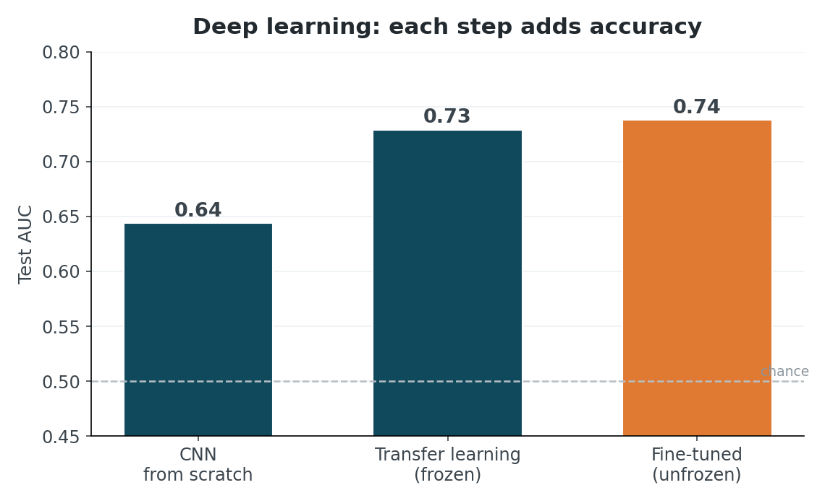
Deep learning: from scratch to fine-tuned
The deep-learning story
• A CNN built from scratch reaches only 0.64, with limited data it can't learn good features on its own.
• Transfer learning (reusing a pretrained network) jumps to 0.73, the big win.
• Fine-tuning the whole network nudges it to 0.74.
This is the core deep-learning lesson: with limited data, standing on a pretrained network beats building one from scratch.
NIH ChestX-ray14 · MSBA 645 Final Project
7
Notes:
[4:45-5:30] SAY: This slide is really the heart of the deep-learning side. We tried three different deep-learning approaches, and the numbers tell a clean story. A network built completely from scratch only reached 0.64, because with our limited data it just can't learn good features on its own. When we reused the pretrained network instead, that's transfer learning, the score jumped to 0.73, and that's the big win. And when we fine-tuned, letting the network adjust just a little to chest X-rays specifically, it went up a bit more to 0.74. So the takeaway is simple: when you don't have a ton of data, standing on a network that's already been trained beats building one from scratch.

Slide 8
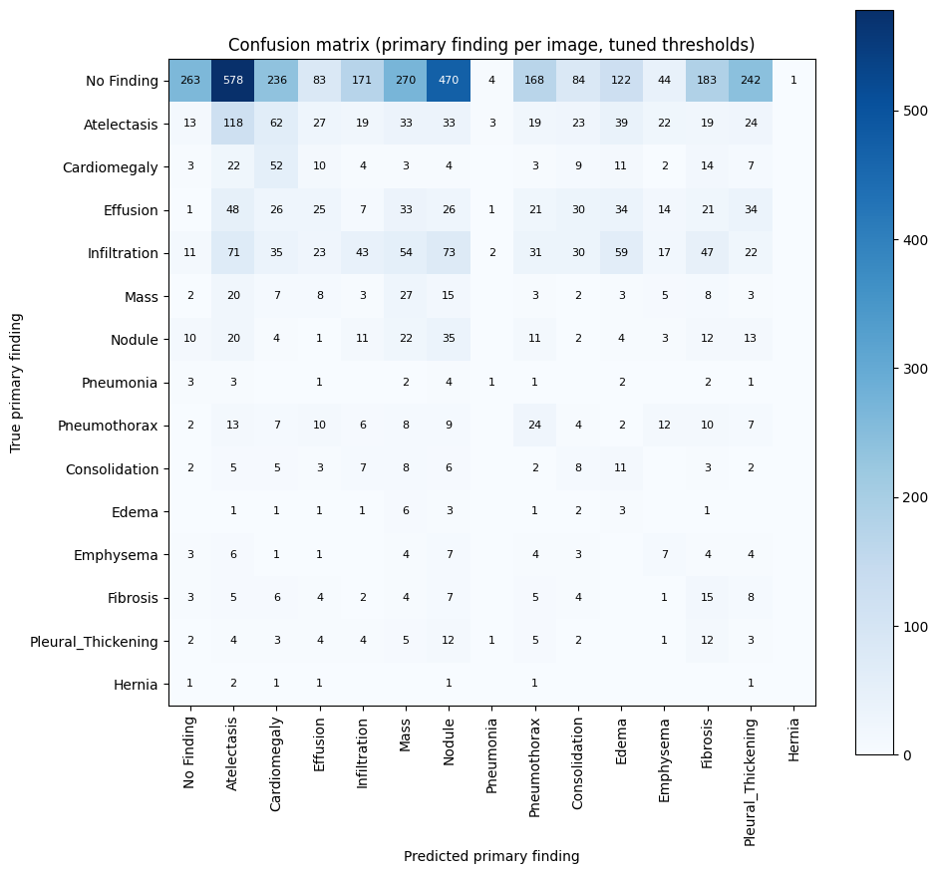
Our best model: how good is it?
The neural network
0.74
Accuracy
0.73
AUC
Train vs. test
Accuracy: 0.75 on training, 0.74 on new data
AUC: 0.84 on training, 0.73 on new data
The test numbers are close to training, so it’s genuinely learning, not just memorizing.
NIH ChestX-ray14 · MSBA 645 Final Project
8
Notes:
[5:30-6:30] SAY: So how good is our chosen model? On X-rays it had never seen before, it gets about 74 percent accuracy and an AUC of 0.73. Just as important, the scores on the training data and on new data are close together, 0.84 versus 0.73 on AUC, which tells us the model is genuinely learning the patterns rather than just memorizing examples. On the right is what's called a confusion matrix. I won't go through every box, but the strong line down the diagonal is where the model got it right, and the cells off that line are the mix-ups, usually between conditions that look alike on an X-ray. With that, let's actually see it in action.

Slide 9
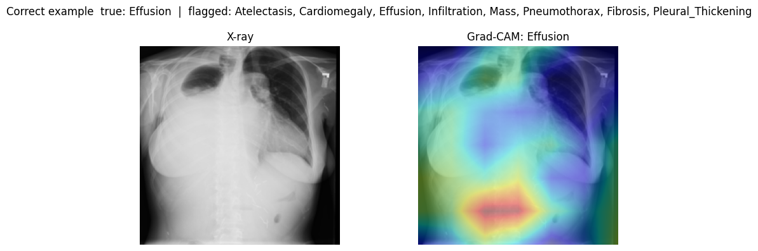
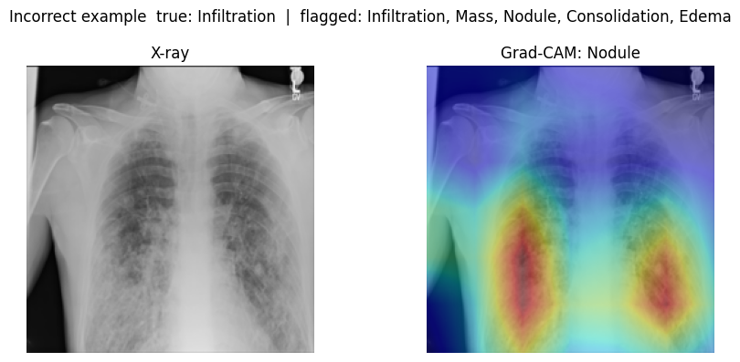
Live demo
We’ll open the app and try it live:
• Upload a chest X-ray.
• See the probability for each of the 14 conditions.
• See which conditions it flags.
• Look at the Grad-CAM heat map, where the model is looking.
• Show one it gets right, and one it gets wrong.
• Then switch to the Monitoring tab (next slide).
Heat maps from the app (backup if the live demo can’t run).
Notes:
[6:30-9:00] (have the app already open before this slide) SAY as you click through: This is the live demo. Let me pick a chest X-ray. Here you can see the model's probability for each of the 14 conditions, and over here it flags the ones it thinks are present. You might notice the flagged condition isn't always the one with the highest number, and that's on purpose: instead of one fixed cutoff, each condition has its own threshold that we tuned to favor catching disease. Now here's the interesting part. This heat map, called Grad-CAM, shows where the model was actually looking when it made its decision. You can see it's focused on the lungs, not the background, which gives us some confidence it's reasoning sensibly. Let me show you one the model gets right, and then one it gets wrong, so you can see both. (If the live app won't run, the two heat maps on this slide are your backup.)

Slide 10
From demo to product: monitoring
The app doesn’t just predict, it keeps a record. Every classification is logged, so you can watch the model across many cases, not just one image.
Classify an X-ray
Log every prediction (CSV)
Monitoring dashboard
or Power BI / Sheets
What the dashboard tracks
• How often each of the 14 conditions gets flagged.
• The spread of the model’s confidence.
• Most recent cases, at a glance.
• User feedback: a “looks right / looks off” tap on each prediction.
Why it matters: one prediction is a demo; logging turns it into something you can actually monitor in use. The same CSV is the single source any BI tool can read.
NIH ChestX-ray14 · MSBA 645 Final Project
9
Notes:
[9:00-9:45] SAY: The app doesn't just make a prediction and forget it. Every single time it classifies an X-ray, it saves a record: the image, the top prediction, all 14 probabilities, and how many conditions were flagged. This Monitoring tab reads all those records and gives a big-picture view: how often each condition gets flagged, how confident the model tends to be, the most recent cases, and any thumbs-up or thumbs-down feedback that users gave. The reason this matters is that a single prediction is just a demo, but keeping a log is what lets you actually watch how the model behaves over time in real use. And because it's just a spreadsheet file, that same data could feed a business tool like Power BI.

Slide 11
What we learned
What worked
What we tested / next
• Telling the model to pay attention to rare cases (instead of ignoring them).
• Preparing the images the way the network expects.
• Checking AUC and recall, not just accuracy.
• Grad-CAM showed it looks at the lungs, not the background.
• Labels are only about 90% accurate (auto-pulled from reports), so some are simply wrong.
• We tried a patient-level split (no patient on both sides): AUC 0.67 vs 0.73, so random splitting was a bit optimistic.
• We checked if more data helps: still rising slowly, so a little, but the bigger win is fine-tuning.
• The deep-learning progression (CNN 0.64 -> transfer 0.73 -> fine-tuned 0.74) is the main story.
How this compares: the best published model (CheXNet) hits 0.7 to 0.85 AUC, but it’s fully trained on all 112,000
images with a GPU. Ours is a lighter, laptop-friendly version of the same idea, 0.73 frozen and 0.74 fine-tuned.
NIH ChestX-ray14 · MSBA 645 Final Project
10
Notes:
[9:45-10:45] SAY: A few things we learned. On what worked: telling the model to pay extra attention to the rare conditions instead of ignoring them, preparing the images exactly the way the network expects, judging the model on AUC and recall instead of accuracy, and using the heat maps to confirm it looks at the lungs and not the background. We also want to be honest about the limits. The labels in this dataset were pulled automatically from doctors' reports and are only about 90 percent accurate, so some of them are simply wrong, which caps how good any model can look. We also tried a stricter test where no patient appears in both training and testing, and the score dropped from 0.73 to 0.67, so our main number is a little optimistic. For comparison, the best published model in this area scores between 0.7 and 0.85, but it uses all 112,000 images and a powerful GPU. Ours is a much lighter, laptop-friendly version, and it lands in the same ballpark.

Slide 12
Thank you
Questions?
Chest X-ray multi-label classifier · NIH ChestX-ray14 · MSBA 645
Notes:
[10:45-11:00] SAY: So to sum up: we built a tool that predicts 14 chest conditions from an X-ray using transfer learning, we measured it honestly with AUC and recall instead of accuracy, and we wrapped it in a working app that explains its reasoning and tracks its own usage. Thank you for listening, and we're happy to take any questions.

